Slide 1
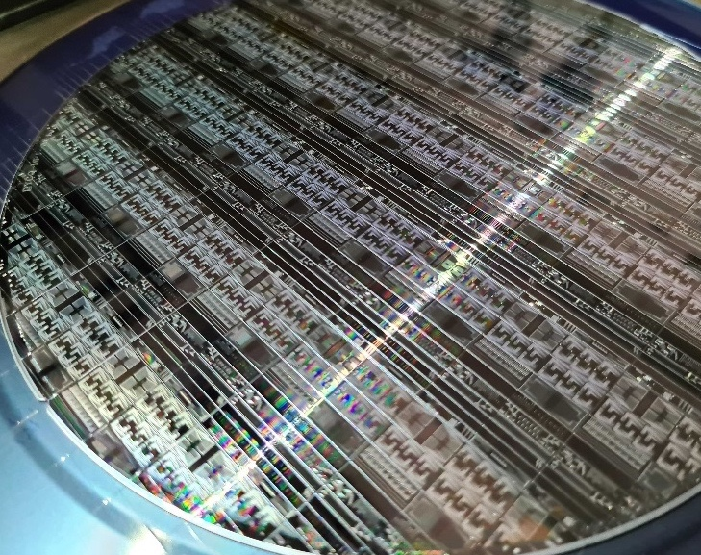

From Copper to Optics for AI scale-up
Joyce Poon
Views expressed are my own and do not represent those of my former employer or any other organization.
Toronto Wireline Workshop | March 6, 2026

Slide 2
Overview of an AI cluster
…
SPINE
Connections to next pod
SCALE-OUT
RAIL
…
RAIL
…
XPU
XPU
XPU
XPU
XPU
XPU
…
…
SCALE-UP
RACK
…
RACK
…
…
Notes:
Traffic per rail of each compute tray is always one hop away from other compute trays in the same Scalable Unit. Traffic between different compute racks, or between different rails, traverses the spine layer.
https://docs.nvidia.com/dgx-superpod/reference-architecture-scalable-infrastructure-gb200/latest/network-fabrics.html

Slide 3
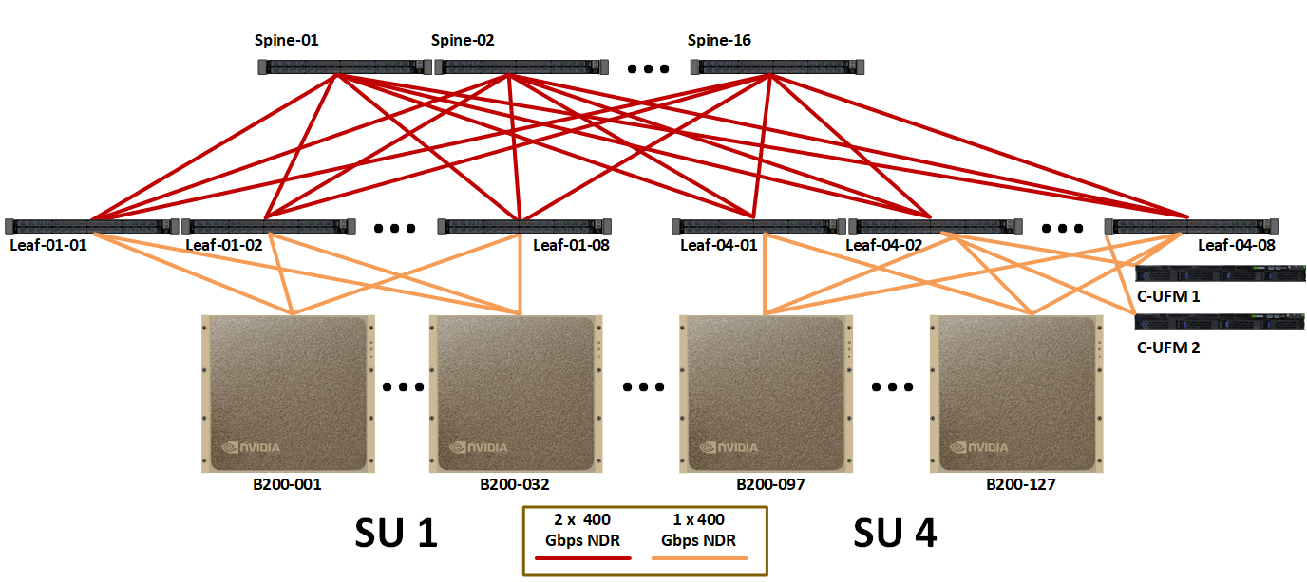
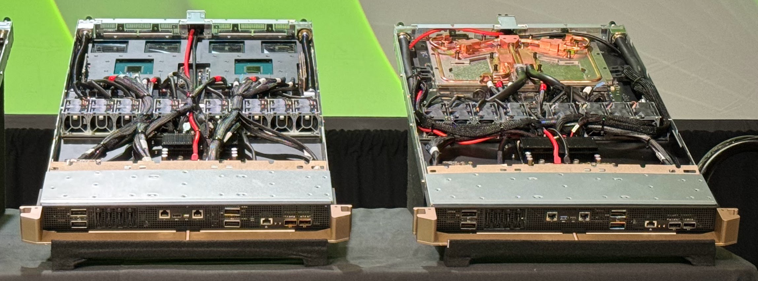
Interconnects
Example: NVIDIA DGX SuperPod
Scale-up
Between XPUs in a rack (distance: 2 - ~10 m)
Protocols: NVLink, UALink, Scale-Up Ethernet
Scale-out
Between racks and pods (distance: 100s m)
Protocols: Ethernet, InfiniBand
Interoperability
Important metrics
Bandwidth density
Power consumption
Latency
https://docs.nvidia.com/dgx-superpod/reference-architecture-scalable-infrastructure-b200/latest/network-fabrics.html
Why bandwidth density matters…
Source: SemiAnalysis
Notes:
https://docs.nvidia.com/dgx/dgxgb200-user-guide/hardware.html

Slide 4
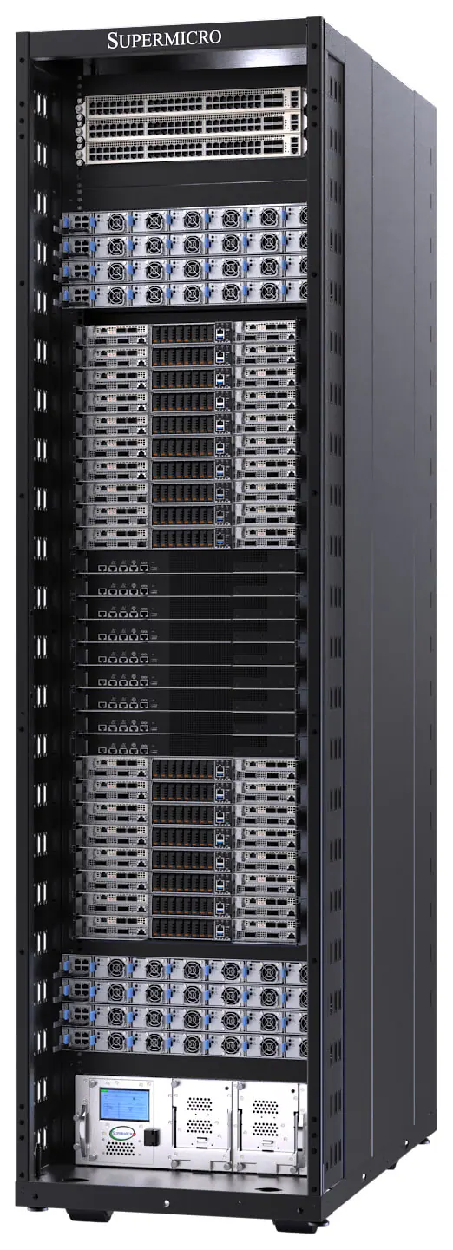
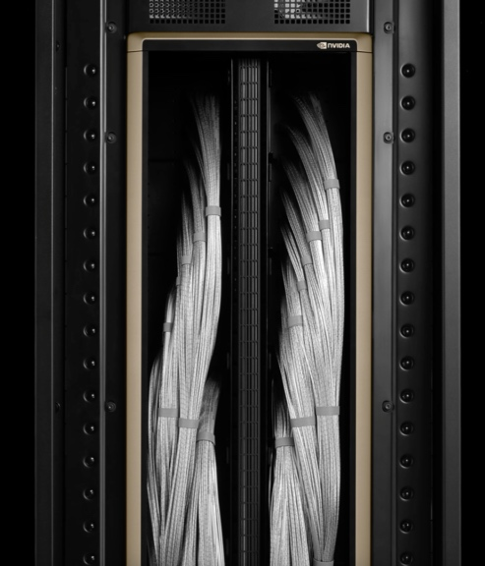
Power consumption
🧱
Top of rack Ethernet switch
Copper backplane
Example: NVIDIA GB200 NVL72
Power
System (per rack)
72 GPUs + 36 CPUs
Power: ~130 kW
Switches: 7 kW¹, NVLink IO: 6-12 kW (assuming 10-20 pJ/bit)
Scale-up IO is 5-10% of the total rack power
Scale-up connectivity (per direction)
18 ports (NVLink 5) x 400 Gbps per GPU
Throughput per GPU: 7.8 Tbps
Lane rate: 224 Gb/s
Cabling
1296 copper cables per rack
5184 high-speed lanes (bi-dir)
10 Compute Trays
9 Switch Trays
(18 switches)
8 Compute Trays
https://developer.nvidia.com/blog/nvidia-gb200-nvl72-delivers-trillion-parameter-llm-training-and-real-time-inference/
Power
Cooling
¹ https://newsletter.semianalysis.com/p/gb200-hardware-architecture-and-component
https://www.supermicro.com/en/products/system/gpu/48u/srs-gb200-nvl72
Notes:
https://docs.nvidia.com/dgx-superpod/reference-architecture-scalable-infrastructure-gb200/latest/_downloads/238ab33ee345a7241fc2f15eedc2ff6c/RA11338001-DSPGB200-ReferenceArch.pdf
https://newsletter.semianalysis.com/p/gb200-hardware-architecture-and-component

Slide 5
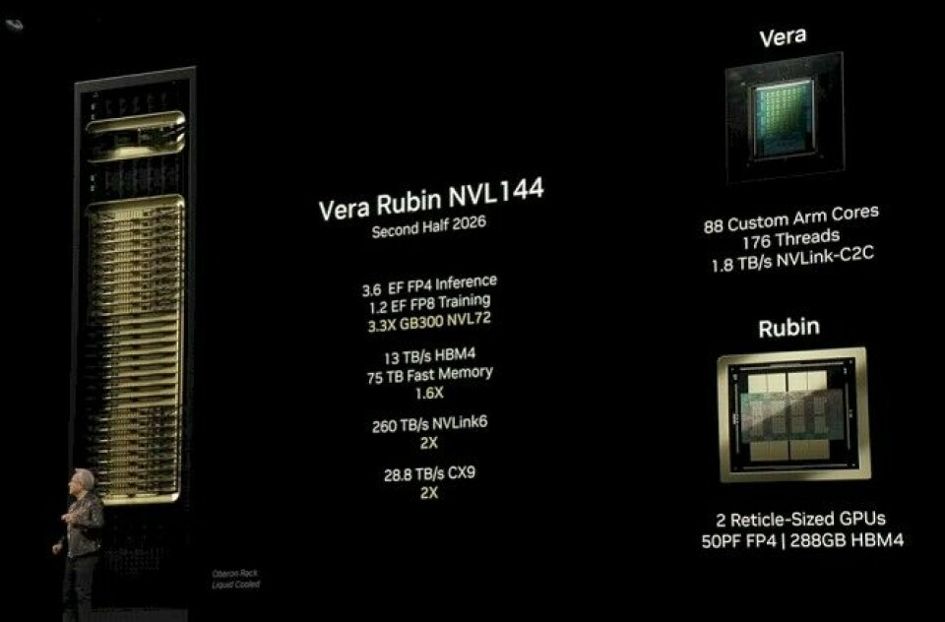
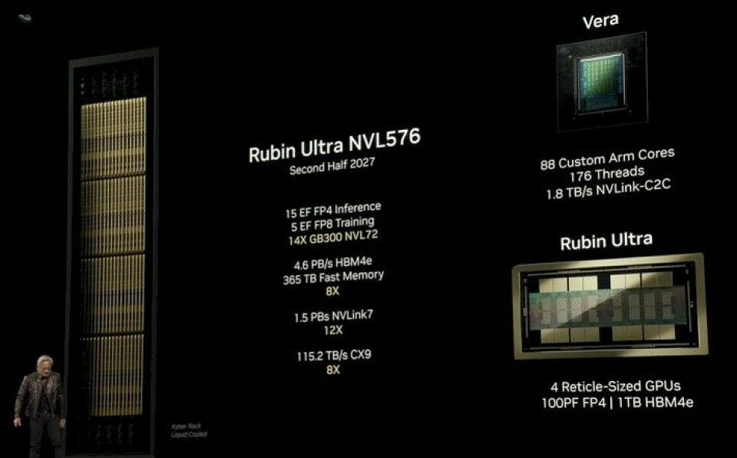
Number of GPUs in a rack
NVIDIA
8X

Slide 6
Scale-up latency
Source: N. Nedovic (NVIDIA), ISSCC 2026
GPU → Switch → GPU: 260-700 ns
SWITCH ASIC
(5)
 | Item | Total Latency (ns)
1 | SerDes + DSP + Analog Front End | 50 – 100 ns
2 | Time of flight [2 to 10 meters] | 10 – 50 ns
3 | FEC | 50 – 100 ns
4 | Encryption | 0 – 50 ns
5 | Switch port-to-port | 100 – 200 ns
6 | Other | 50 – 200 ns
(1)+(3)
(1)
(2)
(2)
(1)
(1)+(3)
GPU
GPU

Slide 7
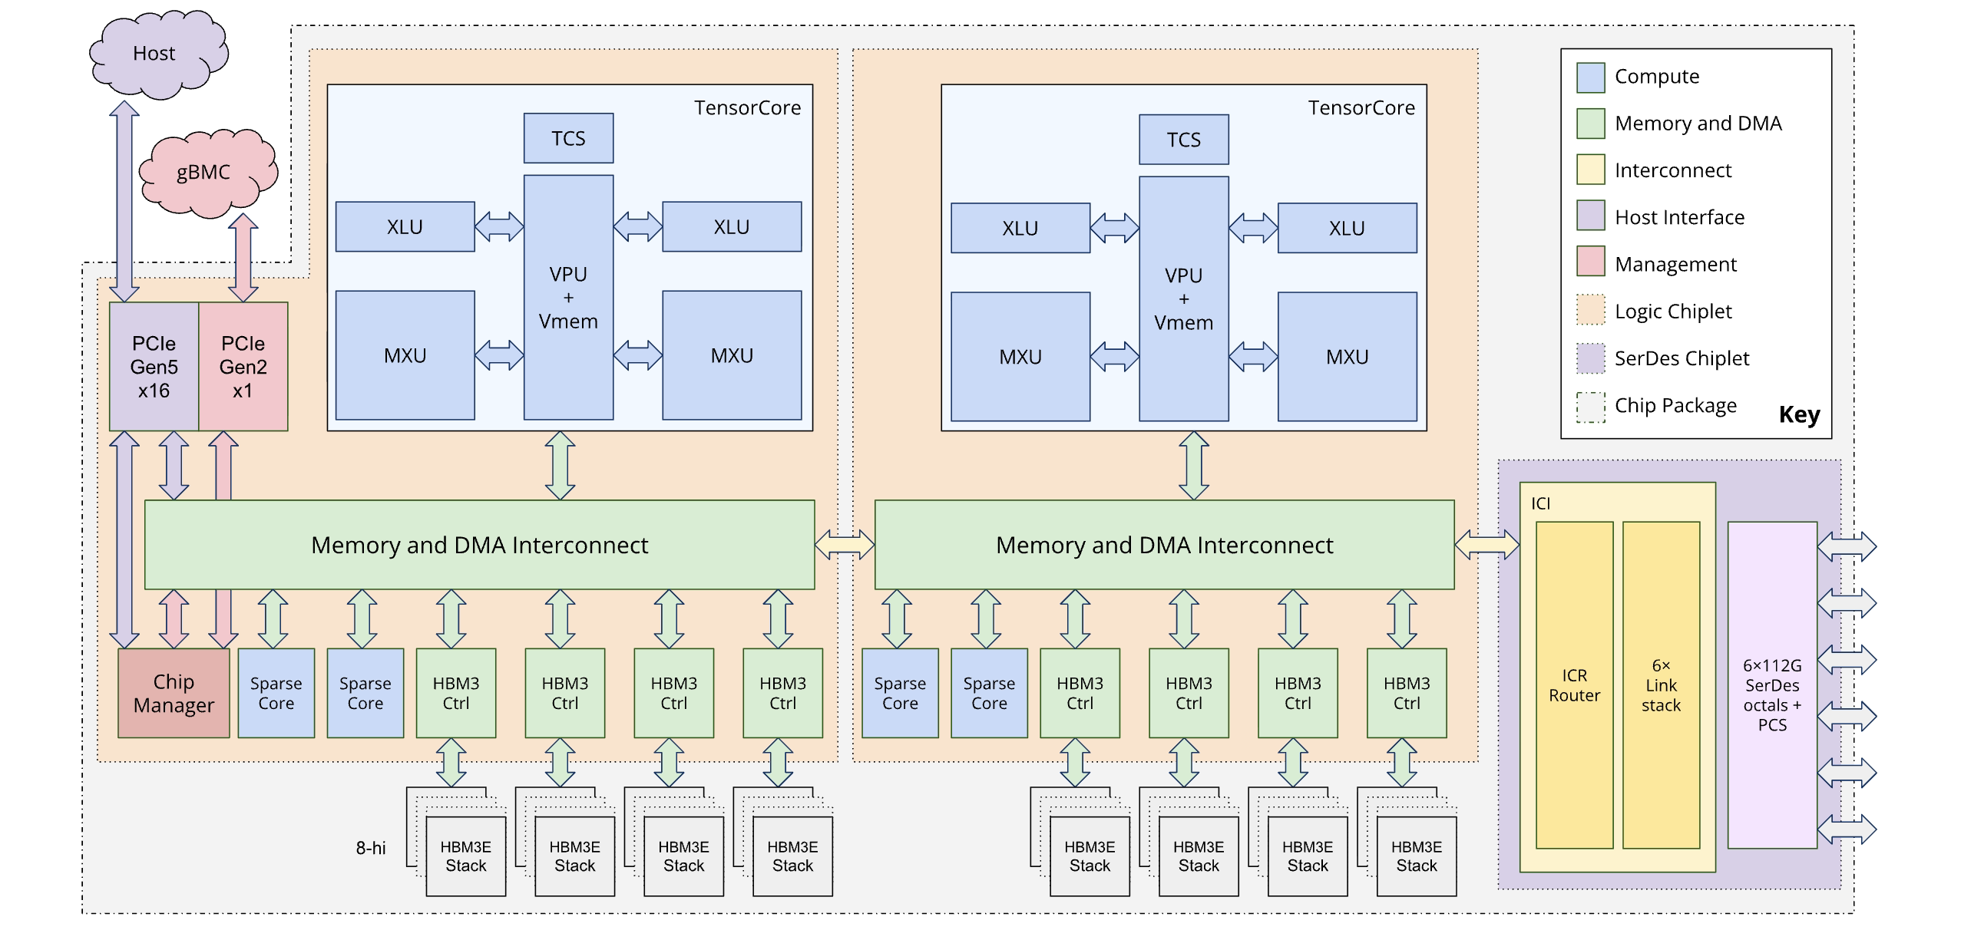
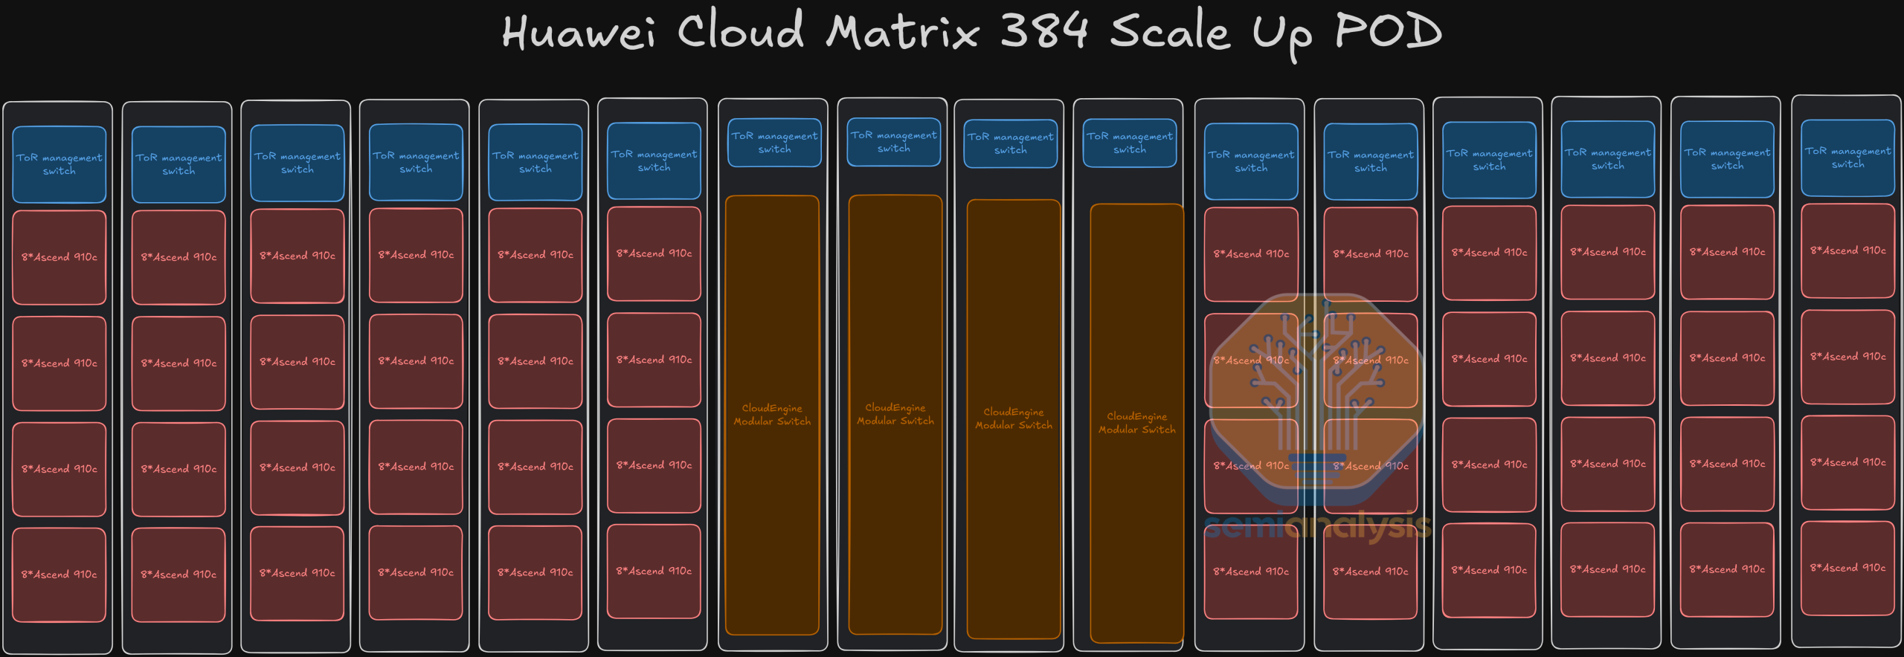
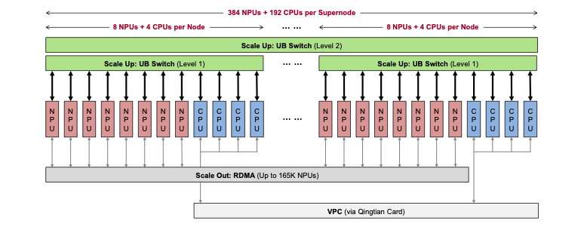
Other architectures
Google Ironwood
Huawei Ascend 910C Cloud Matrix 384
Top of the rack switches
48 lanes x 112G
NPUs
Scale-up Switches
NPUs
Topology
3D torus network with MEMS Optical Circuit Switch
1:6 TPU:TPU connectivity
Scale
Rack: 64 TPUs; Pod: 9216 TPUs
# of lanes per rack: 64 x 48 x 2 directions = 6144
Interconnect
4.8 Tbps per GPU (uni-dir)
Copper
112Gbps per lane
Topology
2-Tier network
All-to-all connections
Scale
Rack: 32 NPUs; Pod: 384 NPUs
# of lanes per rack: 32 x 28 x 2 directions = 1792
Interconnect
2.8 Tbps per GPU (uni-dir)
Linear pluggable optics
112Gbps per lane (likely)
https://newsletter.semianalysis.com/p/huawei-ai-cloudmatrix-384-chinas-answer-to-nvidia-gb200-nvl72
https://docs.cloud.google.com/tpu/docs/tpu7x

Slide 8
Comparison
Late 2026
Late 2027
 | Units | NVIDIA GB NVL72 | Google Ironwood | Huawei CloudMatrix 384 | NVIDIA VR NVL144 | NVIDIA VR NVL576
Number of GPUs per rack |  | 72 | 64 | 32 | 144 | 576
Scale-up technology |  | Copper | Copper | Linear Pluggable Optics | Copper | Copper?
Scale-up BW per GPU | Gbps (uni-dir) | 7200 | 4800 | 2800 | 7200 | 10400
Lane rate | Gbps | 224 | 112 | 112 (tbc) | 224 | 224 (bi-dir?)
Scale-up BW per rack | Tbps (bi-dir) | 1036 | 615 | 180 | 2080 | 12000
Power consumption per rack | kW | ~140 | - | 600 | 190-230 | 600
% Power for IO |  | 5-10% (est.) | - | - | ~10-20% (est.) | 20-40%??
As the number of GPUs per rack doubles per year, the scale-up bandwidth also grows.
Notes:
NVIDIA 576 rack will also hit 600kW per rack
NVL144: 2080Tbps per rack x 10 pJ/b = 20.8 kW for IO
2080Tbps per rack x 20 pJ/b = 42 kW for IO

Slide 9
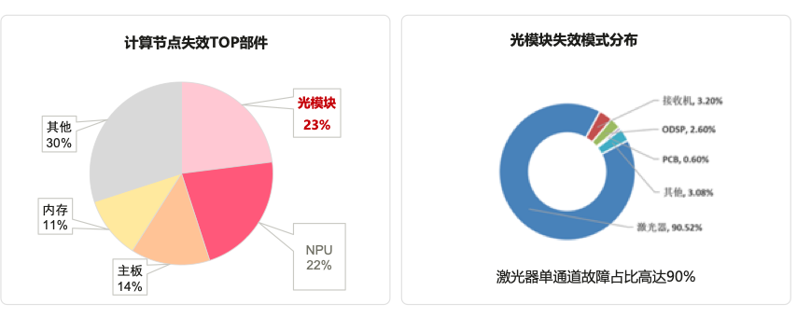
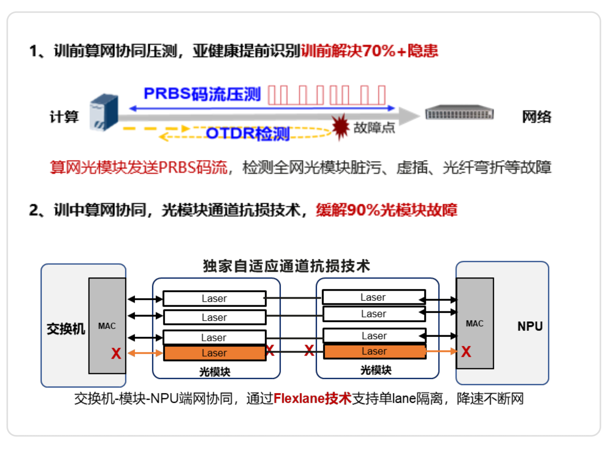
Why not optics (yet)?
Example from Huawei
High power consumption
Optical transceiver failure rates: 6.3 per 1000
“Of the training interruptions caused by optical transceivers, 30% are due to contamination of the transceiver, and 70% are due to single-channel failures within the transceiver”
Top components causing compute-node failures
Optical module failure mode distribution
1. Pre-training compute-network coordinated stress testing, identifying sub-healthy links early to resolve 70%+ of hidden risks before training
Compute
Network
Optical transceivers
Receiver:3.2%
Other
ODSP: 2.6%
PCB: 0.6%
Memory
Other: 3.02%
Laser: 90.52%
Motherboard
Laser single-channel faults account for as high as 90%
2. During training, compute-network coordination with optical module channel damage-tolerance technology, mitigating 90% of optical module faults.
Source: Huawei whitepaper 2024

Slide 10
Why optics?
Scale-out
Scale-Up
2026
Pluggable Retimed Optics
Near-Package Optics
or Linear Pluggable Optics
Co-Packaged Optics
Optical Interposer
XSR
ASIC
OE
OE
ASIC
LR
ASIC
ASIC
Interposer
DSP
OE
LR/MR
OE
Substrate
Substrate
Substrate
Substrate
PCB
PCB
PCB
PCB
ASIC
ASIC
ASIC
ASIC
Energy efficiency
15-20 pJ/b
~10-15 pJ/b
~5-10 pJ/b
~3-5 pJ/b
(2 fewer DSP in OE)
(2 fewer DSP in OE,
XSR vs. LR)
(2 fewer DSP in OE,
better signal integrity)
¹CloudMatrix: 7W per 400G LPO transceiver = 17.5pJ/b

Slide 11
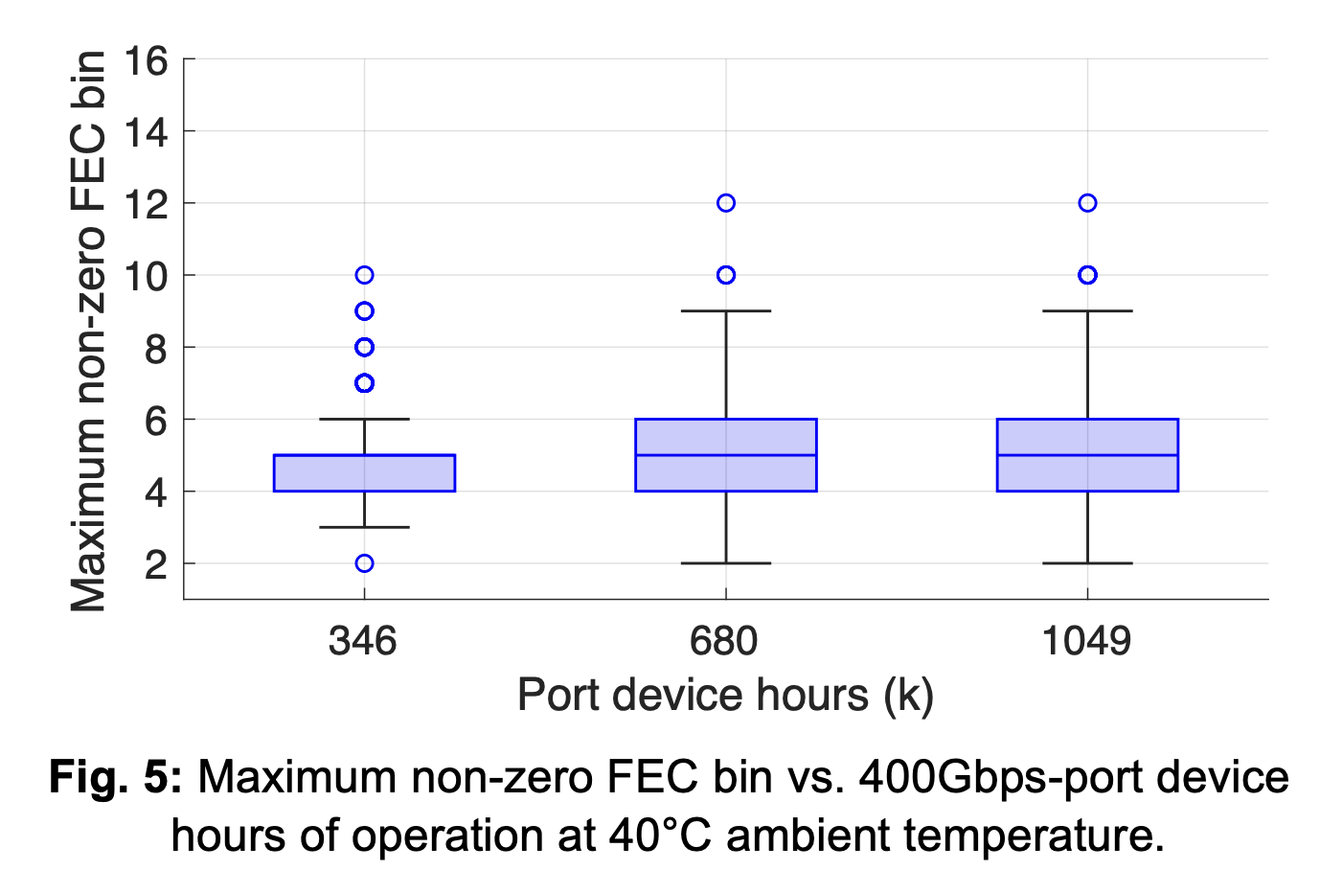
CPO reliability
Example: Meta and Broadcom
Broadcom Tomahawk 5 switches
(Each switch: 128 ports @ 400G per port)
Implications for scale-up
1049k port device hours means
1 Pod: [(18 ports x 72 GPU)_{GPU} + (18 x 72)_{Switch} ] x 8 racks = 50.6 hours
16 Pods: 3 hours (ref: NVIDIA DGX Compute Fabric)
Promising, and continued improvement in link integrity desirable for large clusters
S. Amiralizadeh et al., Co-packaged optics technology evaluation for hyperscale data center fabric switches, ECOC, 2025.

Slide 12
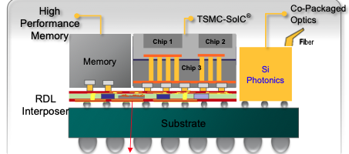
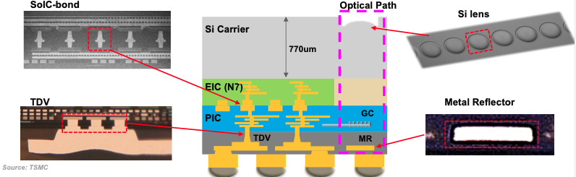
CPO with advanced packaging
Example: TSMC Compact Universal Photonic Engine (COUPE)
Chip-on-Wafer-on-Substrate (CoWoS)
3D-stacked EIC on PIC
Interface (e.g., UCIe-2.5D)
Density: 1-10 Tbps/mm
EIC: Electronic integrated circuit
PIC: Photonic integrated circuit
Observations
Si photonics leverages CMOS manufacturing & packaging
Compact transceivers (≲ 55 μm x 55 μm) simplifies 3D EIC-PIC integration
10 Tbps/mm ⇒ ~1.3 Tbps / fiber @ 127μm fiber pitch
Figures from S. Hou (TSMC), OCP APAC Summit, 2025.

Slide 13
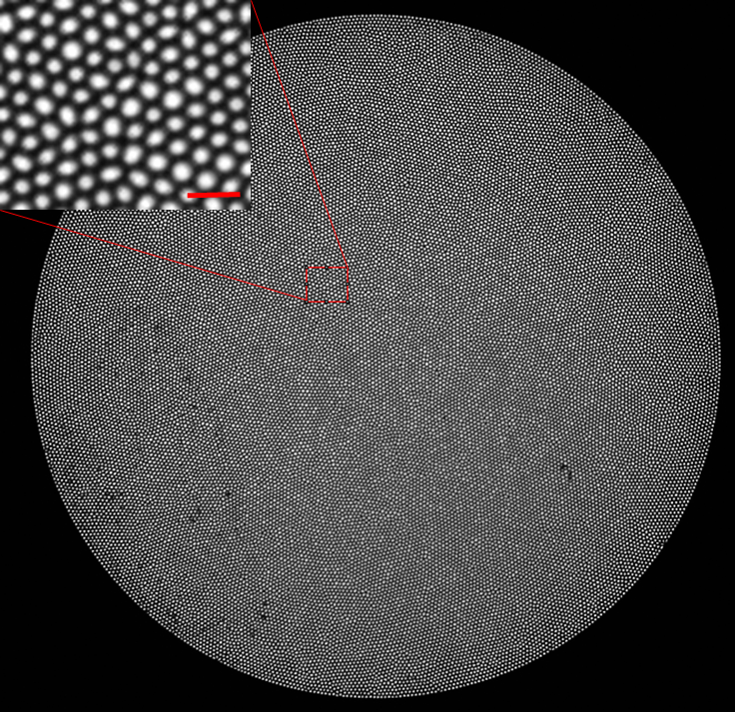

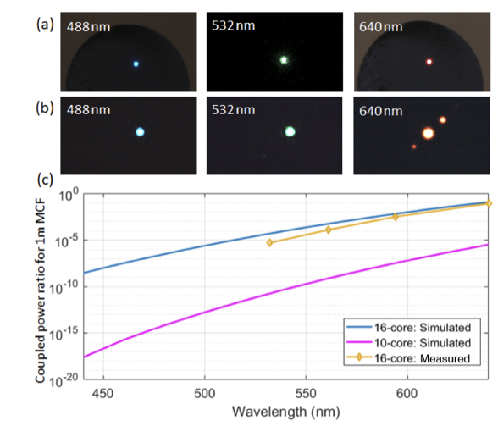
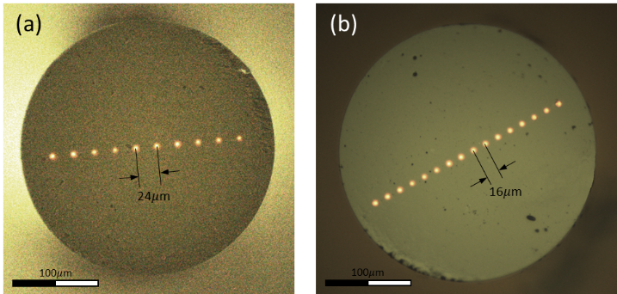
VCSELs and microLEDs
From my group’s neurotech research
Fujikura imaging fiber bundle
Spatially wide-and-parallel links
Fiber bundle facet
10 Tbps/mm ⇒ 200 Gbps / 20 μm
Multi-core fiber and imaging fiber bundles
Crosstalk between cores for λ ≳ 530 nm
Multimode emission ⇒ coupling loss to single-mode fiber cores
No fiber connectors
Our attempt with core expansion: Govdeli et al., CLEO 2022
Cores are not uniform in size and position
Fujikura FIGH-30-650S
Diameter: 650 μm
~30000 cores @ ~1 μm dia.
Inter-core spacing: ~ 3.3 μm
Custom multi-core fiber with Corning
10 single-mode cores
16 single-mode cores
10-core
250 m
16 core
5 m
Pitch: 24 um
Dia: 300 um
Pitch: 16 um
Dia: 300 um
Requires substantial technology & supply chain development!
Azadeh et al., Optics Letters, 2022

Slide 14
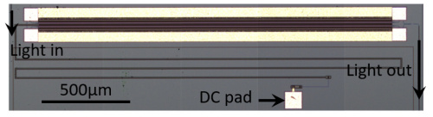
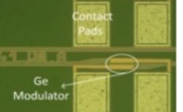
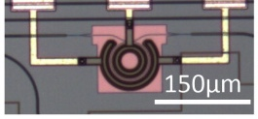
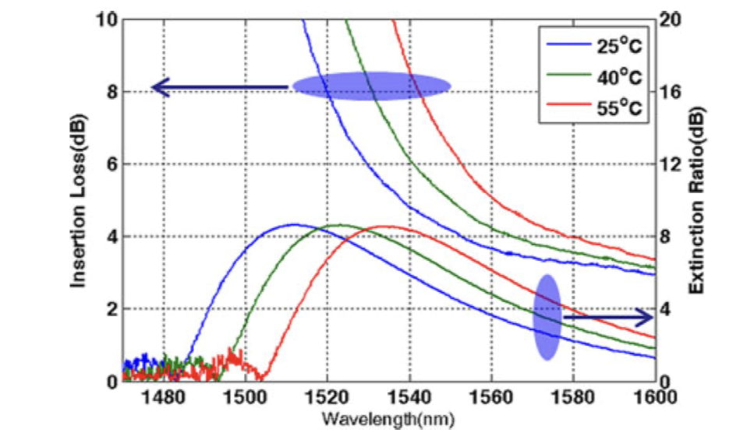
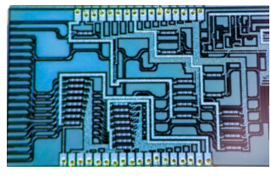
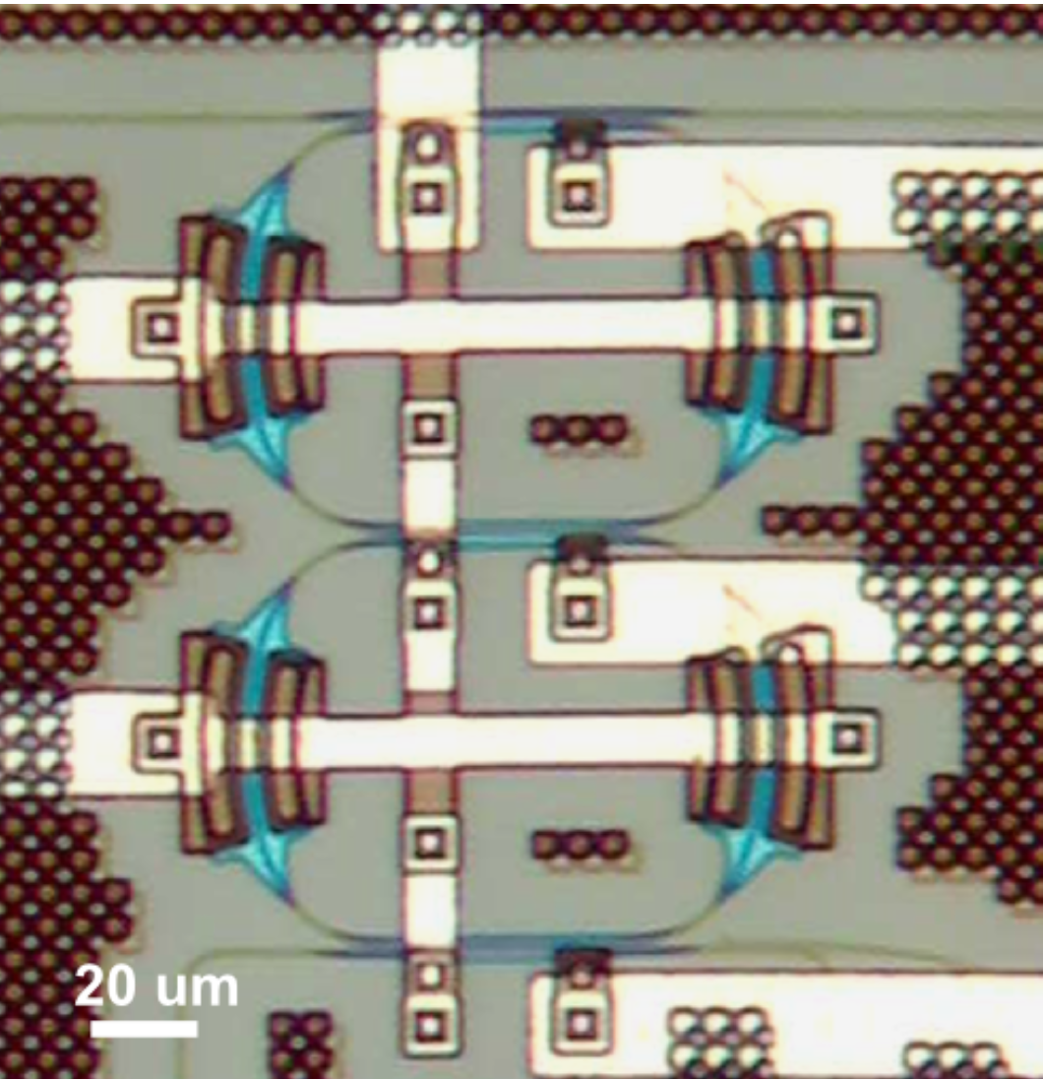

Silicon photonics
Mach-Zehnder Modulators & Lattice Filters
Microring Modulators
& Filters
GeSi Electroabsorption Modulators
MZM
MRM
EAM
λ1
λ1
λ1
λ1
L = 2 – 3 mm
D = 12 – 40 um
L = 30 – 50 um
imec
16λ MUX/DEMUX
MRM + MUX
Coupled rings for filter shaping
λ1, λ2, λ3…
λ1
λ2
λ3
Ring 1
λ1
Ring 2
λ2
Ring 3
λ3
Ring 4
λ4
λ1, λ2, λ3…
2.8 mm
λ1, λ2, λ3…
…
λ1
λ16
200 um
D. Feng et al. (Kotura), JSTQE, 2013.
4.5 mm
Mature technology
Large footprint, large DWDM circuits
Modulation EO BWs: up to ~90 GHz
Wavelength shift: dλ/dT = ~60 pm⋅K⁻¹
-10.5 GHz⋅K⁻¹
Thermal stabilization to ~0.5 K
Highly compact serial MUX/DEMUX
Bulk GeSi: operates near 1550 nm
Bandgap shift dλ/dT = 0.8 nm⋅K⁻¹
Thermal stabilization to ~ 5 K
Heat EAM for broadband coverage
Use MZ lattice or ring filters for WDM
Unless otherwise noted, images are from my research.

Slide 15
1.6 Tbps per fiber
Spectrally wide-and-parallel vs. High-speed serial
Option | Number of Wavelengths | Lane Rate (Gbps) | Modulation Format | Modulator
A | 32 | 50 | NRZ | MRM
B | 16 | 100 | PAM4 | MRM
C | 16 | 100 | NRZ | MRM
D | 8 | 200 | PAM4 | MRM, EAM*
E | 8 | 200 | NRZ | MRM, EAM*
F | 4 | 400 | PAM4 | MRM, EAM*, MZM*
*EAMs and MZMs need more laser fibers (one per wavelength) than MRMs, so the bandwidth density will be lower

Slide 16
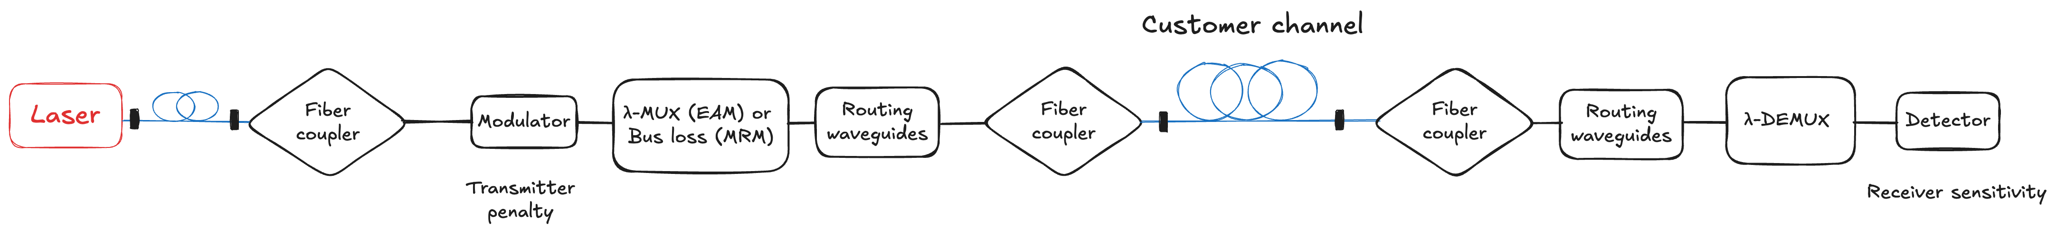
Optical link budget
2.5 dB
2 dB
0.5 dB
2.5 dB
3 dB
2.5 dB
0.5 dB
32λ:1.5 dB
16λ: 1 dB
8λ: 0.5 dB
Transmitter Penalty
Modulation Rate and Format | Input power : OMA (dB) | TDEC(Q) (dB)
MRM 50G NRZ | 2.5 | 0.5
MRM 100G NRZ | 6 | 1
MRM 100G PAM4 | 3.5 | 2
MRM 200G PAM4 | 6 | 3
EAM 100G NRZ | 5 | 1.5
EAM 100G PAM4 | 6 | 2
EAM 200G PAM4 | 7 | 3.5
Receiver Sensitivity
Modulation Rate & Format | RX OMA (dBm)
50G NRZ | -12
100G NRZ | -11
100G PAM4 | -10
200G PAM4 | -8

Slide 17
Energy efficiency
PIC+Laser | Value per λ
MRM tuning | 20 mW
EAM tuning | 10 mW
λ-MUX (EAM) | 20 mW
λ-DEMUX | 20 mW
Laser WPE | 12%
EIC + XSR | pJ/b
50G NRZ | 2
100G NRZ | 2.5
100G PAM4 | 2.5
200G PAM4 | 3.0
Observations
Trade-off between optical power and electrical power
Increase symbol rate ⇒ PIC pJ/bit decreases (amortization of DC dissipation) in exchange for laser and EIC+XSR pJ/bit (DSP)
Laser is 50-90% of the optical pJ/bit
Reduce major losses and penalties: fiber couplers, modulator penalty

Slide 18
Latency: a rough estimate
NRZ offers the lowest latency due to reduced/no FEC
Higher data rate ⇒ Lower latency
Time-of-flight is a large fraction of the latency
With today’s 200G-PAM4 technology, consider 100G NRZ for best energy efficiency and latency

Slide 19
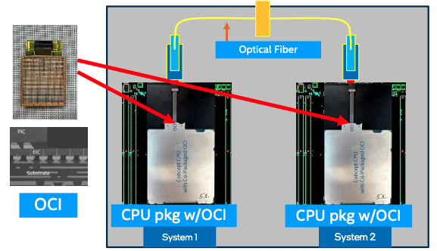
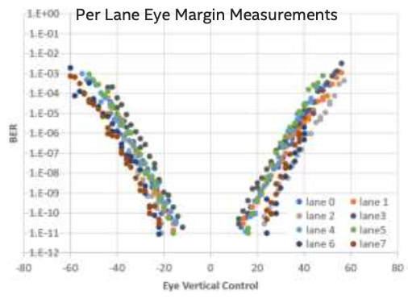
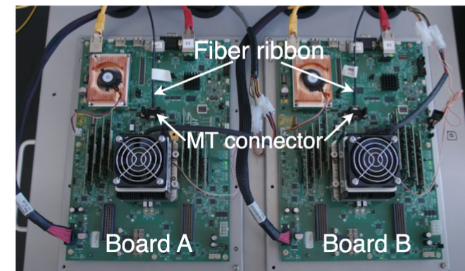
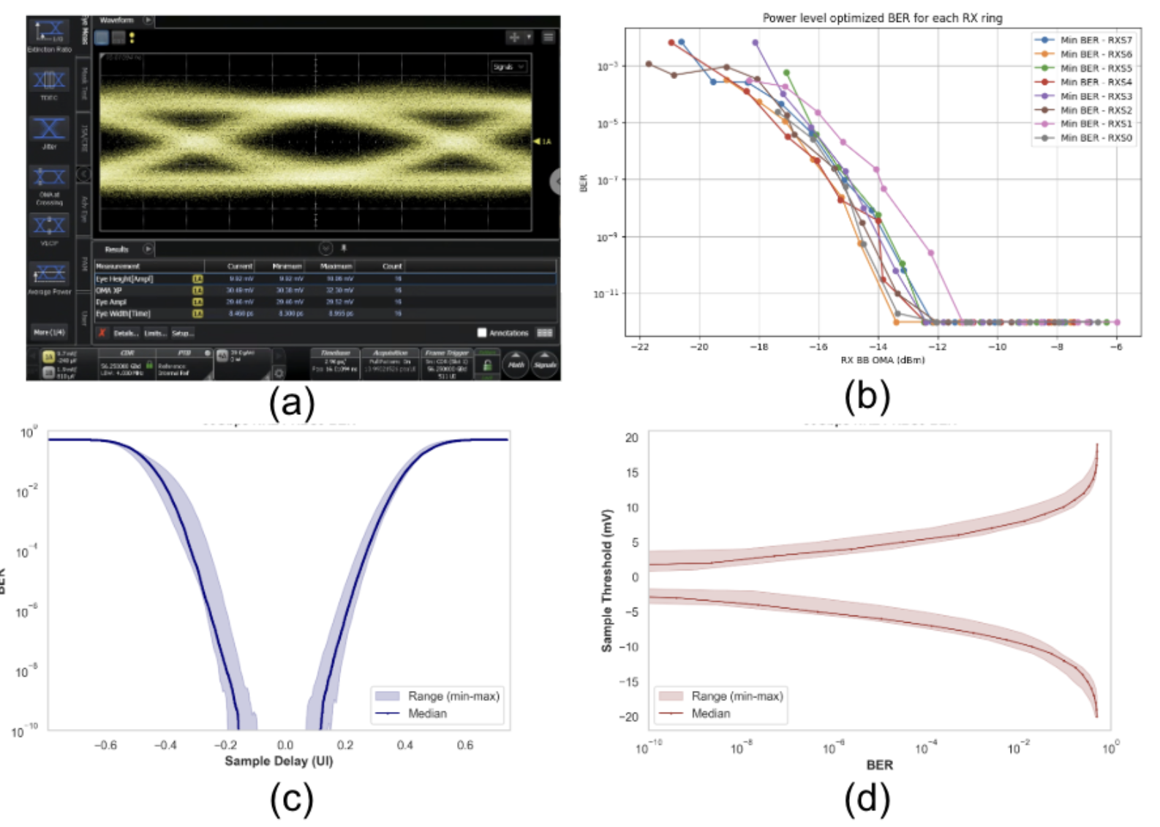
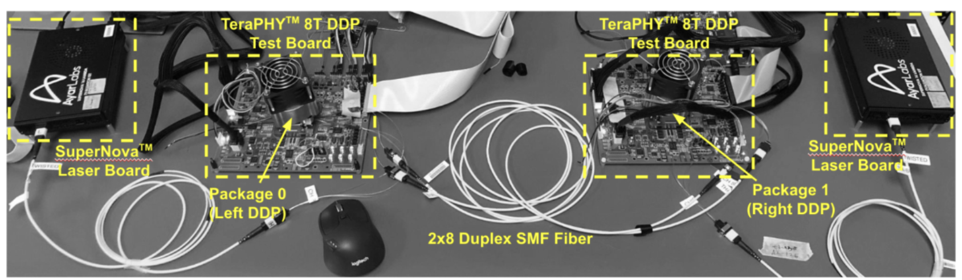
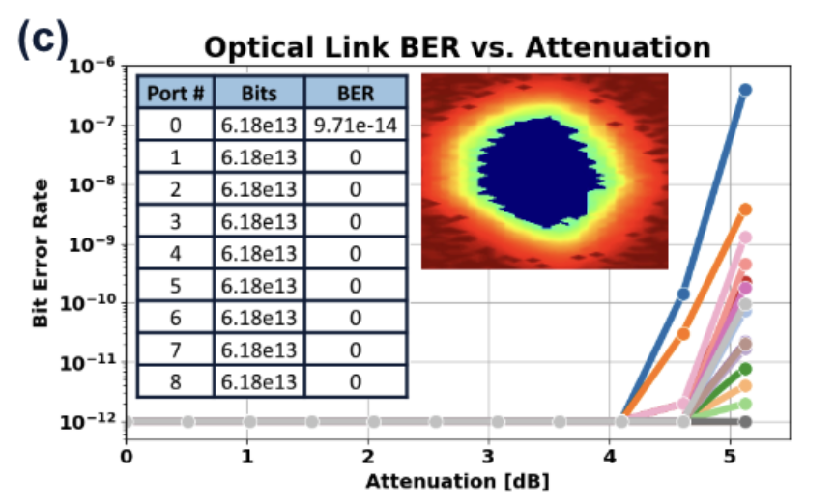
MRM WDM link examples
Intel (OFC & Hot Chips 2024)
8λ x 32G NRZ = 256 Gbps (integrated lasers)
Lightmatter (OFC 2026)
16λ x 56G NRZ = 896 Gbps (bi-dir)
Ayar Labs (OFC 2025)
16λ x 32G NRZ = 512 Gbps
Single-wavelength per fiber MRM links
Ranovus: 100G PAM4 (ref)
Intel: 240Gbps (OFC 2022)
NVIDIA: 200Gbps (OFC 2026?)
NVIDIA Research (ISSCC 2026)
8λ x 32G NRZ = 256 Gbps

Slide 20
Lightmatter: 16λ x 112G PAM4

Slide 21
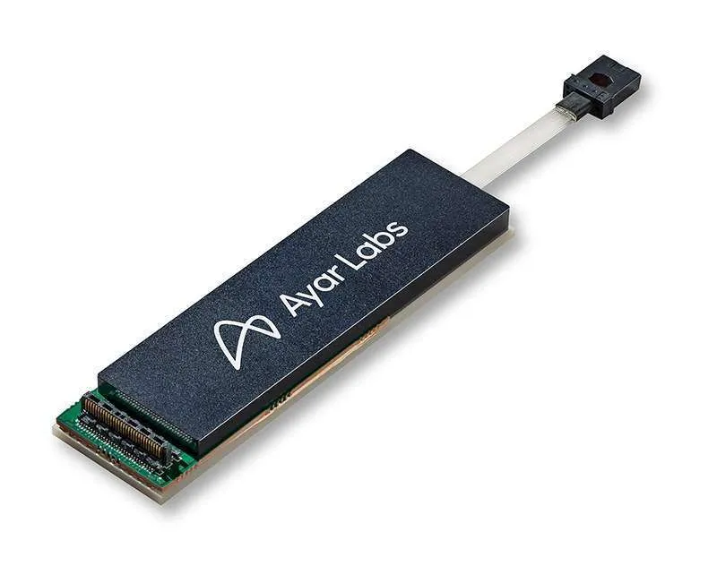
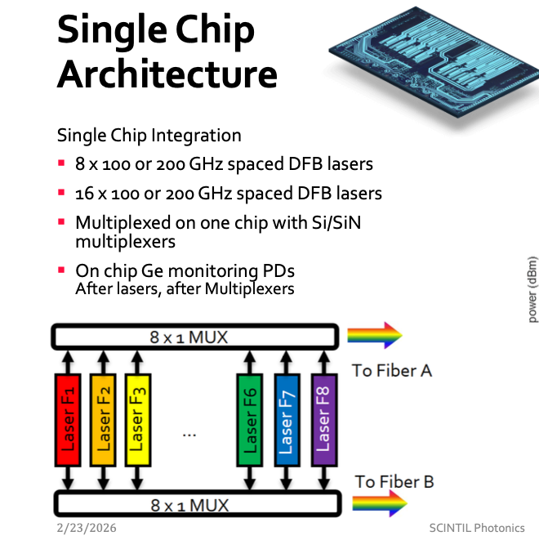
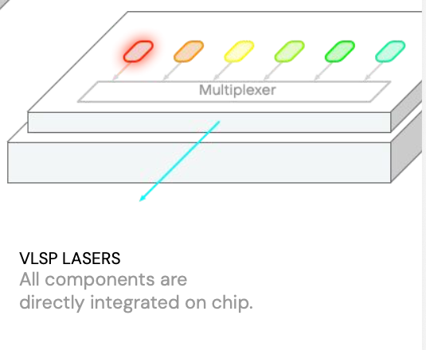
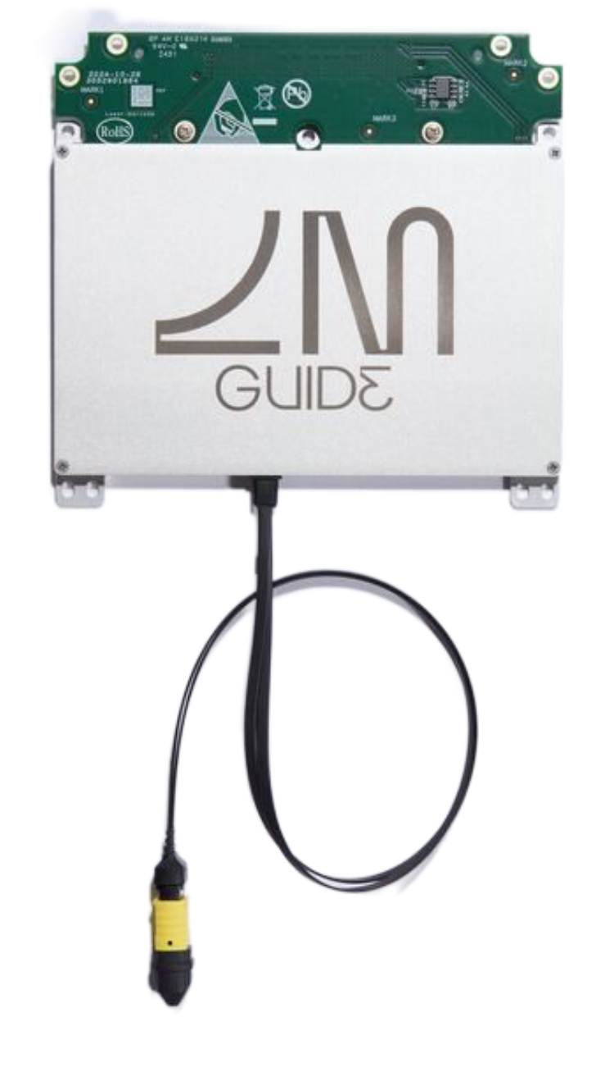
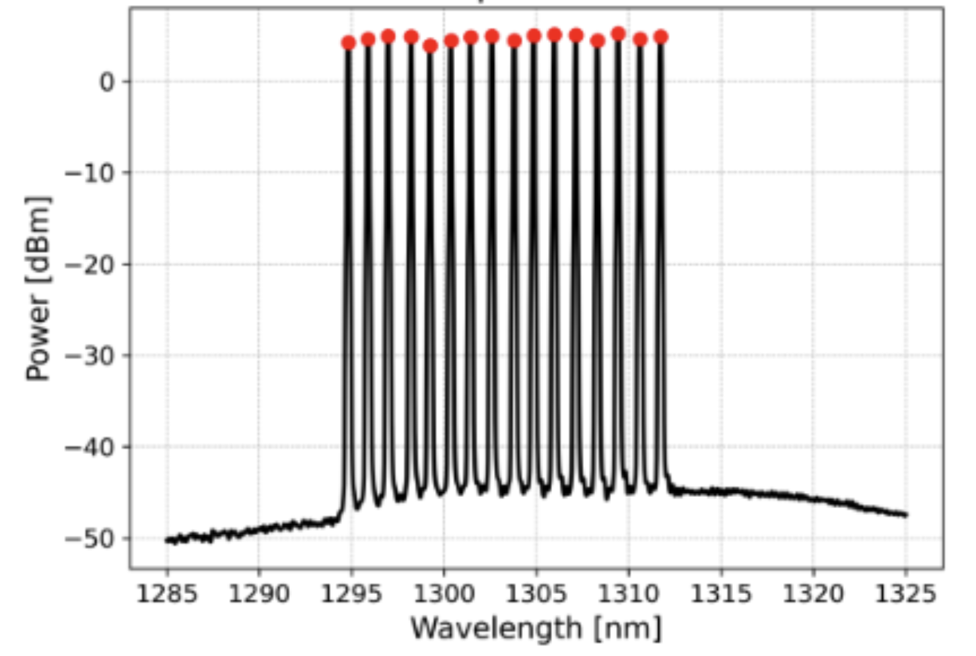
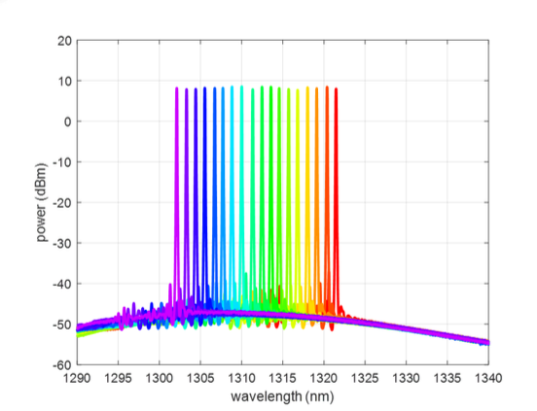
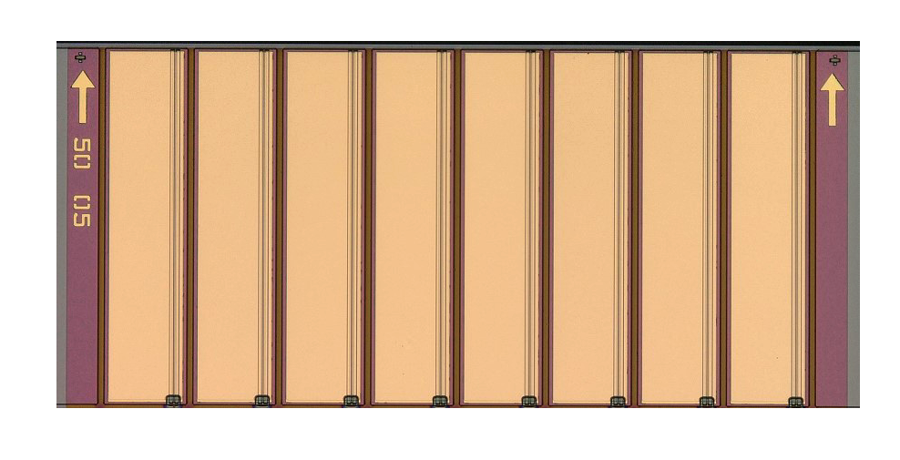
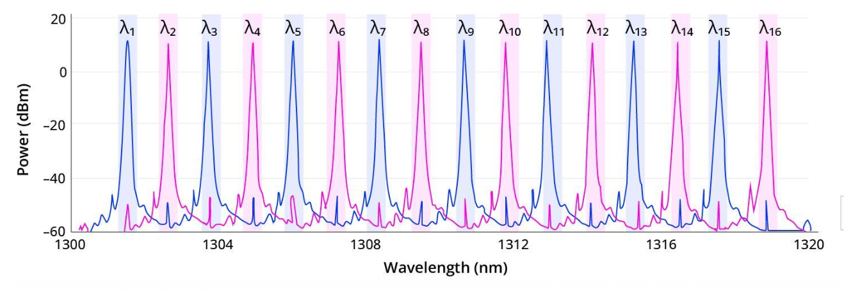
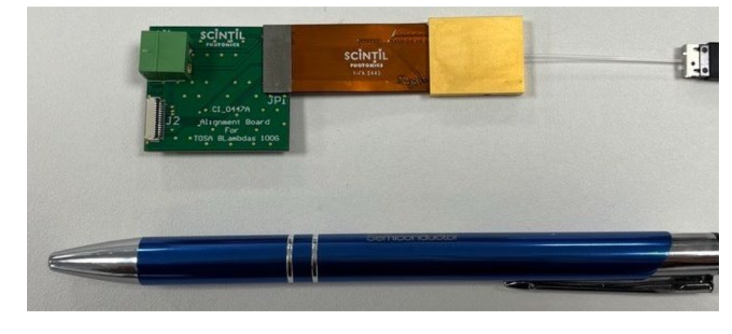
DWDM laser source examples
Ayar Labs with Sivers
Monolithic InP DFB array
16λ x 200GHz
Scintil Photonics
Hybrid InP-on-Si
16λ x (100 or 200 GHz)
Lightmatter
Single-chip integrated
16λ x 200 GHz, 32 fiber output
18 x 200 GHz
100 mW per λ

Slide 22
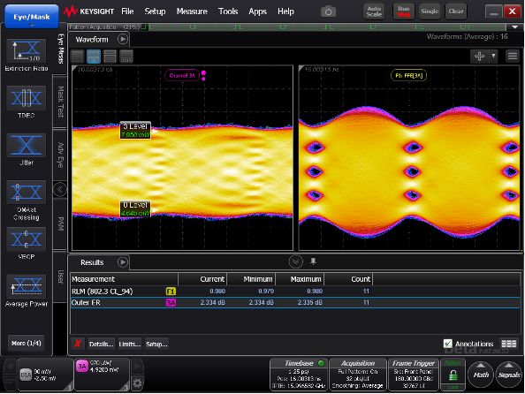
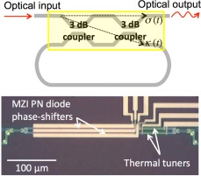
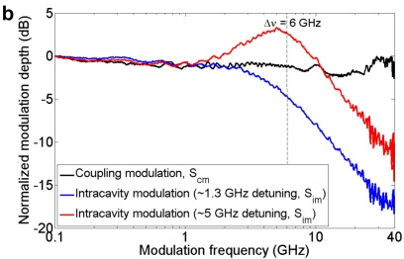
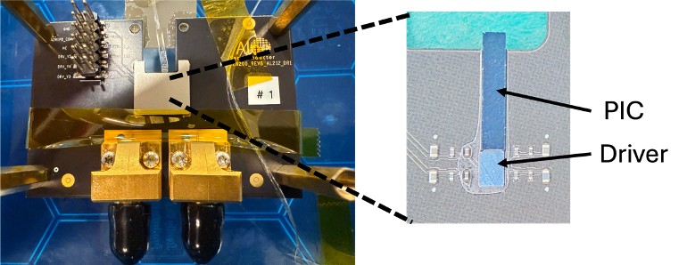
Toward 400-448G PAM4 per lane
Nyquist: 100-112GHz
Intrinsic Si PN junction bandwidth
C = 0.5 to 1 pF/mm
R = 1 - 2 Ohm·mm
⇒ 80 - 300 GHz ✅
Mach-Zehnder Modulators
BW of CPW electrodes is typically limited by RF loss
E.g., Segmented electrodes
Microring Modulators
Conventional MRM: challenging (Q ≲ 1000)
Coupling-modulated microring?
Aloe Semiconductor
180 Gbaud
Coupling modulation
W. Sacher et al., Optics Express, 2013.
Beyond Si: Thin film LiNbO₃, EO polymers, BaTiO₃, ferroelectric liquid crystals

Slide 23
Summary
System requirements on scale-up networks
~10⁴ Tbps-class interconnects per rack ➞ Supply chain
Bandwidth density, power consumption, latency, reliability
Limits of copper
Works today (up to 200G per lane)
Complexities are growing (rack power, cable management)
Co-packaged optics for 1.6 Tbps/fiber and beyond
WDM + moderately high (100+G) lane rate to achieve bandwidth density
NRZ for the lowest latency
Today’s limit: Microring based 16λ x 112G ➞1.6Tbps per fiber
400G-class transceivers are not fundamentally out of reach for Si photonics
Views expressed are my own and do not represent those of my former employer or any other organization.

