Slide 1
Future of I/O: optical vs Electrical + Optical
Masum Hossain

Slide 2
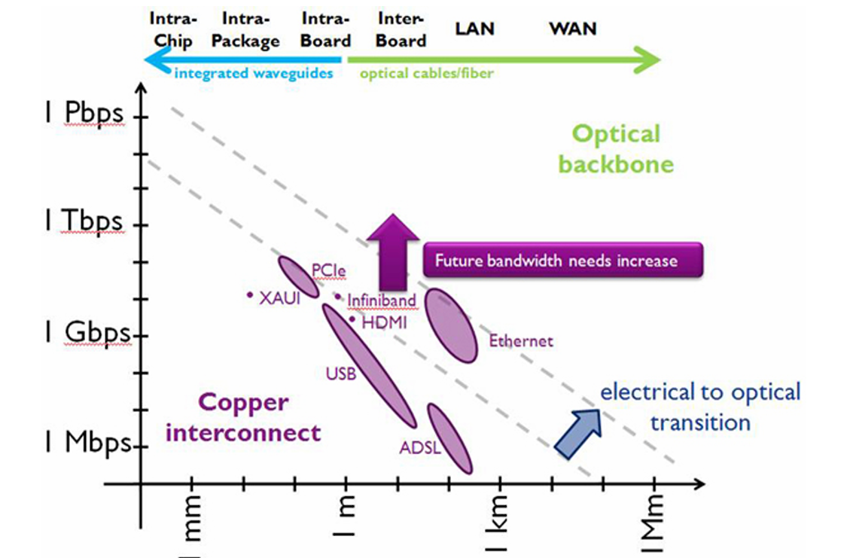
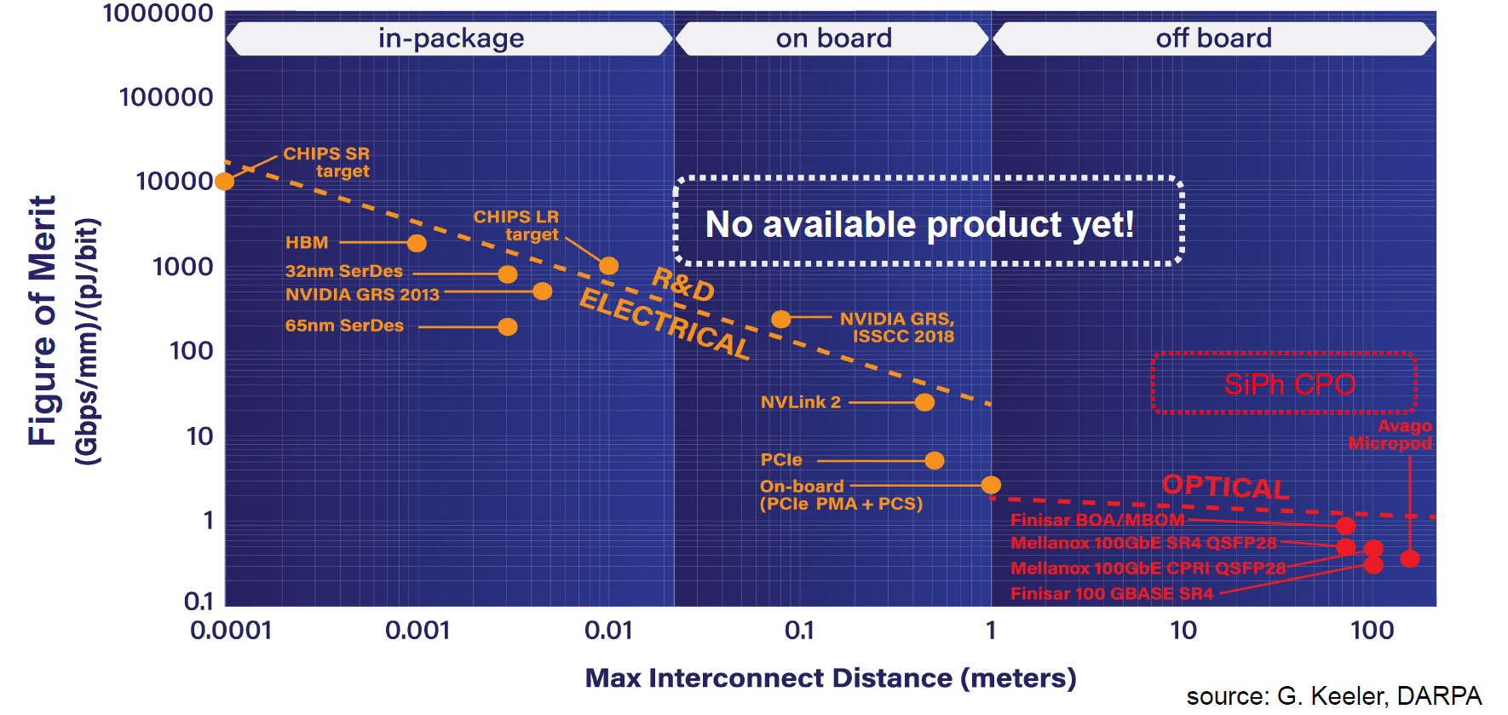
The boundary between Electrical and Optical Links
UCIe (advanced)
UCIe (standard)

Slide 3
Outline
Evolution of Optical Links towards lower power
Silicon Photonics
Monolithic vs Co-Packaged
Approach 1: Wide Parallel Interface
Approach 2: Optimizing bandwidth/λ
Electrical Alternative: Co-packaged Copper
What about On Package Photonics?
What about On Die photonics?
Summary

Slide 4
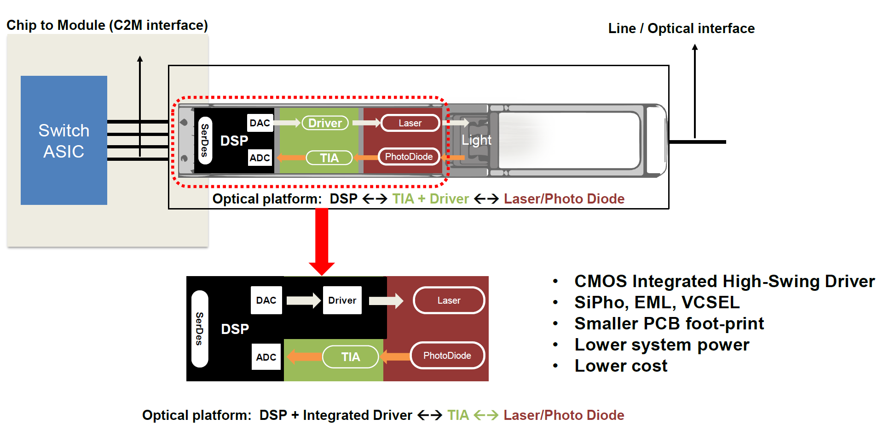
Pluggable Optics – need to improve energy efficiency

Slide 5
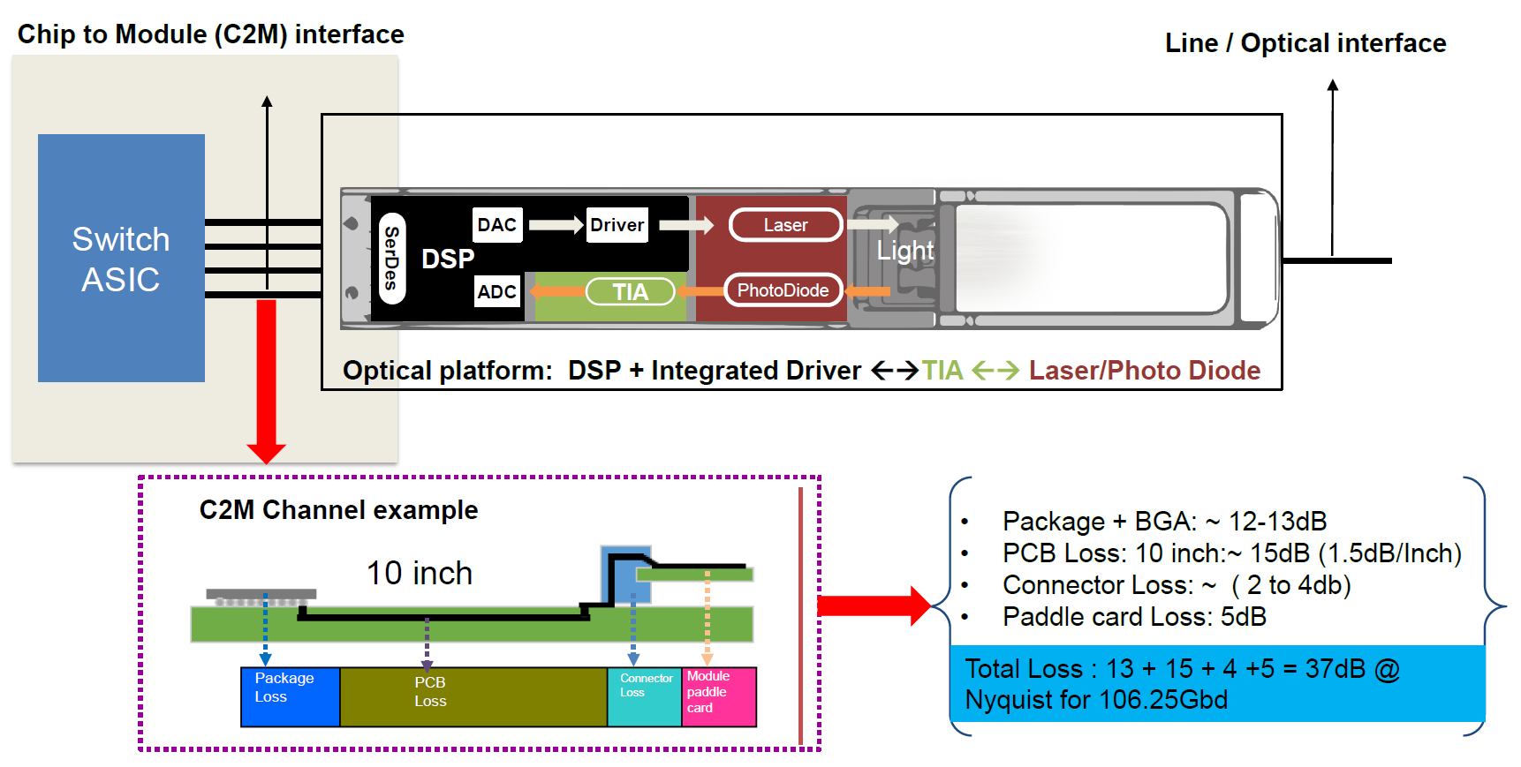
Pluggable Optics – need to improve energy efficiency

Slide 6
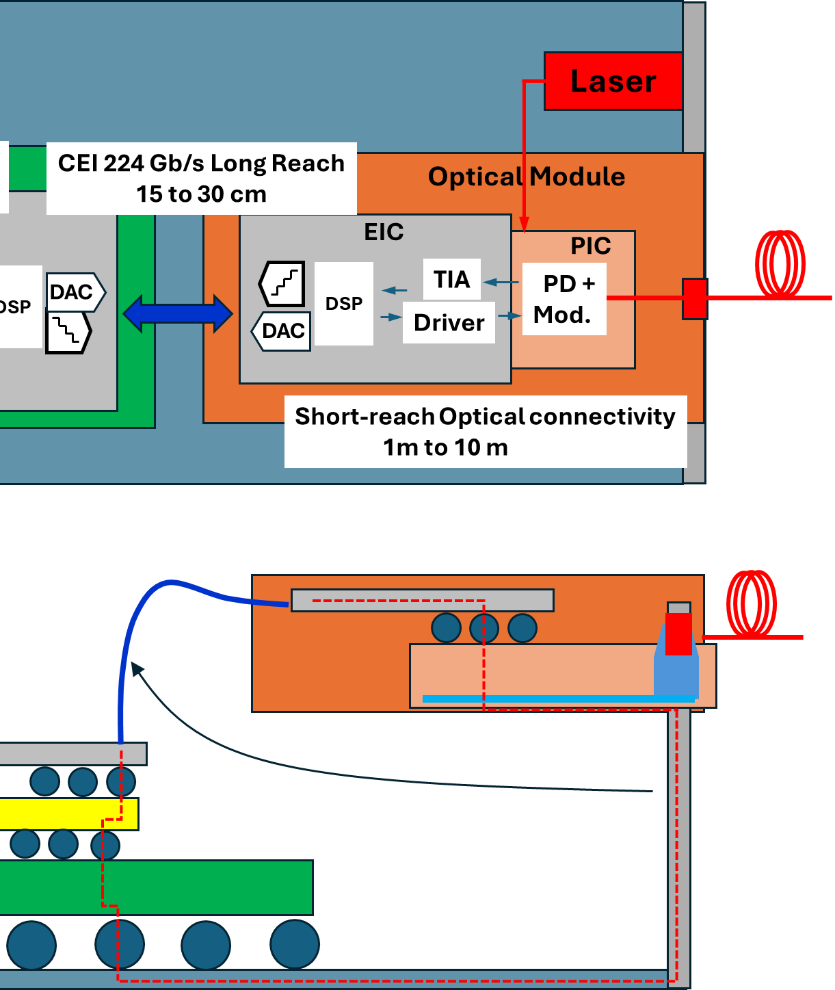
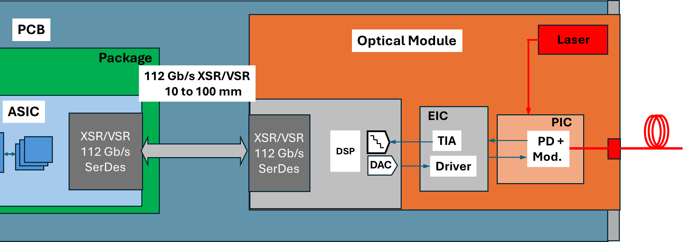
Simplify ASIC to Module connectivity
Bringing optics closer to the ASIC we can reduce the ASIC to EIC loss to XSR
Further power reduction can happen if CMOS can directly drive the modulator and eliminate the off-chip TIA if SNR allows.

Slide 7
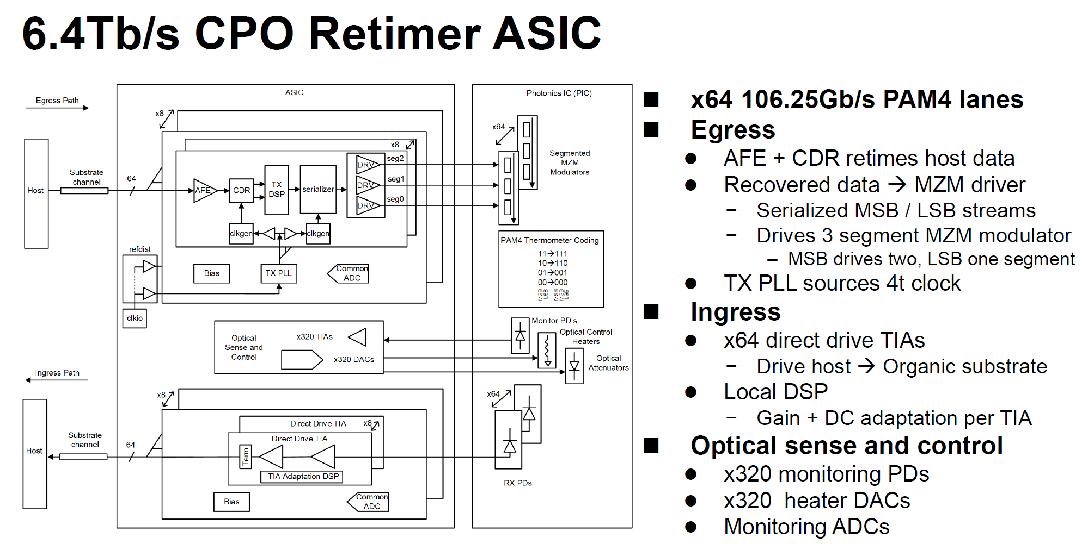
Example: Broadcom’s Tomahawk

Slide 8
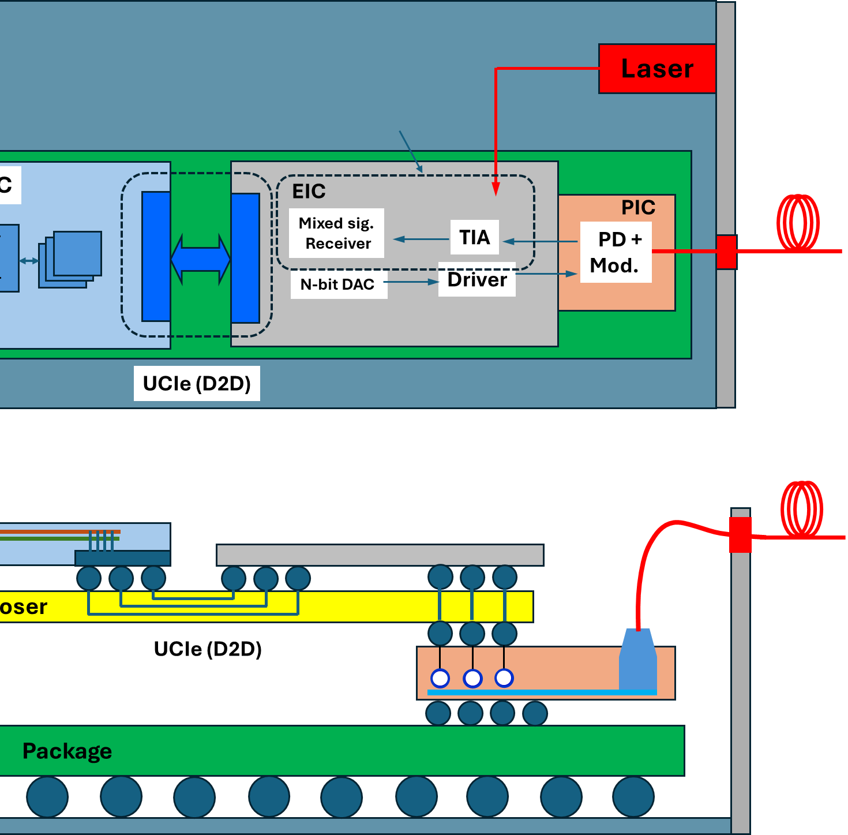
Why Co-Packaged Optics?
Pluggable Optics: 15 pJ/bit
Near Package Optics (NPO)/LPO:
XSR Link 2 pJ/bit
Optical Transceiver: 5 to 7 pJ/bit
Bandwidth: 64x100 Gb/s
Co-Packaged Optics:
Die-to-Die : 0.3 pJ/bit
Optical Transceiver: 5pJ/bit
Latency < 50 nsec
Bandwidth > 1 Tb/s

Slide 9
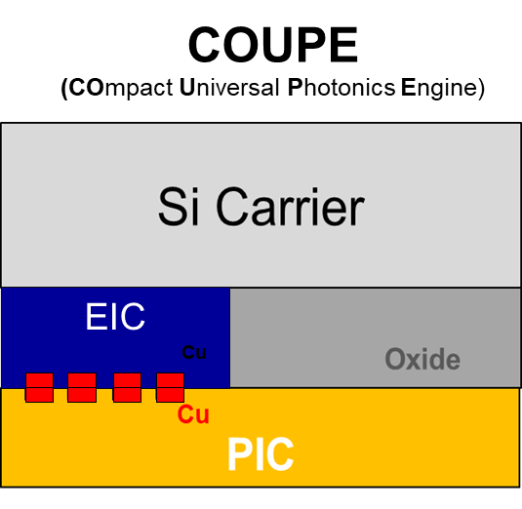
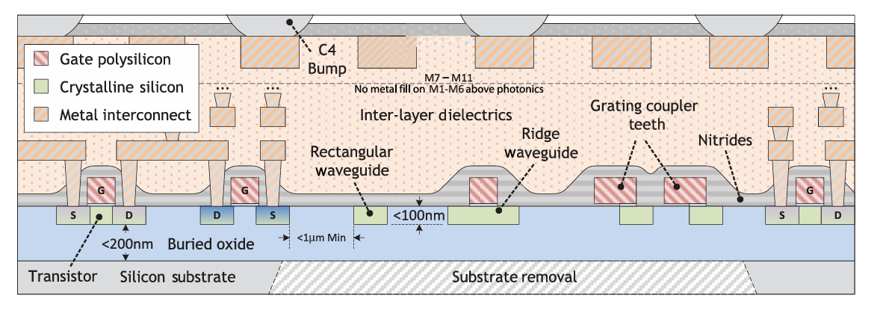
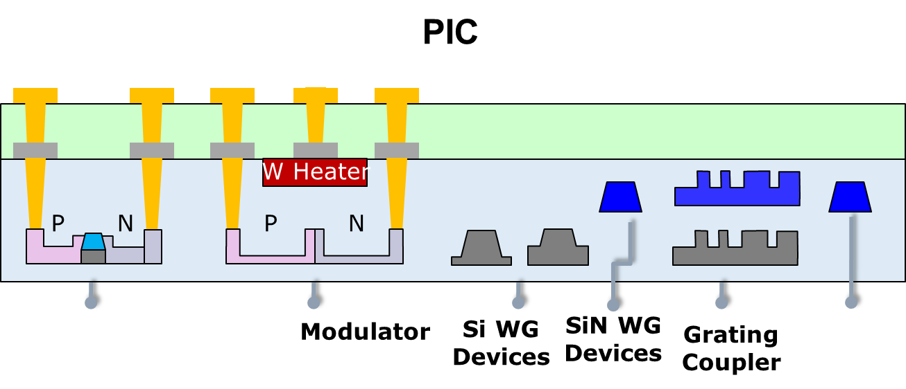
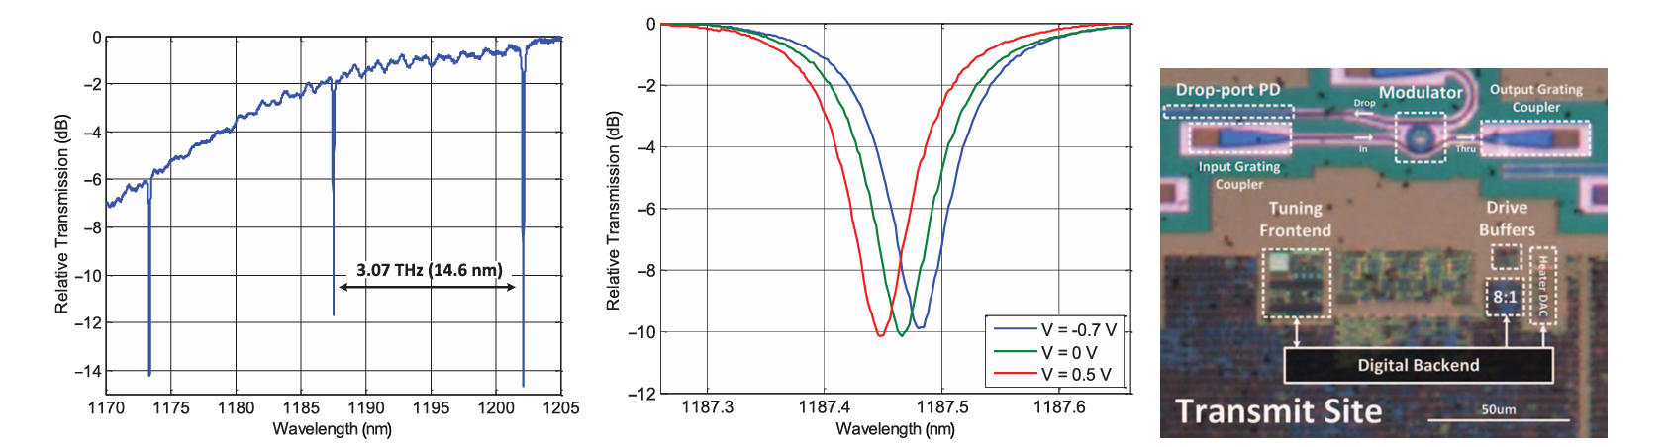
CPO options: Monolithic vs Co-Packaged
GF 45nm SPCLO Process

Slide 10
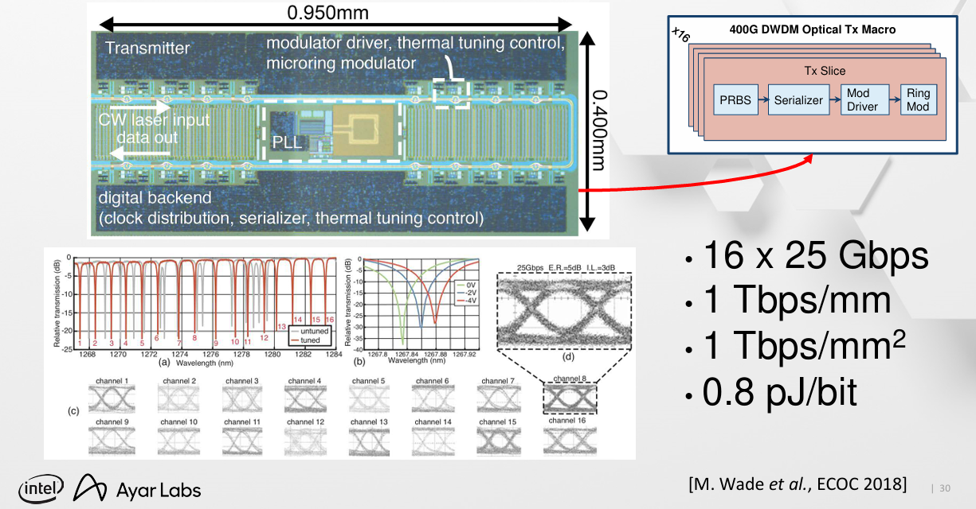
Slow and Wide Monolithic Approach

Slide 11
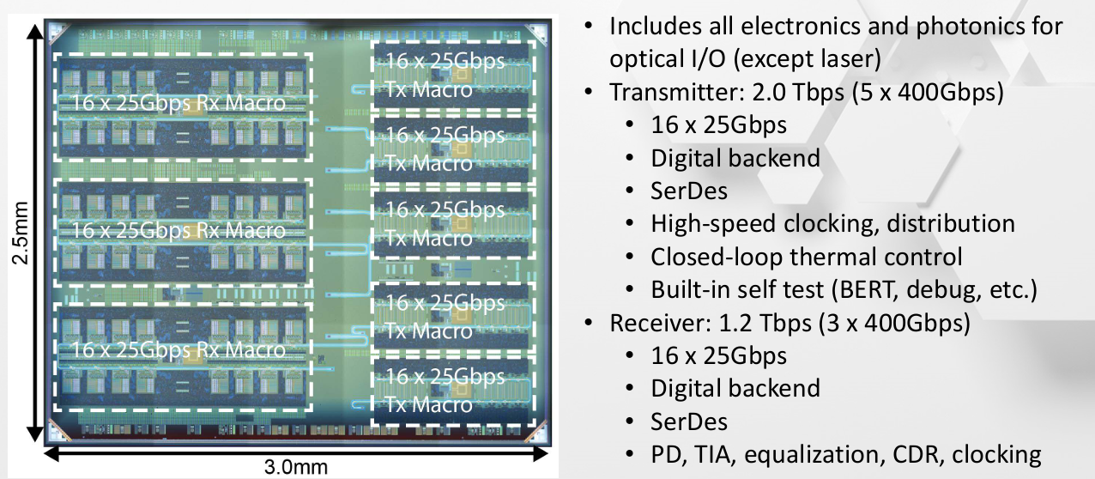
Slow and Wide Monolithic Approach
[Wade OFC’2018]

Slide 12
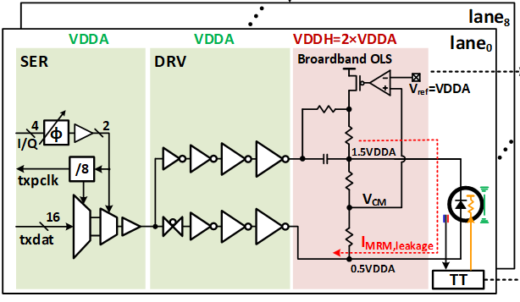
NVIDIA CPO: 32 Gb/s Links in 7nm FinFET EIC

Slide 13
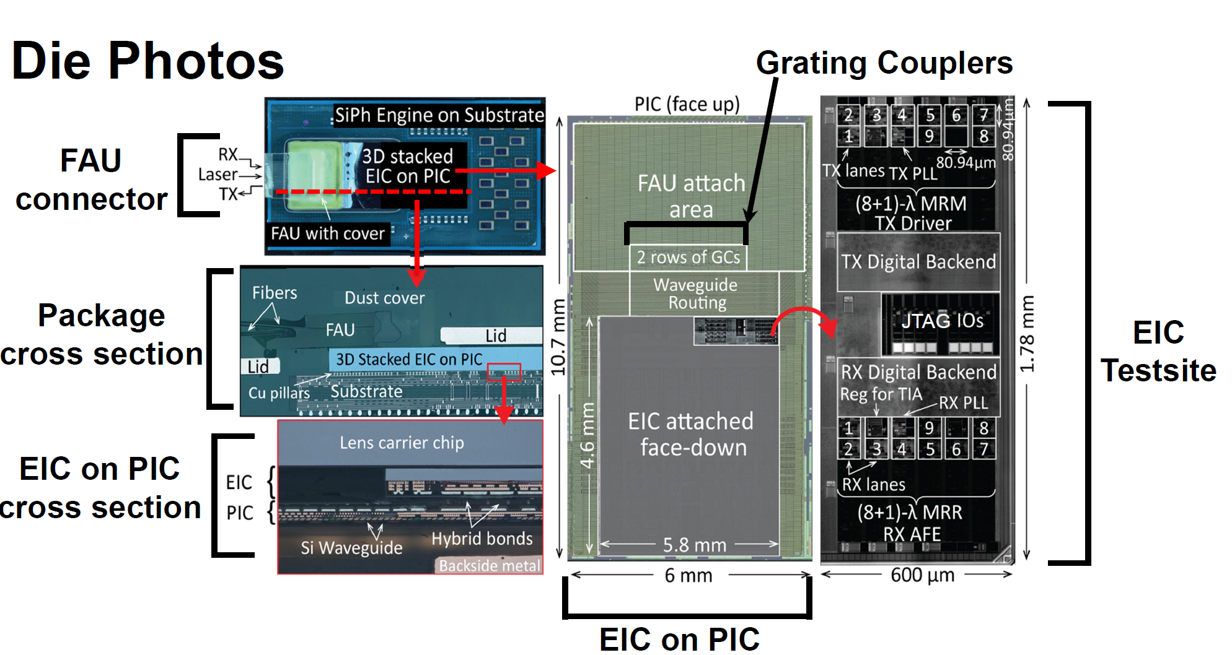
NVIDIA CPO: 32 Gb/s Links in 7nm FinFET EIC

Slide 14
Summary of NRZ DWDM Links
 |  | IMEC ISSCC 2015 | Intel VLSI 2022 | AMD ISSCC 2023 | Intel VLSI 2023 | Ayar Labs VLSI 2024
 |  | TRX | TRX | RX | RX | TRX
Process | EIC | 40nm | 45nm SOI | 7nm | 28nm | 45nm SOI
 | PIC | 130nm SOI |  | 45nm SOI | Intel SiPh
# of wavelengths |  | 4 | 8 | 7 | 8 | 8
Per-λ Data Rate (Gbps) |  | 20 | 16 | 50 | 32 | 32
Per-Fiber Data Rate (Gbps) |  | 80 | 128 | 350 | 256 | 256
Modulation |  | NRZ | NRZ | NRZ | NRZ | NRZ
RX Sensitivity OMA (dBm) @ 1e-12 |  | -7.2 | N/A | -10.1 | -10 | -14.2
Energy Efficiency (pJ/b) |  | 2.33 | 5 | 0.96 (RX only) | 3.8 (RX only) | 3.45
NVIDIA 2026
TRX
7nm finFET+
65nm PIC
9
32
256
NRZ
-16
2.59 (RX only)
DWDM per-λ data rate is relatively low compared to CWDM
Can utilize wide and parallel D2D interface (UCIe, AIB, BoW, OpenHBI, etc)
No need power-hungry SerDes
Preserve low power and low latency

Slide 15
Slow and Wide Silicon Photonics Solution
Energy Efficiency: 0.3 pJ/bit + 3 to 4 pJ/bit + 0.3 pJ/bit
Latency 3 ns 10 ns 3ns
Bandwidth : 8x32 Gb/s = 256 Gb/s
Bandwidth Density : ~0.5 to 1 Tb/s/mm
Cost: High
Additional Challenges: Thermal stability, volume manufacturability

Slide 16
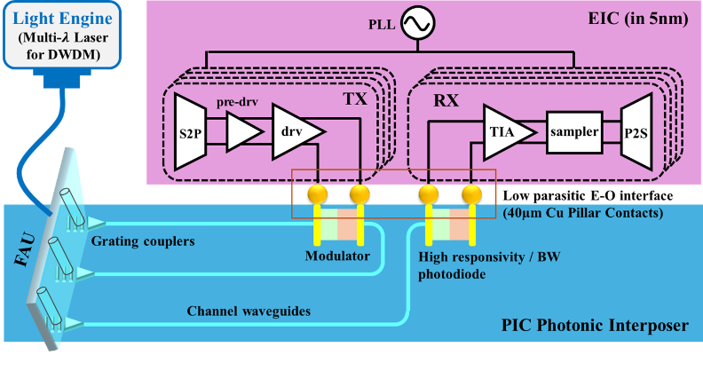
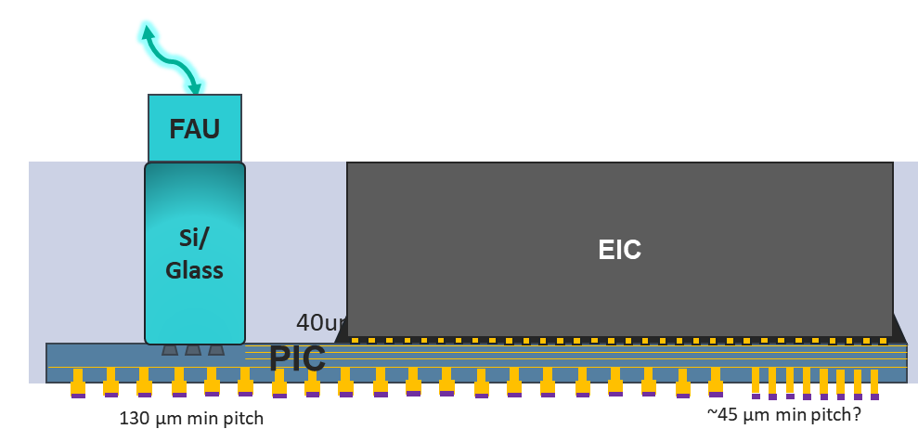

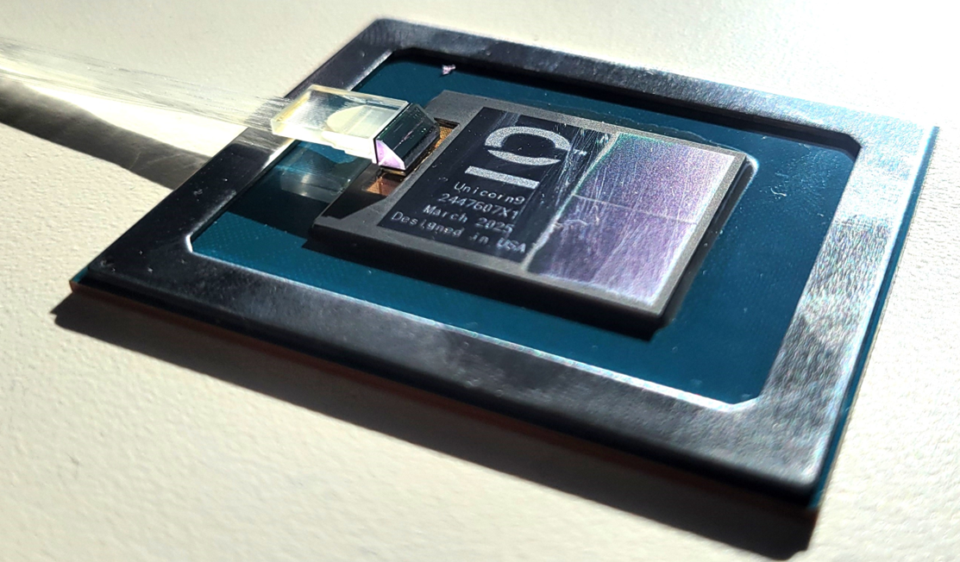
Packaging of 3D SiPh Transceiver
Optical I/O Chiplet in XPU Package
Cold Plate
XPU
Organic interposer
Silicon Bridge
Organic Substrate
TSVs in PIC
Embedded silicon bridge to support fine-pitch D2D I/O
FAU integration w/ PIC grating couplers
Power delivery through LGA, substrate DSC and LSC

Slide 17
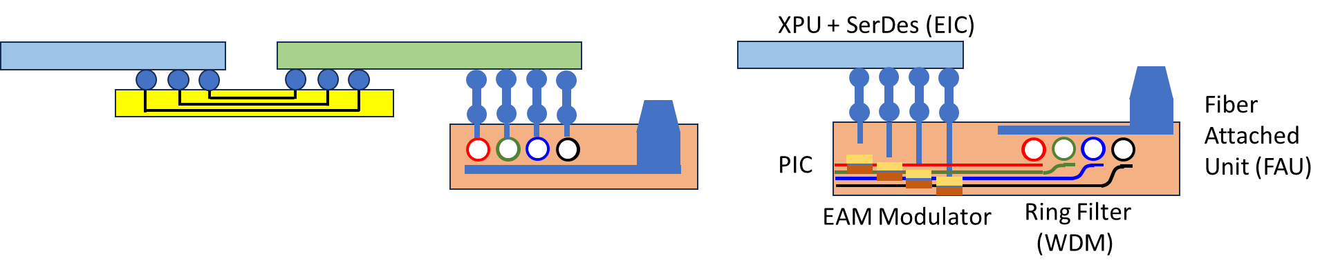
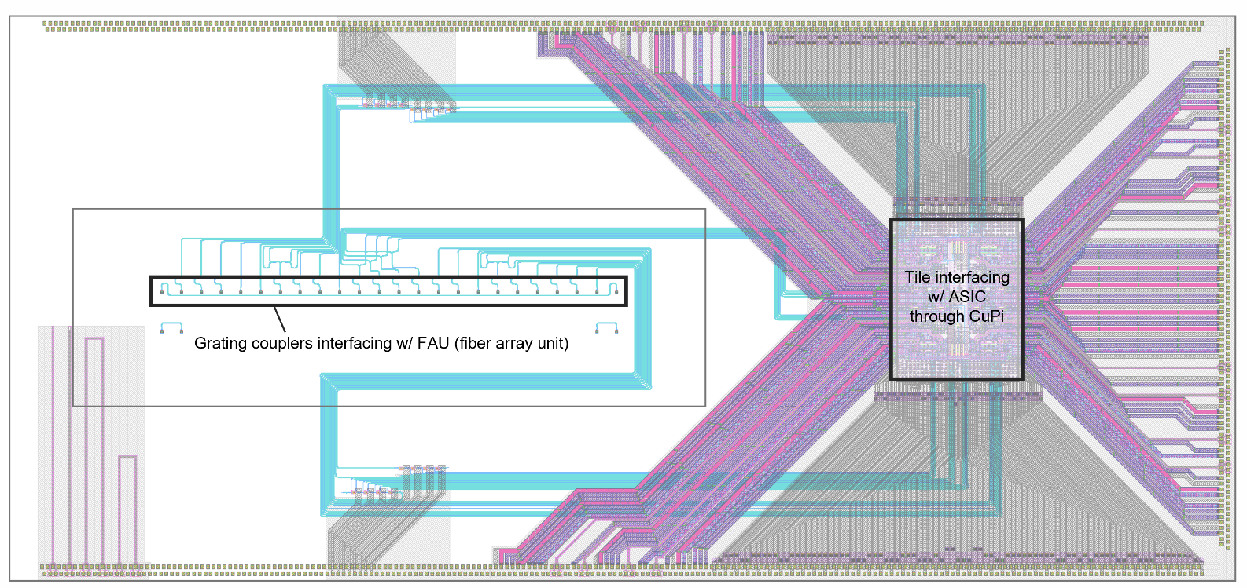
Improving Bandwidth and Thermal Stability
EIC flip-chip-attached to PIC through Cu pillars
32 Gb/s/λ → 56 Gb/s/λ (NRZ) → 112 Gb/s /λ
EAM Modulators in proximity to XPU
8λ based WDM using Ring Modulator

Slide 18
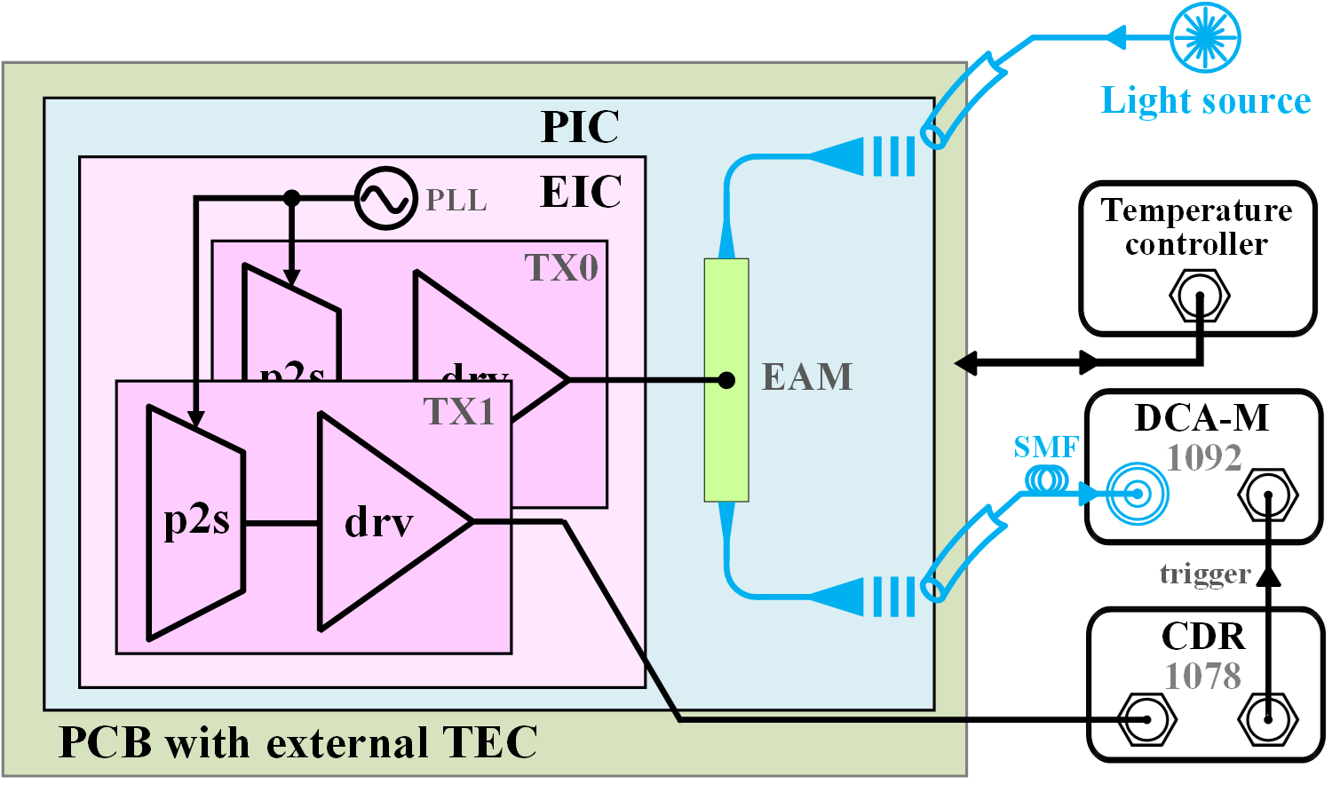
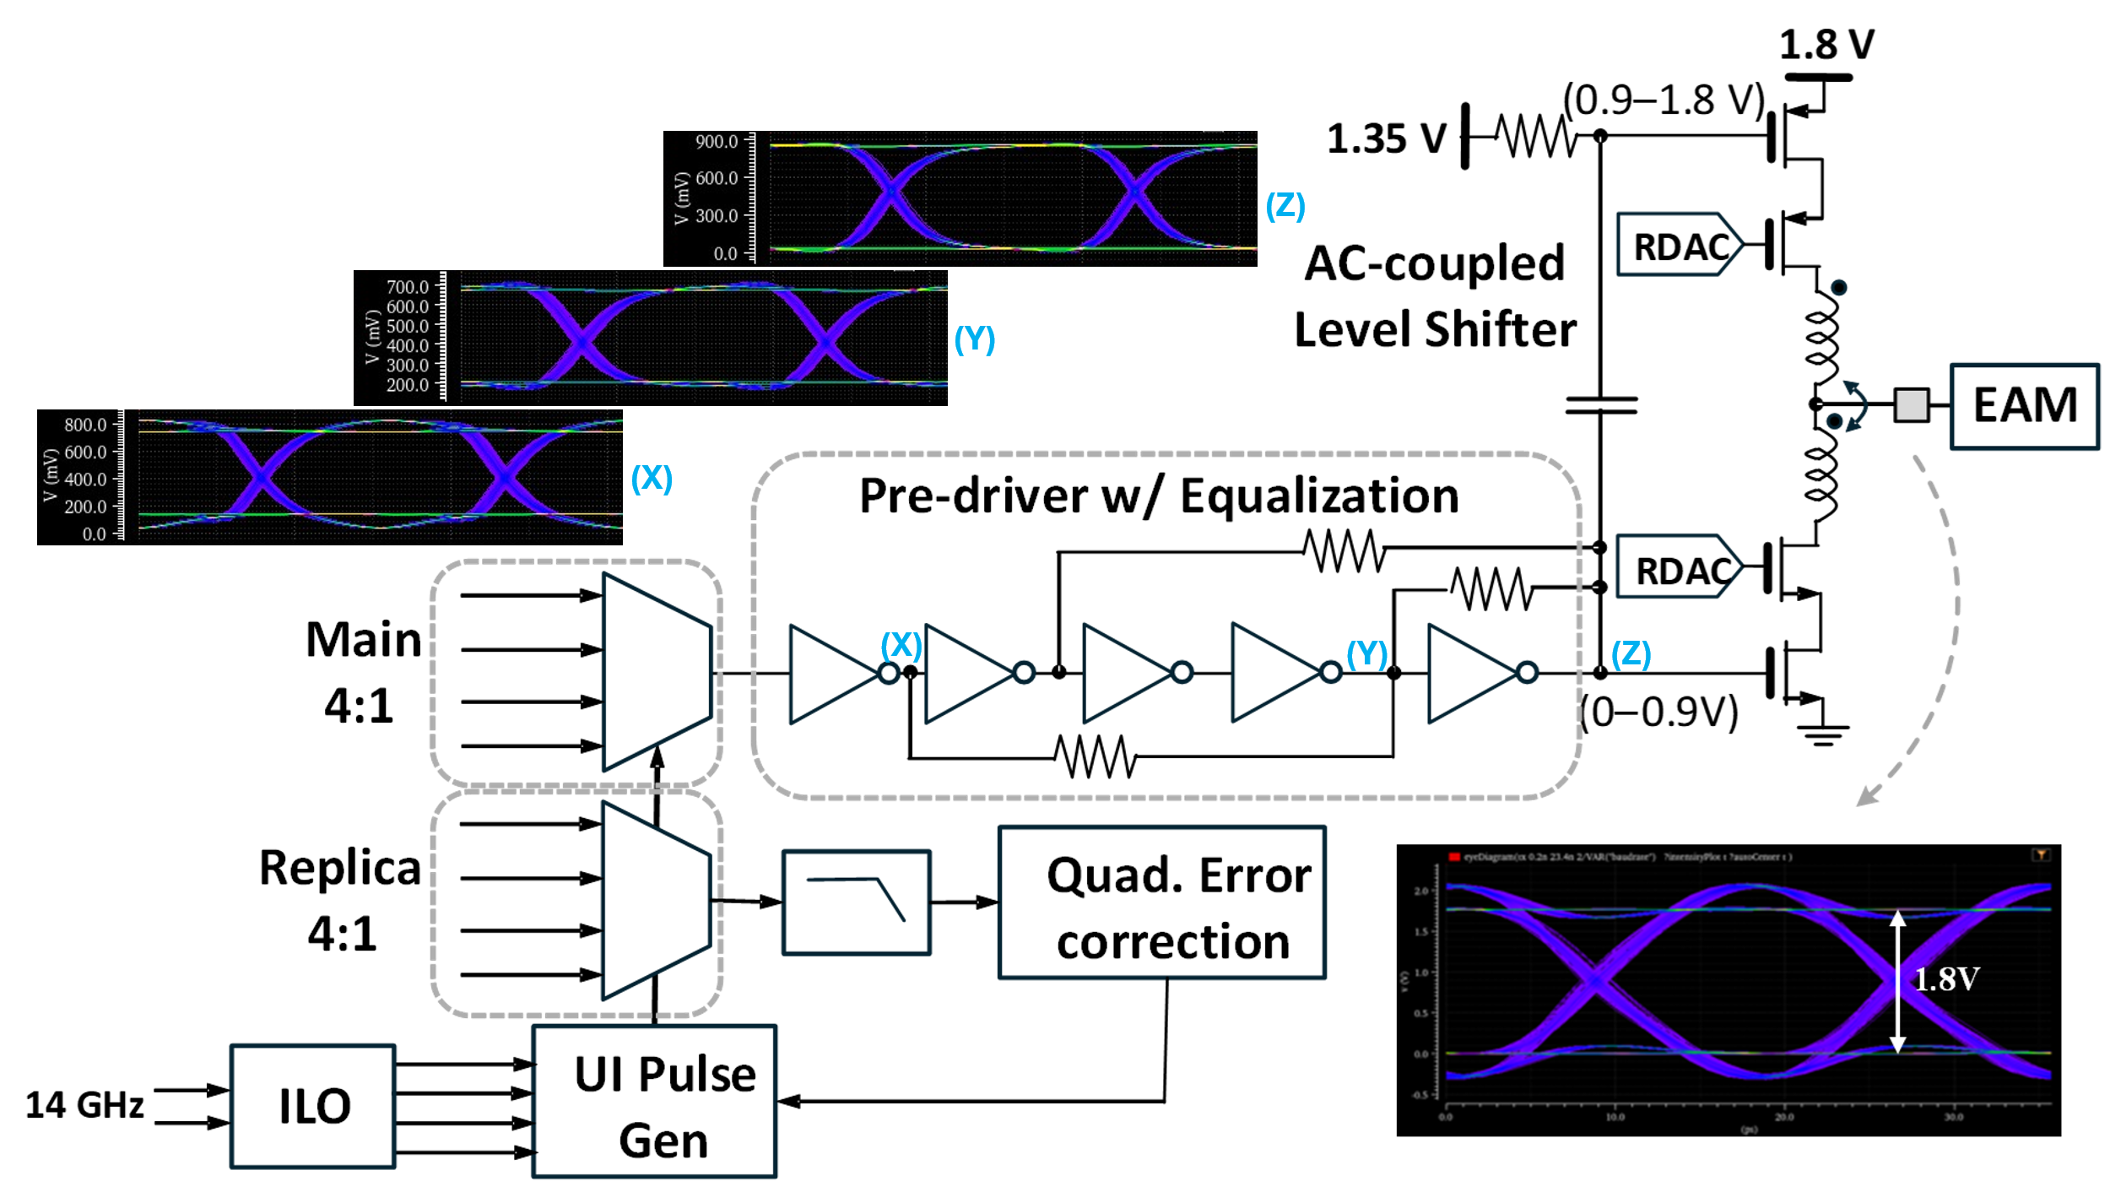
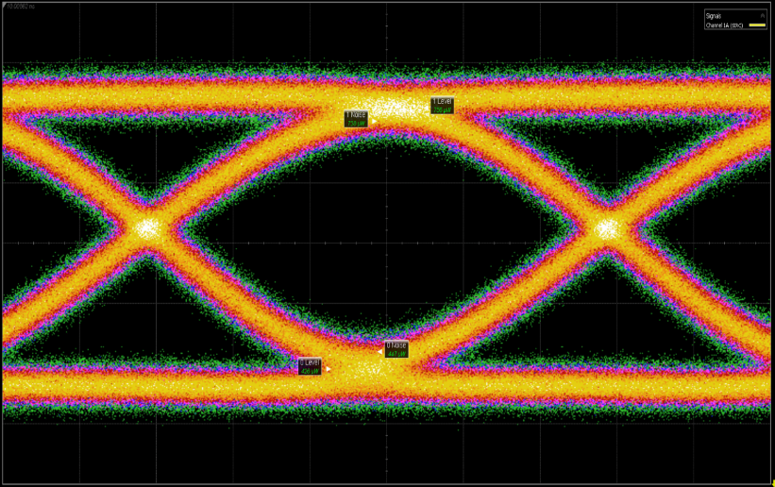
Transmitter and Driver
Measurement Setup
TX Signal Path
56 Gbps OTX Eye
Ref. [16]
OMA = -4.4 dBm

Slide 19
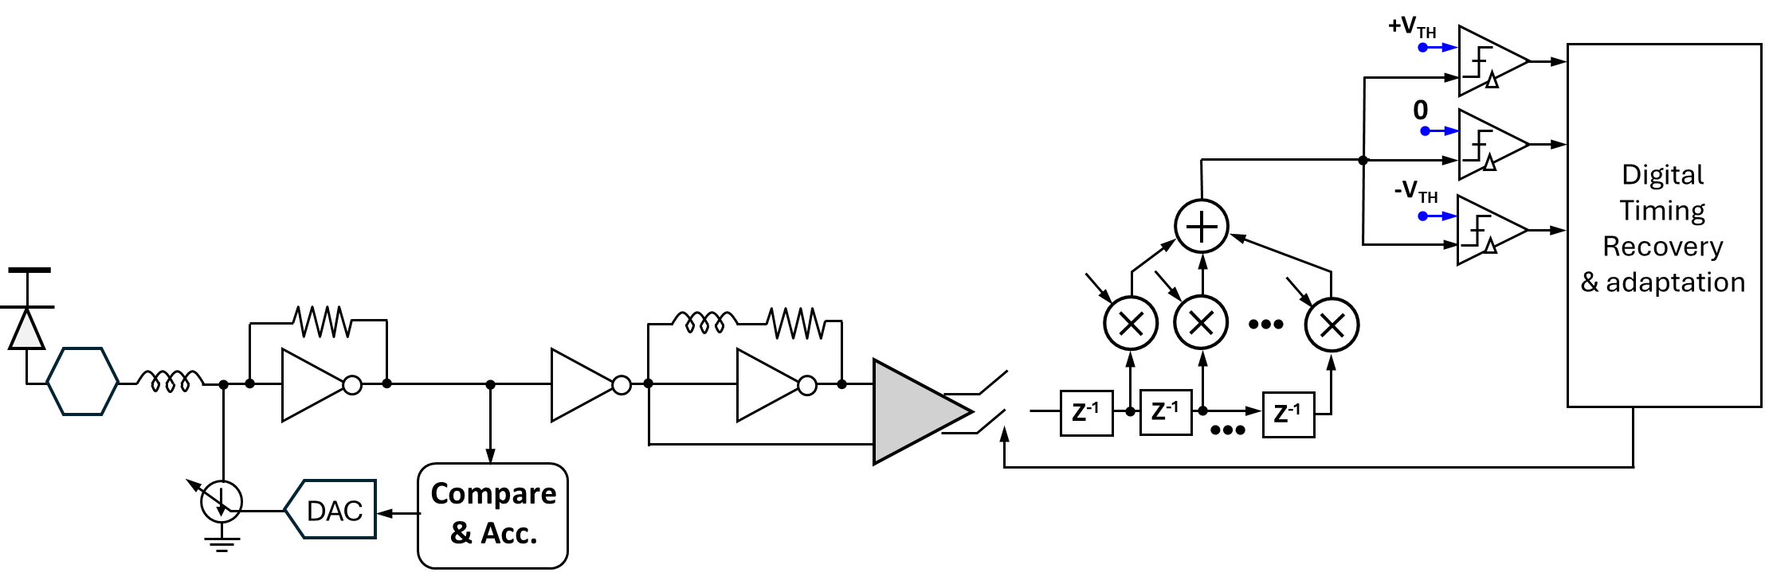
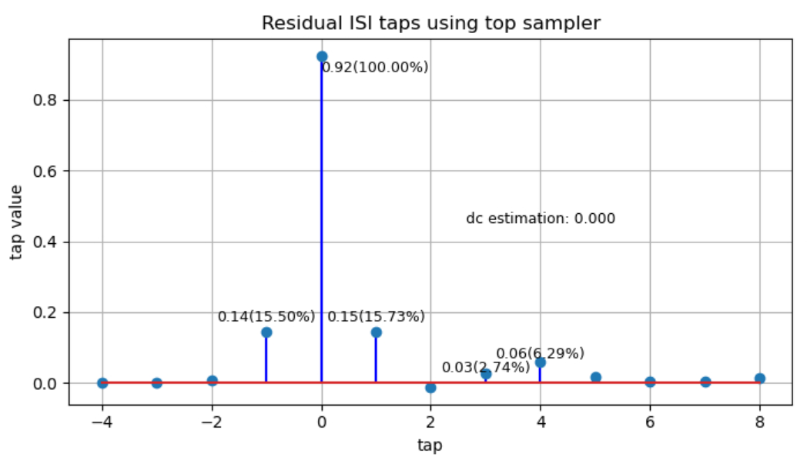
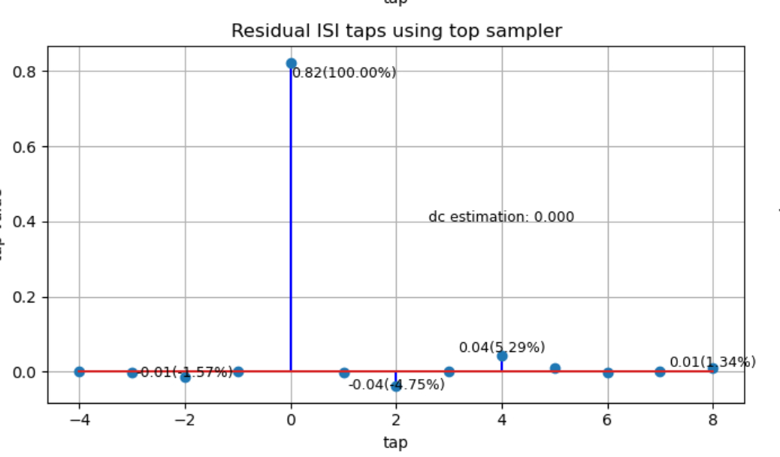
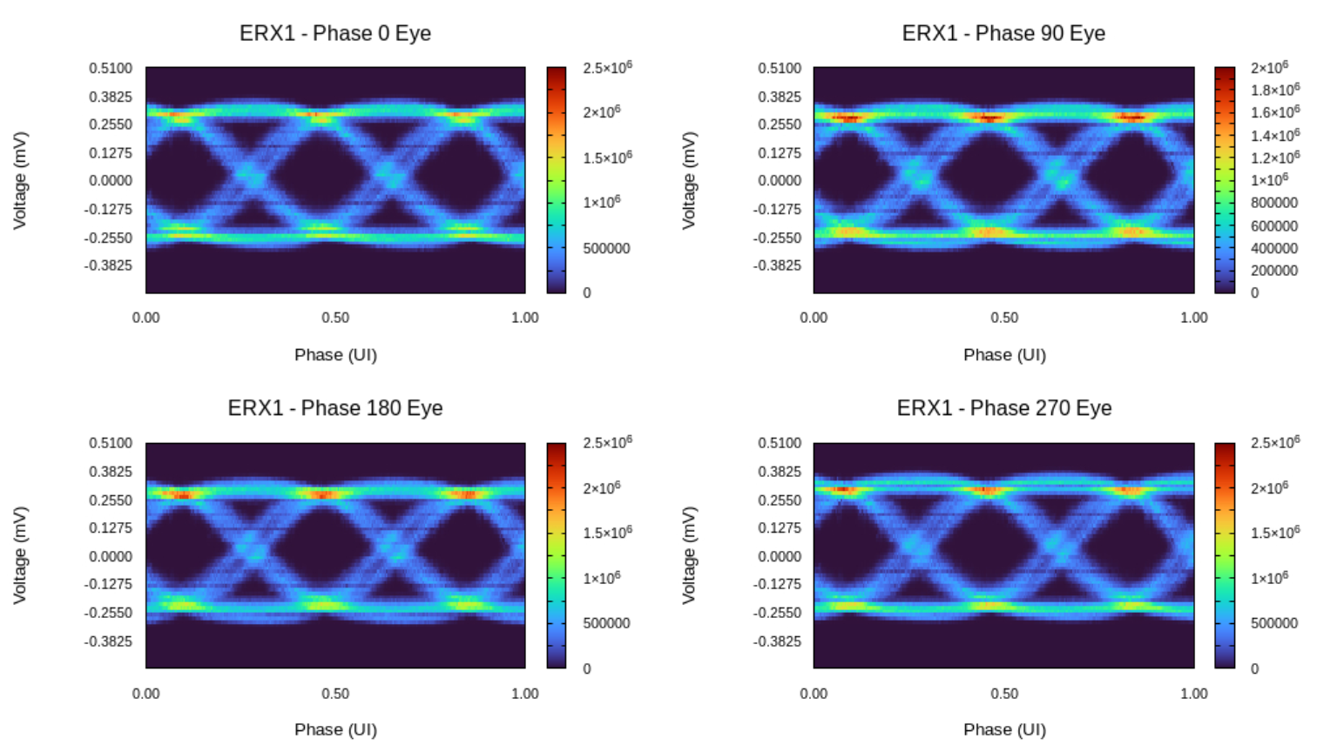
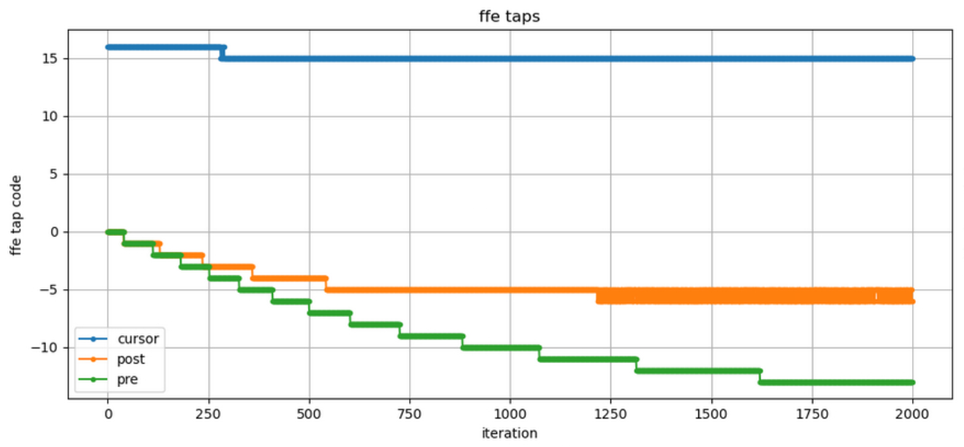
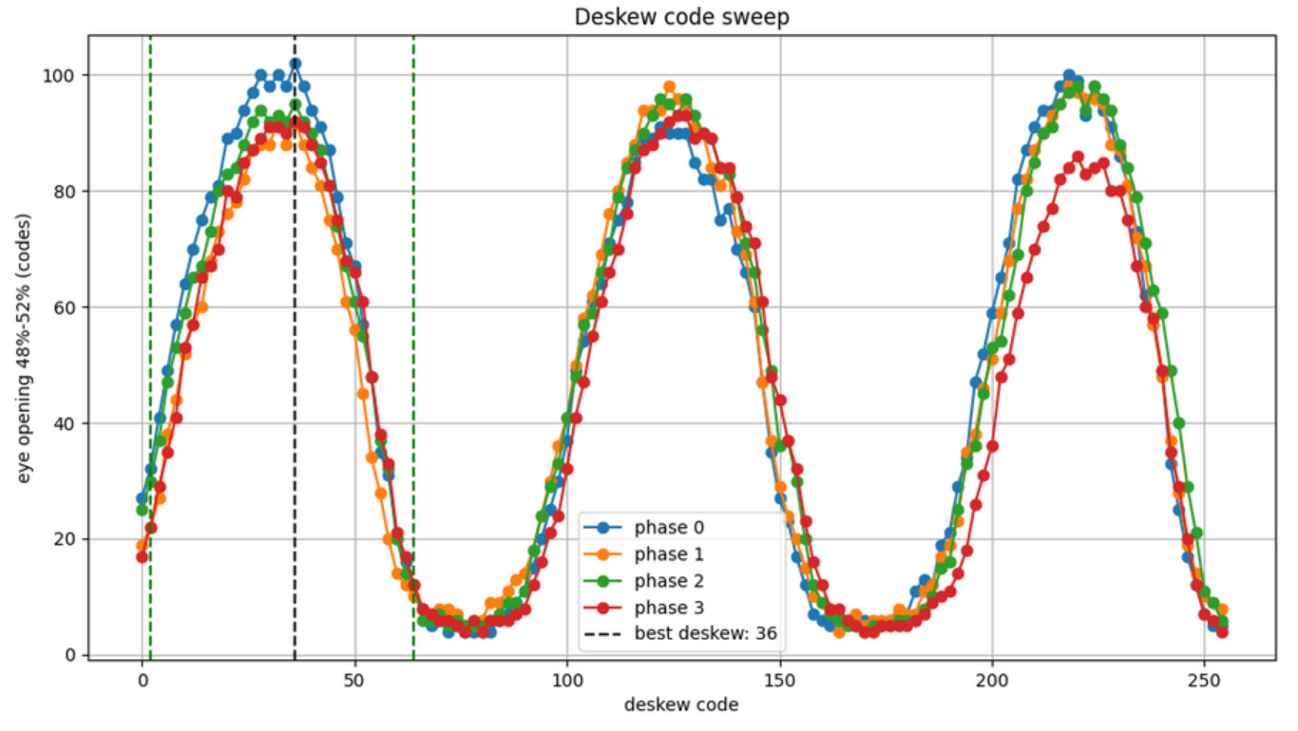
SNR Optimized Receiver

Slide 20
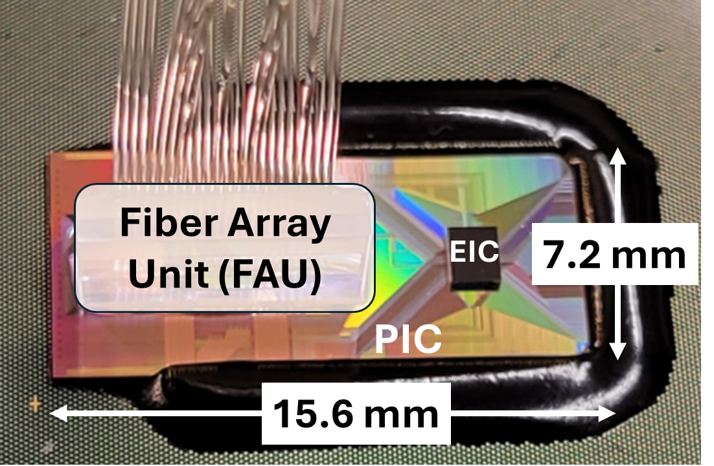
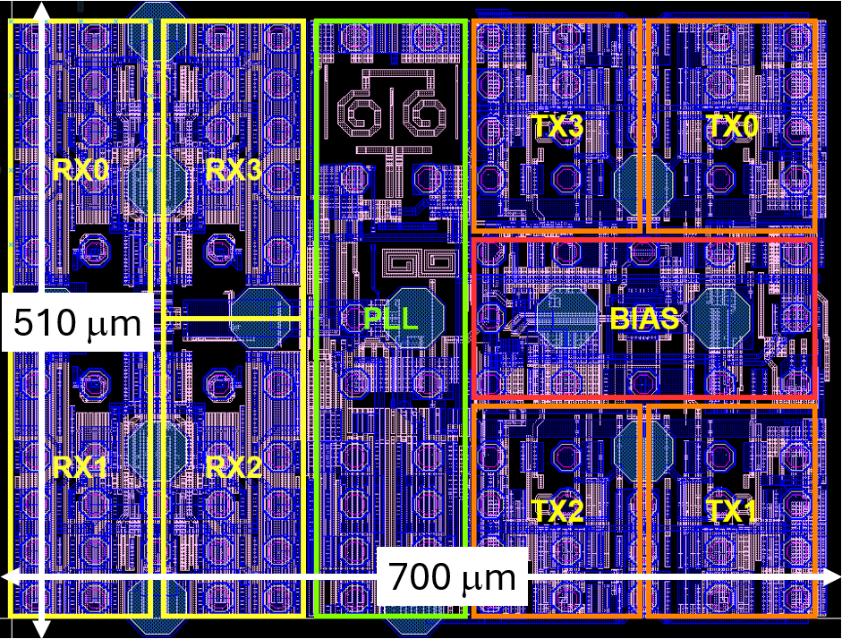
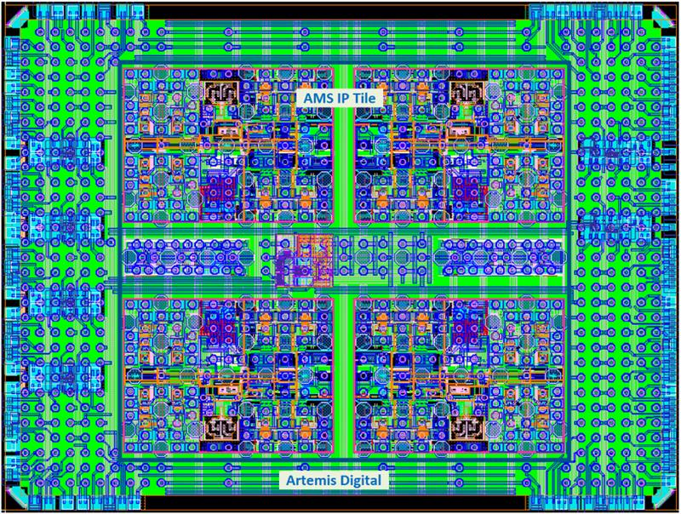
Photonic Fabric Test Vehicle
5nm CMOS EIC
4λ * 56 Gbps/λ = 224 Gbps/fiber
16 transceiver lanes, 1.8Tbps bisectional BW in <2mm²
4 channels, 4 lanes per channel

Slide 21
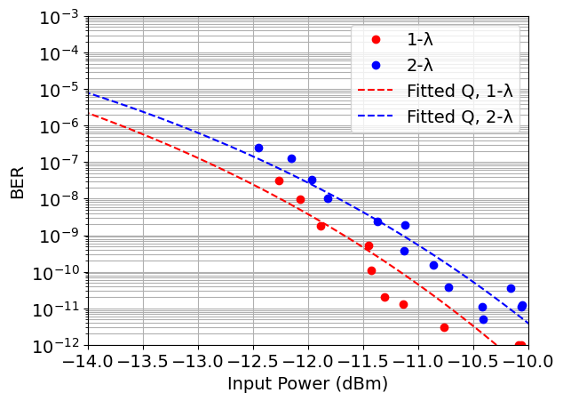
Measurements: WDM Mode, Power
Electronics: 2.8 pJ/bit
Laser: ~1 pJ/bit
~0.5 dB penalty due to WDM

Slide 22
Summary of NRZ DWDM Links
 |  | IMEC ISSCC 2015 | Intel VLSI 2022 | AMD ISSCC 2023 | Intel VLSI 2023 | Ayar Labs VLSI 2024
 |  | TRX | TRX | RX | RX | TRX
Process | EIC | 40nm | 45nm SOI | 7nm | 28nm | 45nm SOI
 | PIC | 130nm SOI |  | 45nm SOI | Intel SiPh
# of wavelengths |  | 4 | 8 | 7 | 8 | 8
Per-λ Data Rate (Gbps) |  | 20 | 16 | 50 | 32 | 32
Per-Fiber Data Rate (Gbps) |  | 80 | 128 | 350 | 256 | 256
Modulation |  | NRZ | NRZ | NRZ | NRZ | NRZ
RX Sensitivity OMA (dBm) @ 1e-12 |  | -7.2 | N/A | -10.1 | -10 | -14.2
Energy Efficiency (pJ/b) |  | 2.33 | 5 | 0.96 (RX only) | 3.8 (RX only) | 3.45
NVIDIA 2026
TRX
7nm finFET+
65nm PIC
9
32
256
NRZ
-16
2.59 (RX only)
Celestial 2025
TRX
5nm finFET+
PIC
4
56
256
NRZ
-11
2.8 (RX only)
DWDM per-λ data rate is relatively low compared to CWDM
Can utilize wide and parallel D2D interface (UCIe, AIB, BoW, OpenHBI, etc)
No need power-hungry SerDes
Preserve low power and low latency

Slide 23
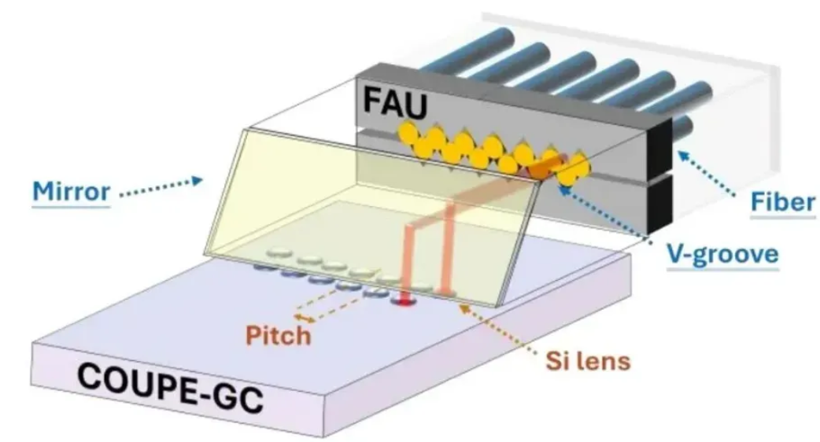
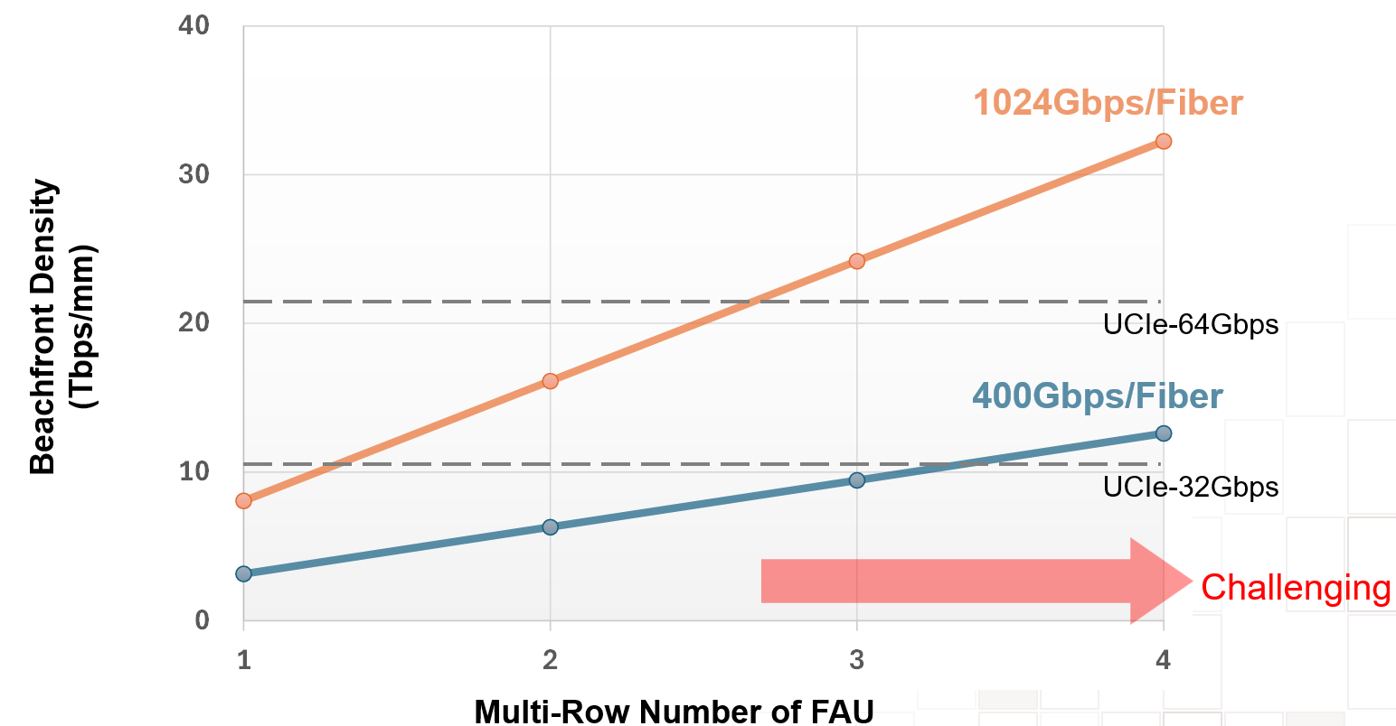
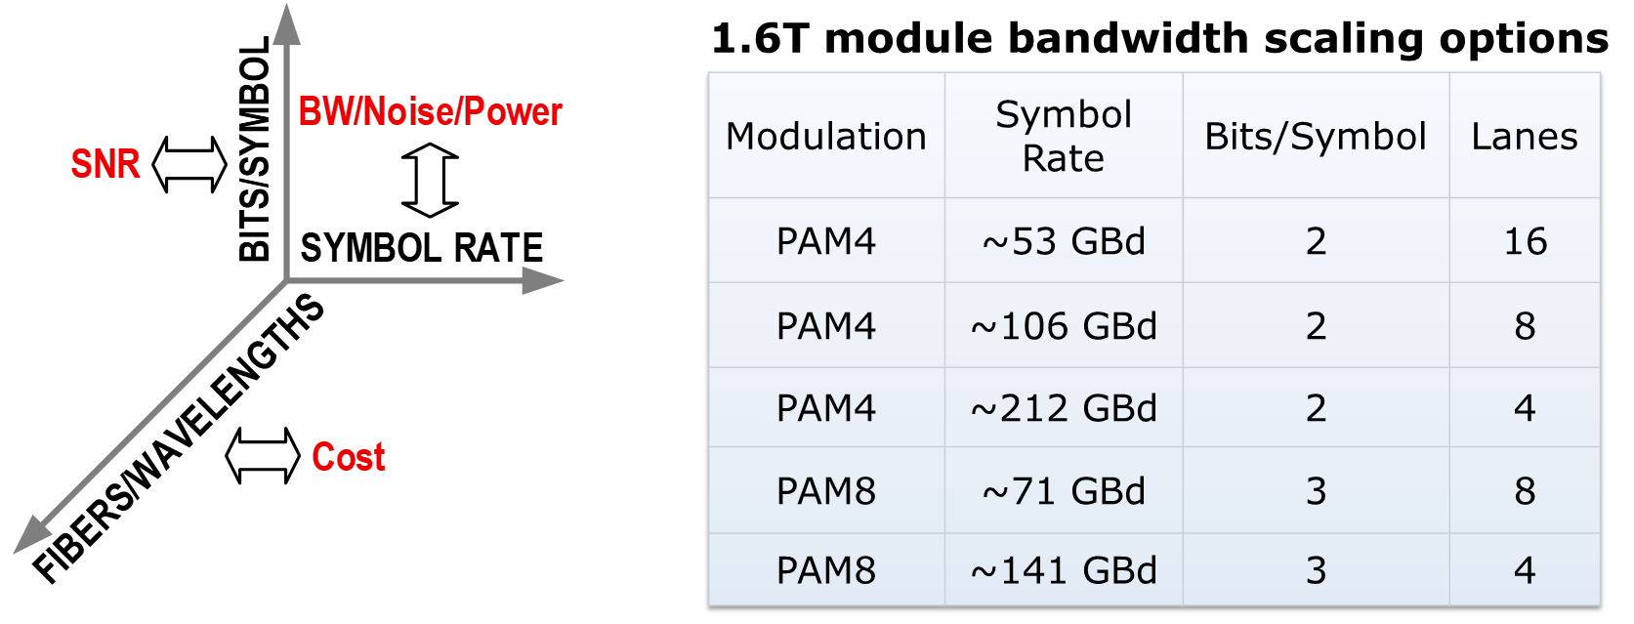
Scaling Options for CPO
Multi-Row FAU enhances the escaped beachfront density from OE.
https://tspasemiconductor.substack.com/p/from-chips-to-optics-tsmcs-metalens
Notes:
As shown by the right-hand side of this slide, the beachfront density, the y-axis, is dictated by how many rows of fibers we have on a fiber array units, or FAU, the x-axis and how fast we pass data on each fiber, the colors of lines.
Vertical-light-paths of grating couplers, rather than in-plane paths of edge coupling, allow multi-row FAU. This significantly increases the number of optical connections and, consequently, the beachfront density attainable.
However, as shown in the left side of the slide, this approach has challenges related to mechanical alignment of fibers, and focusing issues of the silicon lenses. This is because it needs a mirror or prism to make a 90-degree turn.

Slide 24
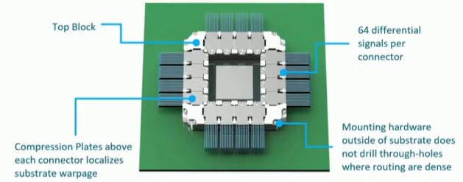
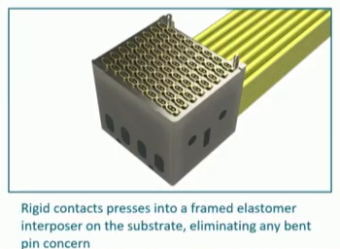
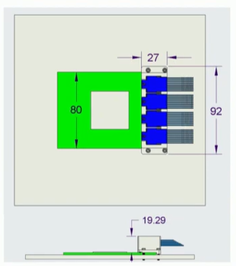
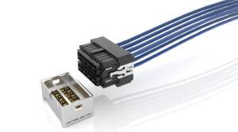
Electrical Alternative: Co-Packaged Copper
Bandwidth density
4*64*224/80 ~ 700 Gb/s/mm
4*64*448/80 ~ 1.4 Tb/s/mm

Slide 25
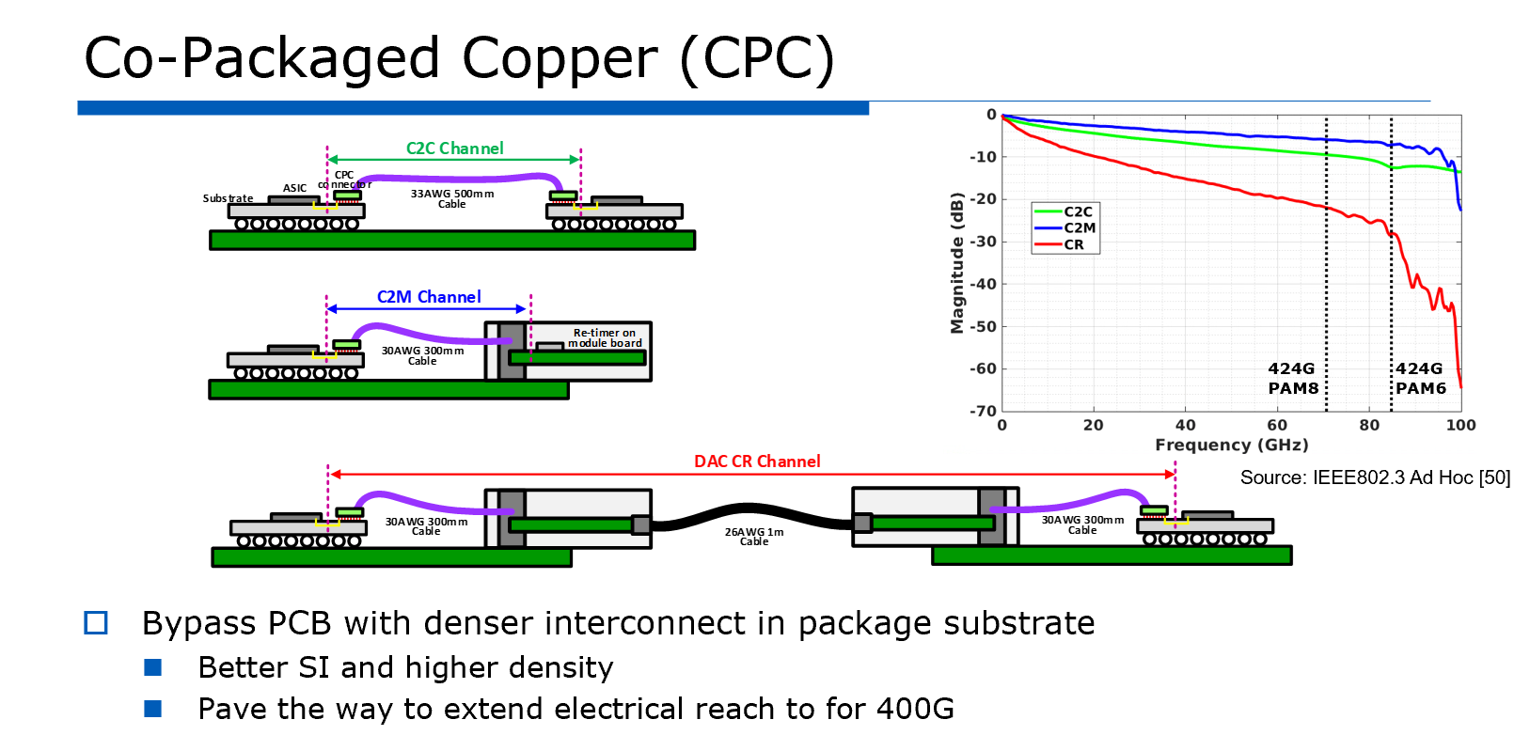

Slide 26
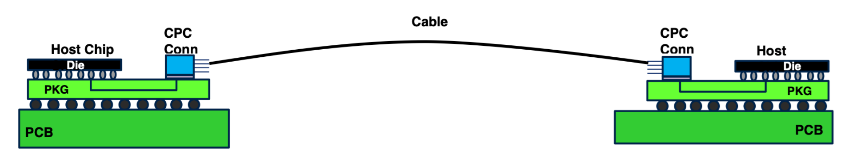
XPU to XPU/Switch Connectivity Options
Energy Efficiency: 0.3 pJ/bit + 3 to 4 pJ/bit + 0.3 pJ/bit
Latency 3 ns 10 ns 3ns
Bandwidth : 8x32 Gb/s = 256 Gb/s
Bandwidth Density : ~0.5 to 1 Tb/s/mm
Cost: High
Additional Challenges: Thermal stability, volume manufacturability
Reach 50 meters
Energy Efficiency: 0.3 pJ/bit + 5 to 7 pJ/bit + 0.3 pJ/bit
Latency 3 ns 100 ns 3ns
Bandwidth : 4x64x 224 Gb/s
Bandwidth Density : 0.7 to 1.4 Tb/smm
Cost: Low
Reach\: 1 m to 2 m

Slide 27
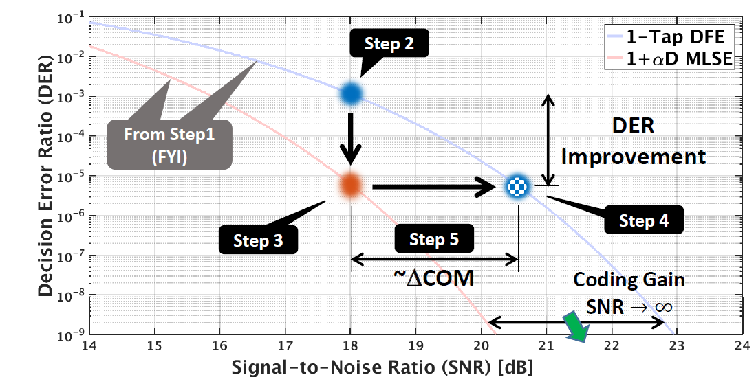
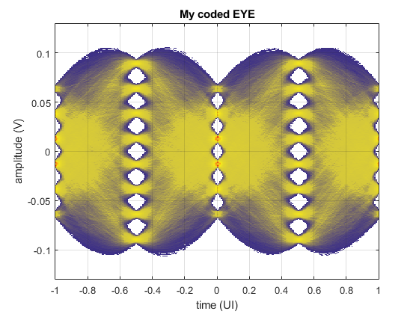
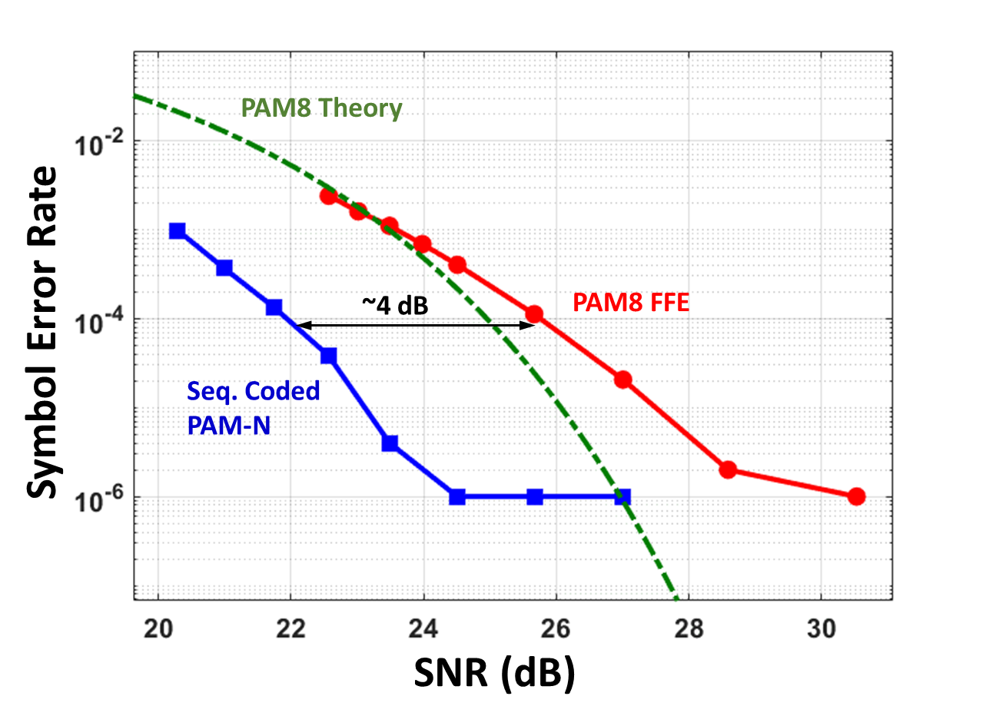
Extending Electrical Link Speed
Unlike Optical, the degree of freedom is very limited.
Channel and connectors have to improve
MLSD or other Advanced signal
processing is a must [ Hossain Shakiba’23 IEEE 802..]
Combine MLSE with FEC to get
More coding gain [ Prof. Carusone
Group Design Con]

Slide 28
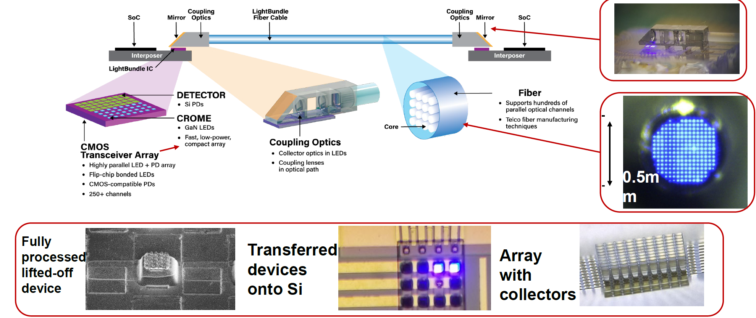
Bandwidth Density Enhancement with Micro-LED Array
Avicena Tech

Slide 29
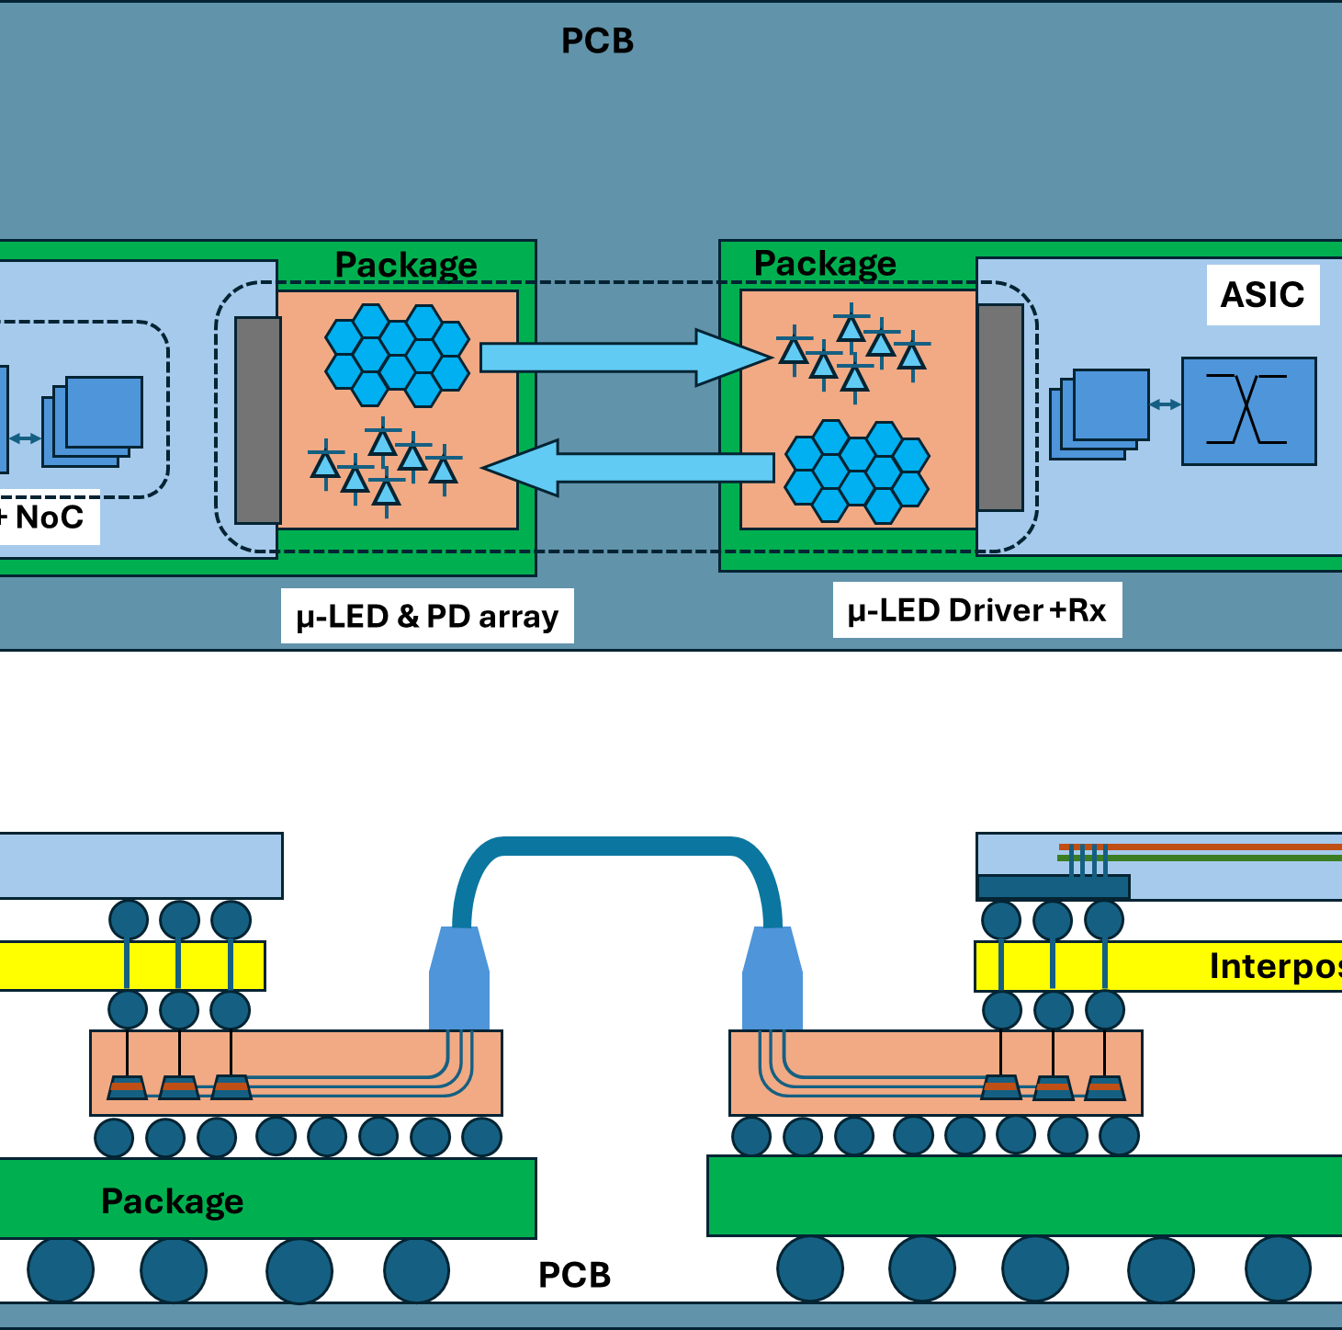
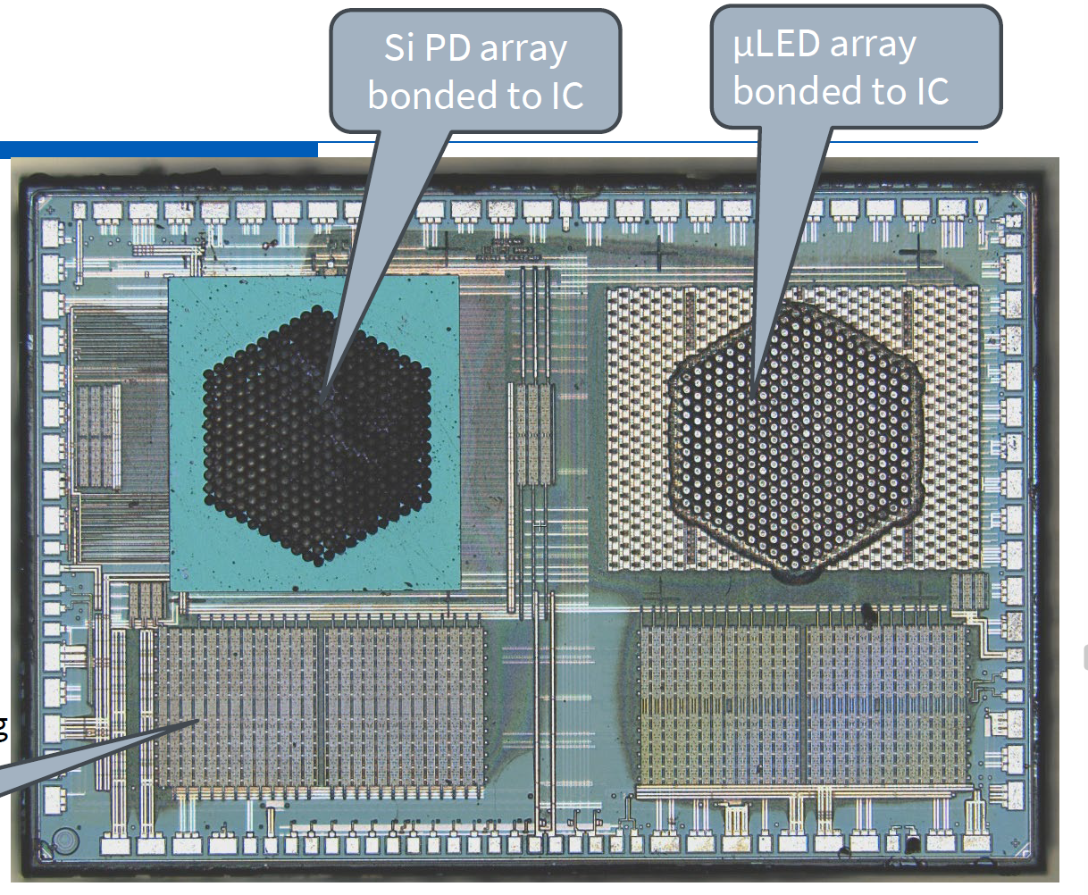
Micro-LED Array-Based Slow and Wide

Slide 30
Photonic Die to Die with longer reach
Driver
Array
MIMO
Encoder
SNR and bandwidth limitations must be addressed through innovative modulation
Reach: up to 10 meters
Micro-LED bump mitch can be 15 to 20 um
Possible Bandwidth Density:
60 x 60 x 5Gb/s → 18 Tb/s/mm^2
Can we do it with 2 pJ/bit?

Slide 31
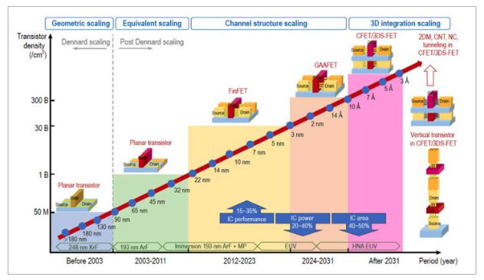
Optics inside the IC

Slide 32



Optics inside the IC

Slide 33
Summary
Next 2 to 3 years: Co-Packaged Copper will be used for cost and maturity
Need better FEC and MLSD
SNR is the main challenge
Next 3 to 6 years: Co-Packaged Optics will show up in products
Maturity and Cost
Comb laser source
Coherent will take more solution space compared to IMDD
Next 8 to 10 years: Micro-LED-based links will find some solution space
SNR challenge
Bandwidth Challenge
Die-to-Die: will remain electrical for the highest escape bandwidth
10+ Tb/s/mm

