Slide 1
Pluggable Optics Are Alive and Well
Toronto Wireline Workshop
Mike Bichan
Director, Analog Design, Marvell Optical PHY Group
March 6th, 2026

Slide 2





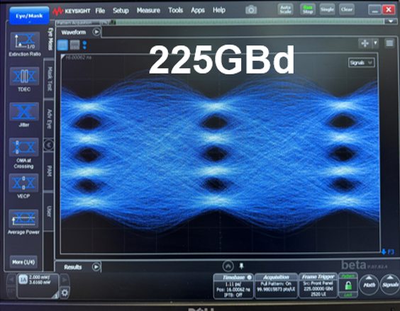

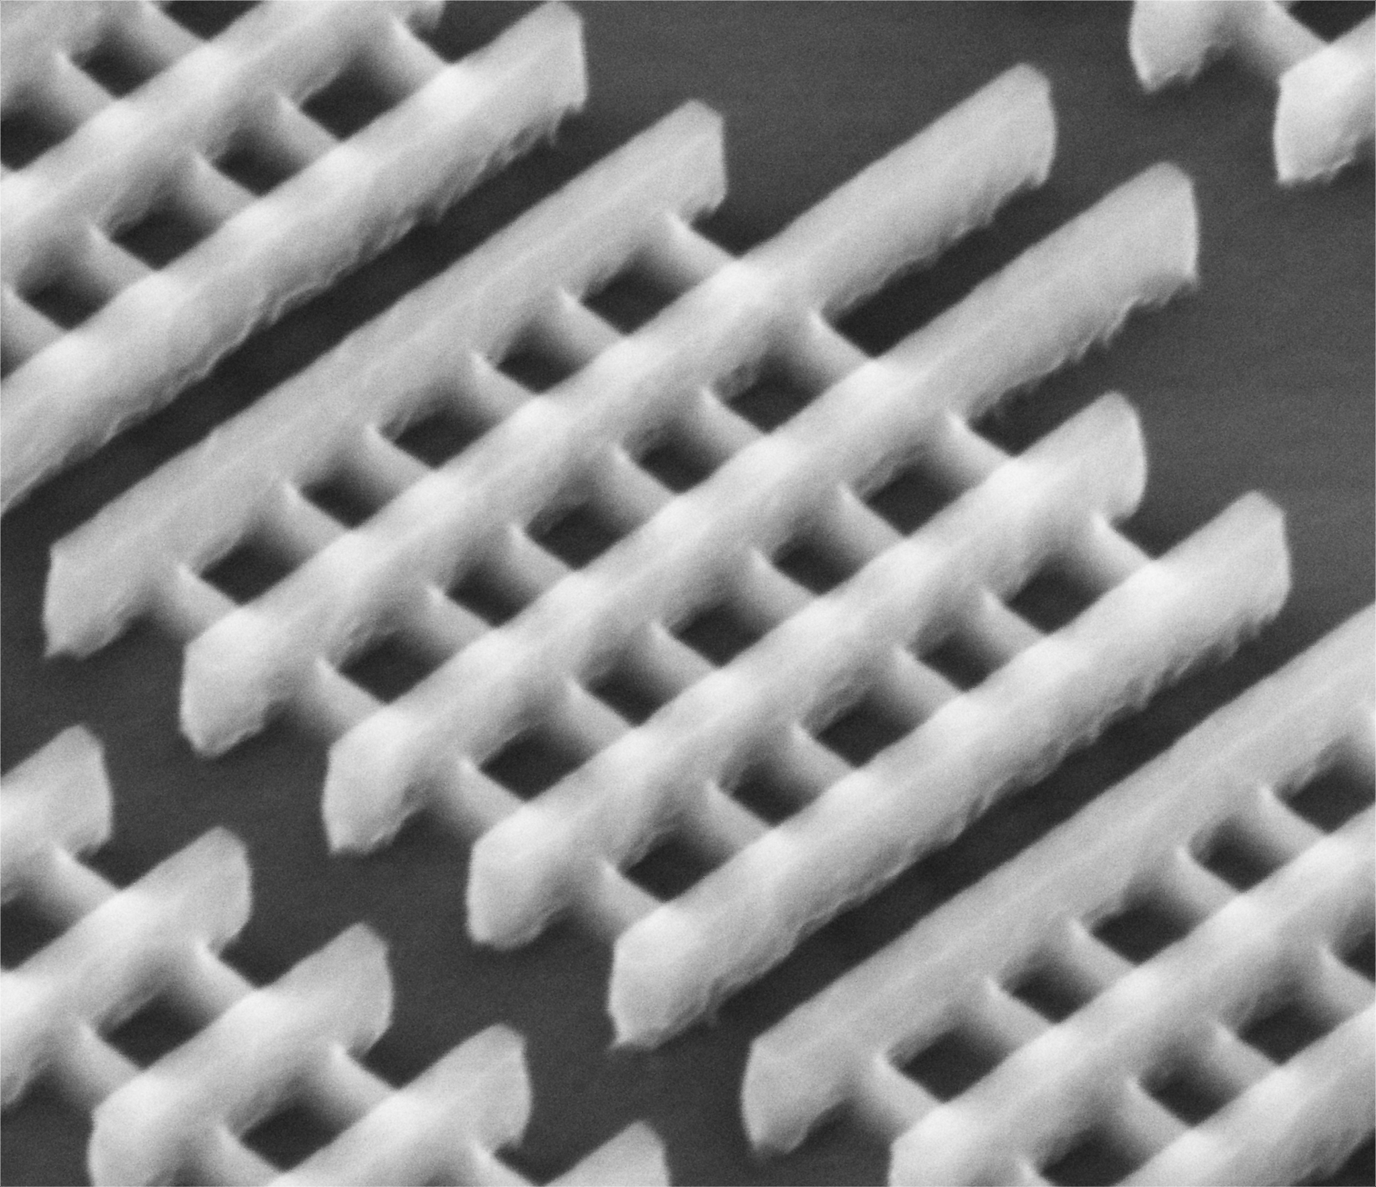
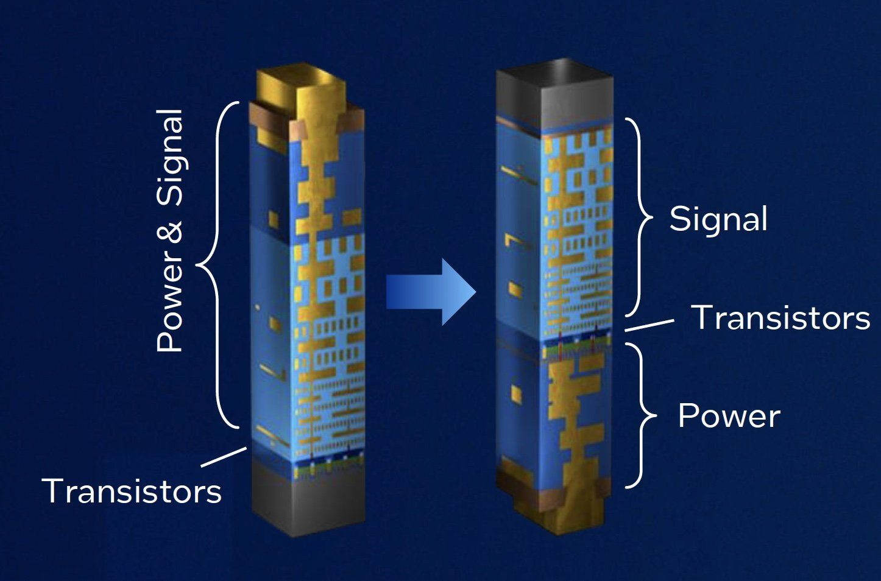

My Background
Optical
224G,448G
128G
ADC
58G
DFE
10G, 25G, 32G
NRZ
FinFET
Backside Power
Source: OFC 2025

Slide 3
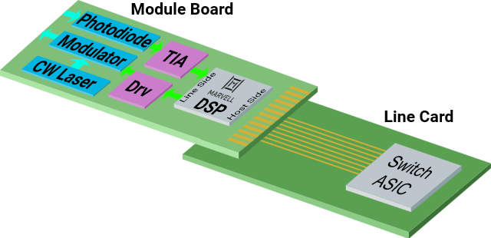
What’s inside an optical module?
Advantages:
hot-swappable
easier test
good thermals
faster design cycle
Ingress
Drawback:
long channel from module to host
Egress

Slide 4
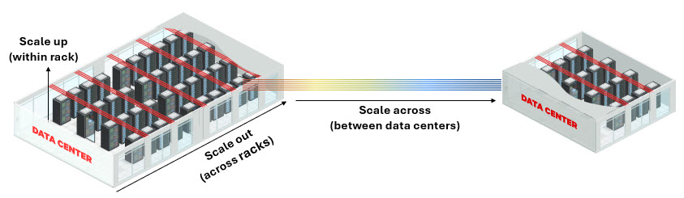
Scaling Terminology
Scale-Up
Increase the capability of a single server
<1m
Density and latency are key
Active optical cable (AOC)
Co-Packaged Optics (CPO)
Short-reach PAM4 direct-detect
Scale-Out
Add more servers within the same data centre
1m-1km
Long-reach PAM4 direct-detect
Power/perf trade-off
Scale-Across
Interconnect multiple data centres
1km-1000km
Performance and spectral efficiency are key
Coherent transceiver
Wavelength-division multiplexing

Slide 5
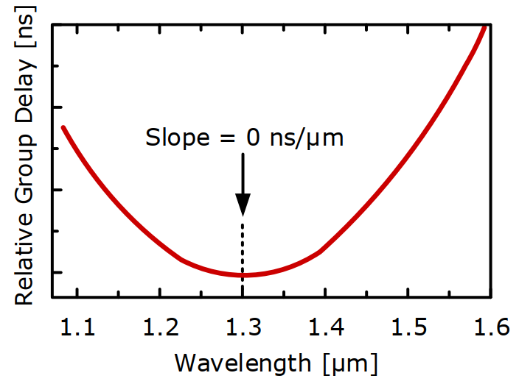
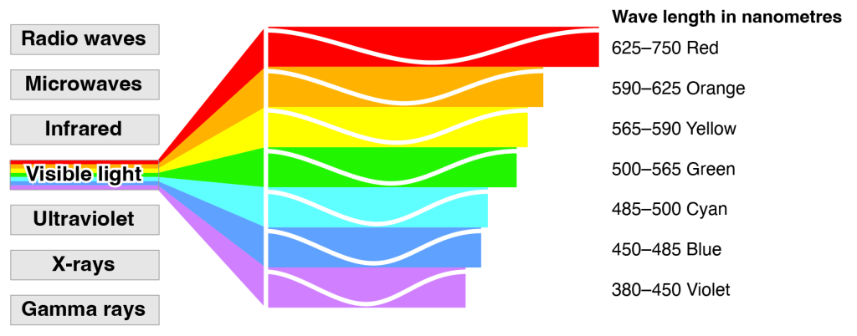
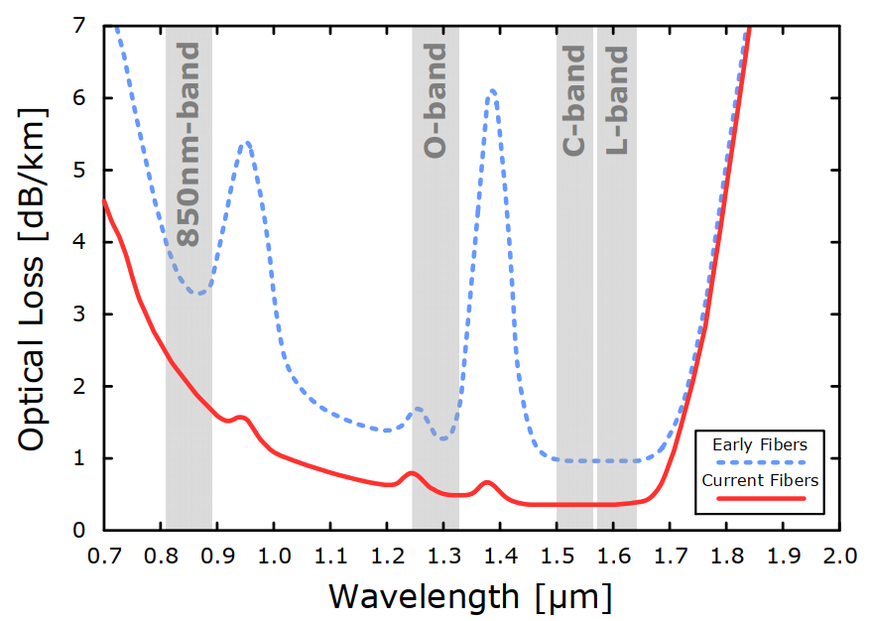

Optical Links
visible light is 380-750nm
850nm is produced by VCSELs
O-band (original), very low chromatic dispersion, used for datacom
C-band (conventional), lowest attenuation, used for coherent
Other bands (E-band, S-band, L-band, U-band) are less used
Source: Enrico Temporiti, “VCSEL-based Solutions: Components, Circuits and Integration”, ISSCC Short Course, 2026.

Slide 6
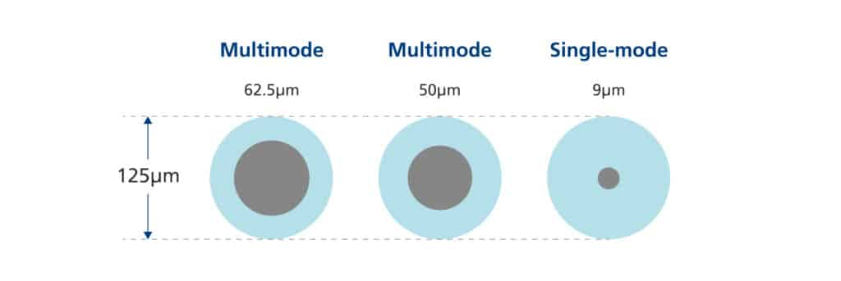
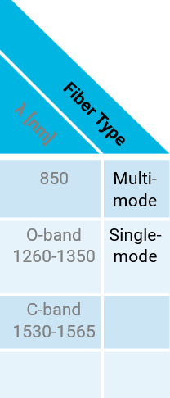
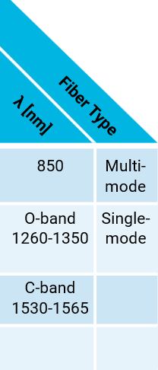
Optical Links
Multi-mode fiber (MMF)
  50um core couples well to VCSEL emission pattern
  high loss: 2.5dB/km
Single-mode fiber (SMF)
  9um core
  low loss: 0.2-0.35dB/km
Source: Enrico Temporiti, “VCSEL-based Solutions: Components, Circuits and Integration”, ISSCC Short Course, 2026.

Slide 7
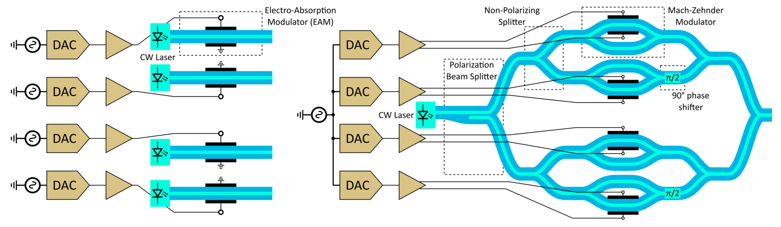
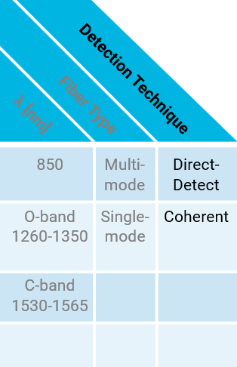
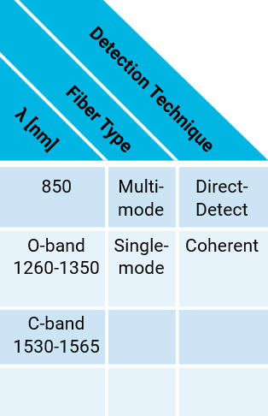
Optical Links
(a) Direct-Detect Transmitter
(a) Coherent Transmitter
Intensity Modulation and Direct-Detection (IMDD)
  Only uses light intensity, not phase
  Lower power and performance
Coherent
  Sensitive to the intensity, phase, and polarization of light
  Polarization diversity receiver corrects for many non-idealities
  Requires a single laser source and single clock source
  High power and performance
  Used with dense wavelength division multiplexing (DWDM)

Slide 8

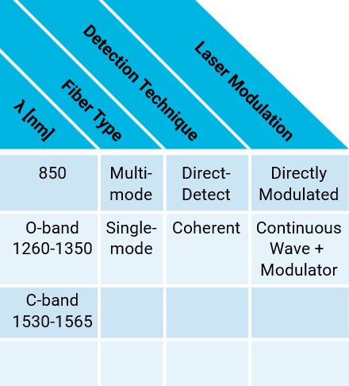
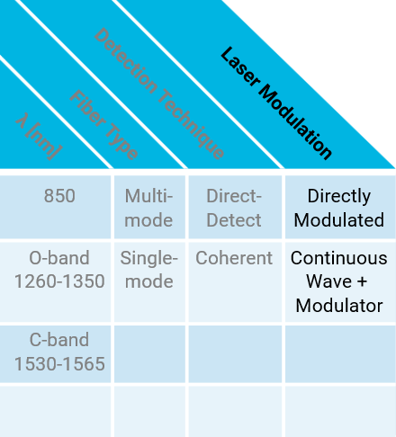


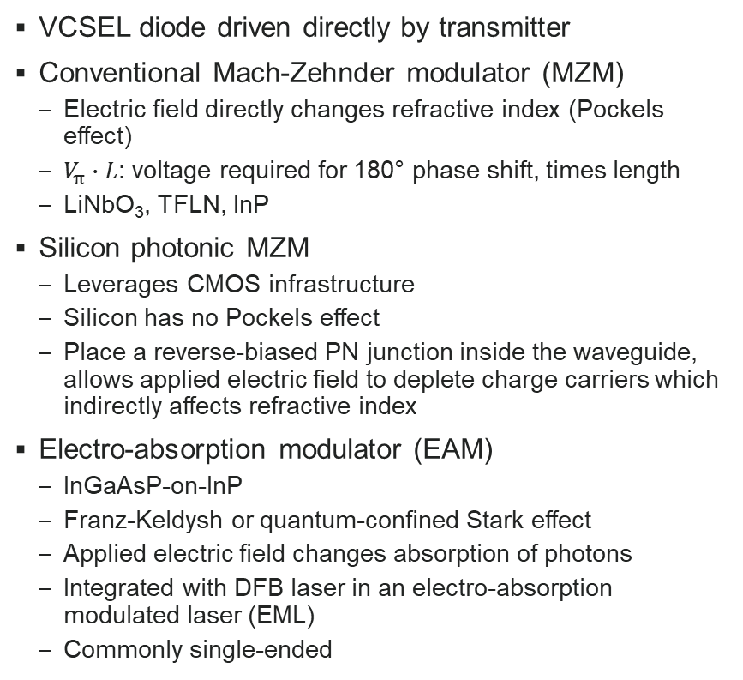
Optical Links
VCSEL diode driven directly by transmitter
Conventional Mach-Zehnder modulator (MZM)
  Electric field directly changes refractive index (Pockels effect)
  $V_{π}∙L$: voltage required for 180° phase shift, times length
  LiNbO₃, TFLN, InP
Silicon photonic MZM
  Leverages CMOS infrastructure
  Silicon has no Pockels effect
  Place a reverse-biased PN junction inside the waveguide, allows applied electric field to deplete charge carriers which indirectly affects refractive index
Electro-absorption modulator (EAM)
  InGaAsP-on-InP
  Franz-Keldysh or quantum-confined Stark effect
  Applied electric field changes absorption of photons
  Integrated with DFB laser in an electro-absorption modulated laser (EML)
  Commonly single-ended

Slide 9
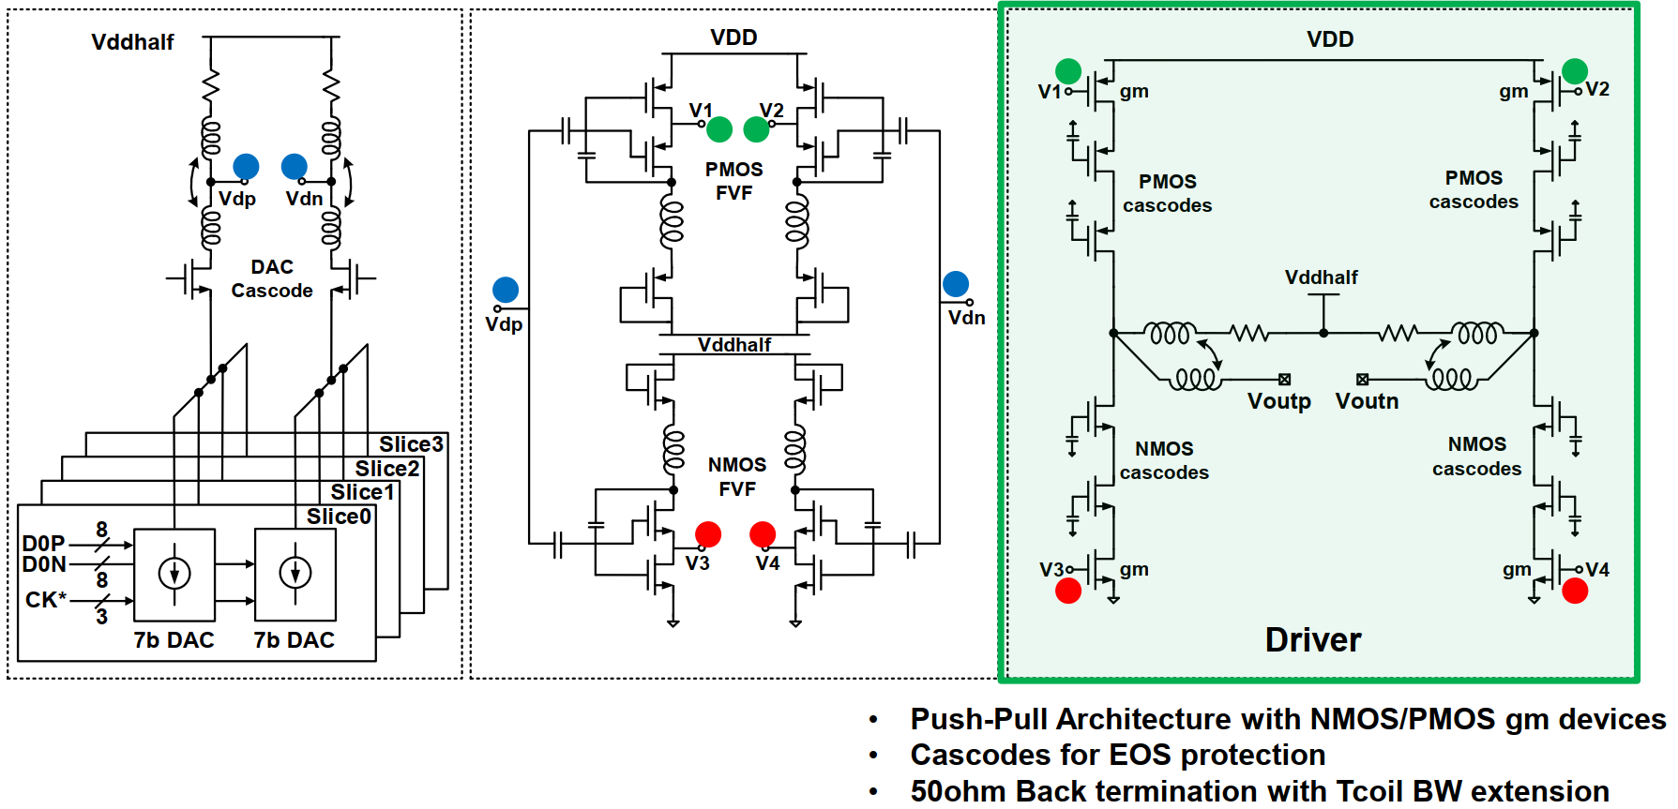
High-Swing CMOS Transmit Driver
Source: V. Gurumoorthy et al., “A 212Gb/s PAM-4 Retimer with Integrated High-Swing Optical Driver and Chip-to-Module Long Reach Capability of 40dB in 5nm FinFET”, ISSCC, pp. 344-345, Feb. 2025.

Slide 10
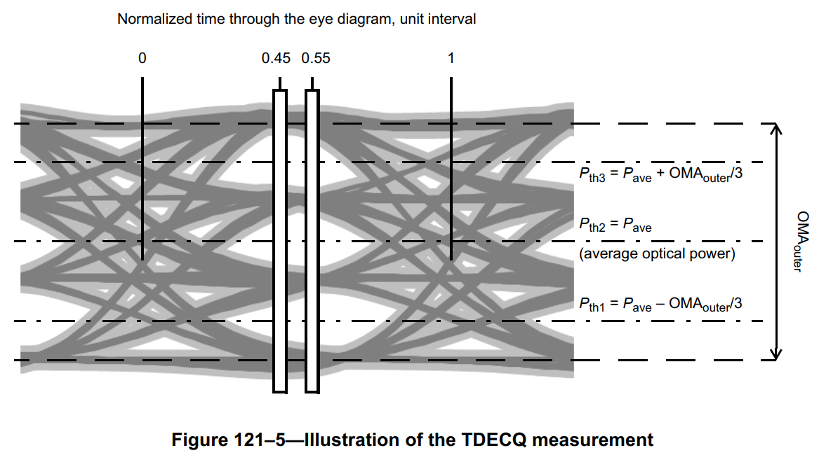
TDECQ
TDECQ: Transmitter and Dispersion Eye Closure Quaternary
It measures how much more optical power is needed for a real transmitter to achieve the same error rate as an ideal transmitter
Steps:
  Transmitter sends SSPRQ pattern
  Optical signal goes through 1m fiber then photodiode
  4th-order Bessel filter with bandwidth at Nyquist
  Optimize receive equalizer tap values (5-, 9-, or 15-tap)
  Measured histograms around the received eye center
  Determine added noise required to reach target error rate
TDECQ < 3.4dB
Source: 802.3bs Ethernet spec

Slide 11
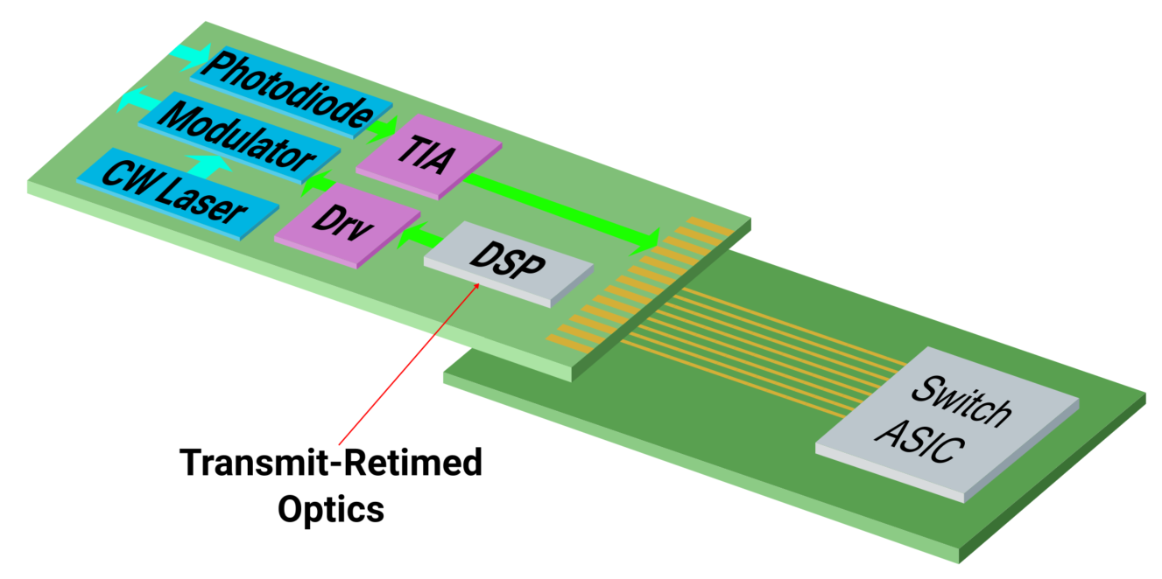
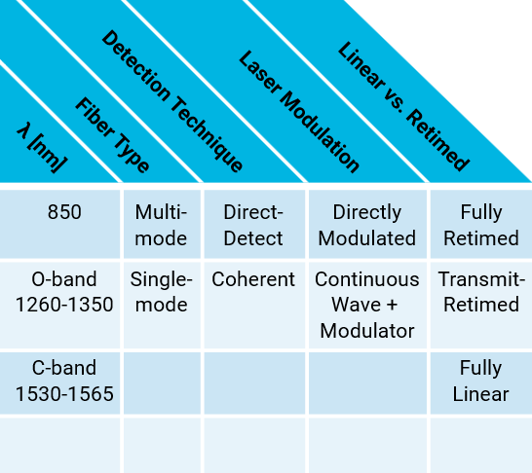
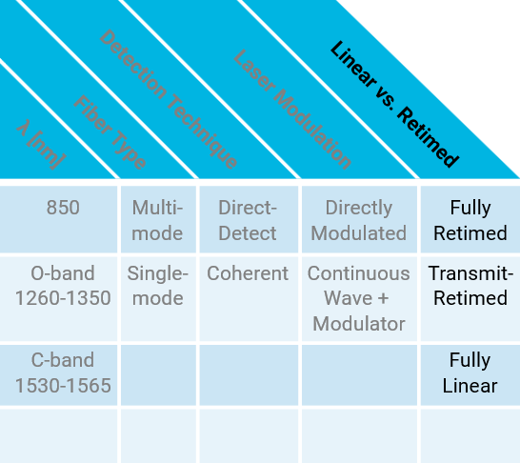
Optical Links
Can save power by pushing retiming to switch ASIC
Reduces performance
More complicated link budget

Slide 12
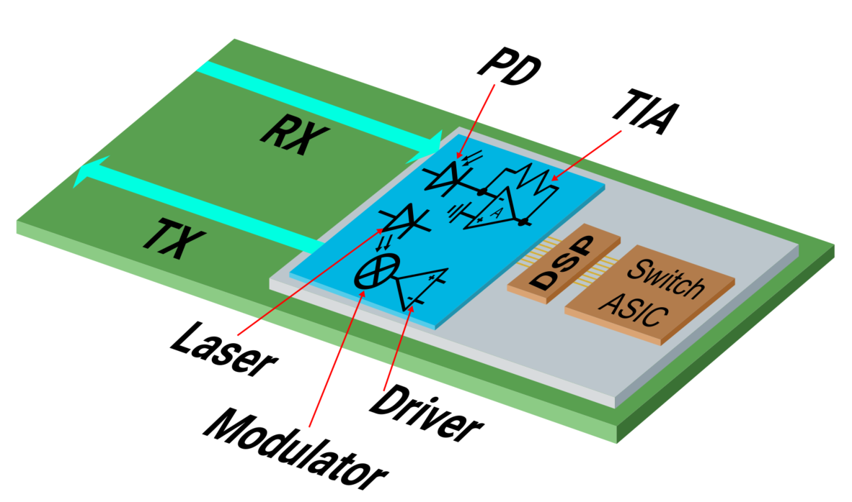
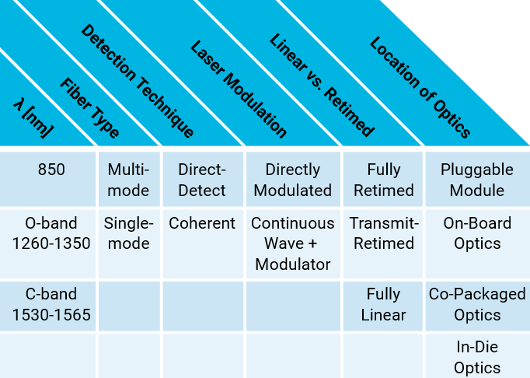
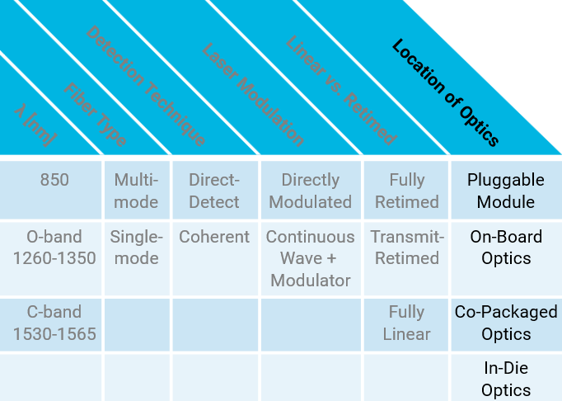
Optical Links
Overwhelming majority of optical links are currently using pluggable optics
Moving optics closer to switch ASIC:
  Saves power
  Reduces latency
  Overcomes high loss from host to module
Co-Packaging Challenges:
  Optics don’t benefit from proximity to switch ASIC
  Lower power budget for optics
  Test is more difficult
  Not hot-swappable, upgradeable
  Switch ASIC is hot
  High temperature degrades:
    laser slope efficiency, TIA noise, modulator Vpi, jitter, electromigration

Slide 13
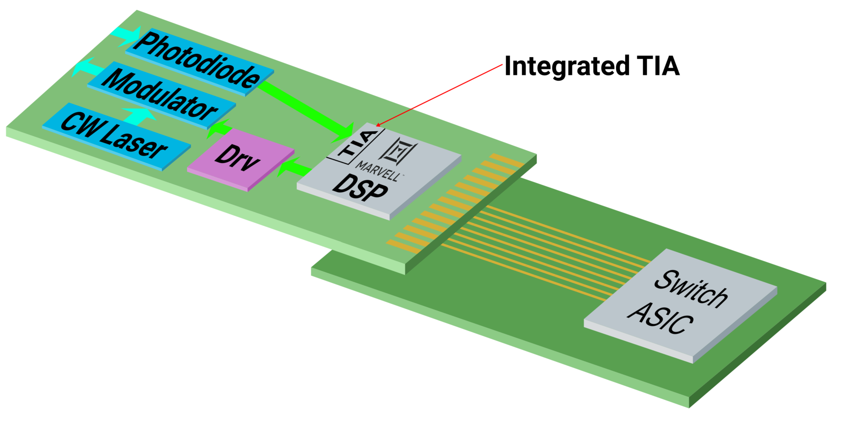
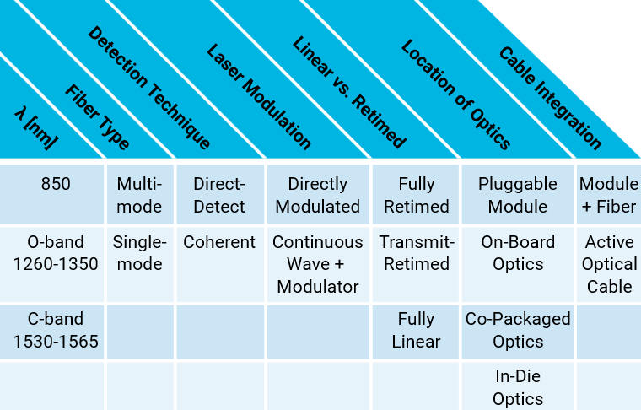
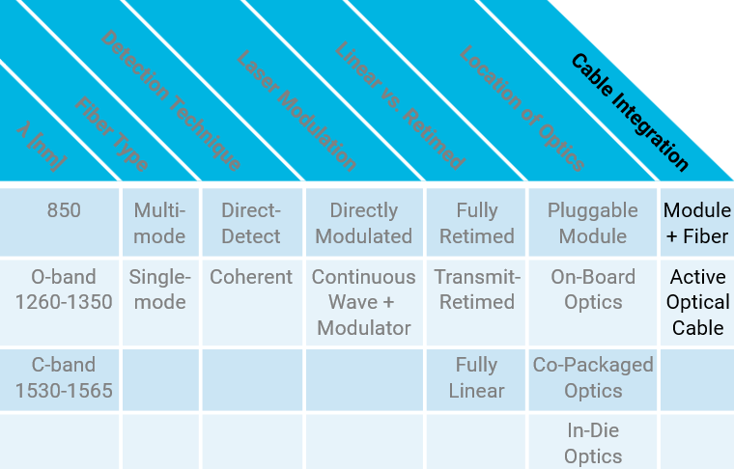
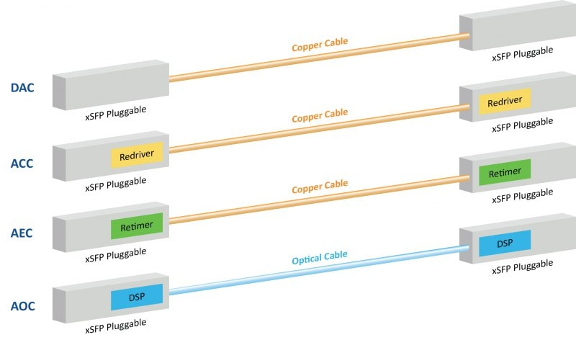
Optical Links
Low-cost DSP with integrated TIA
Attractive for pre-built cable market

Slide 14
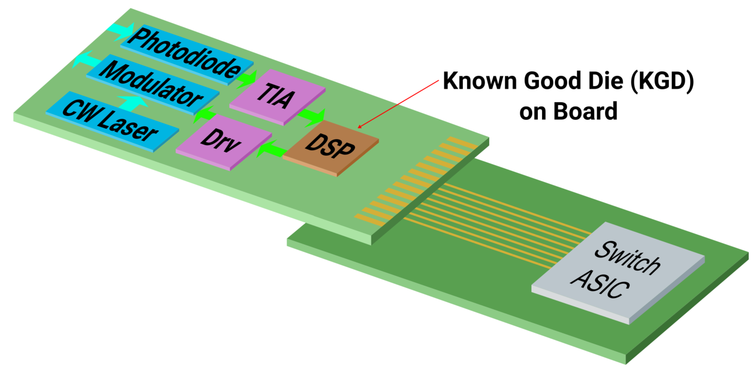
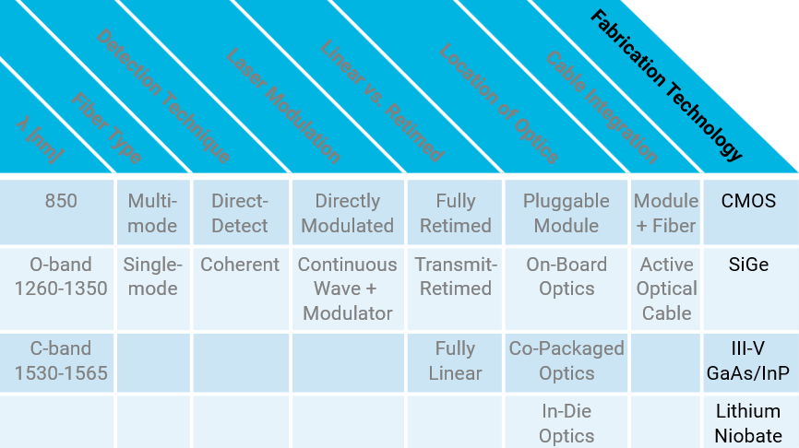
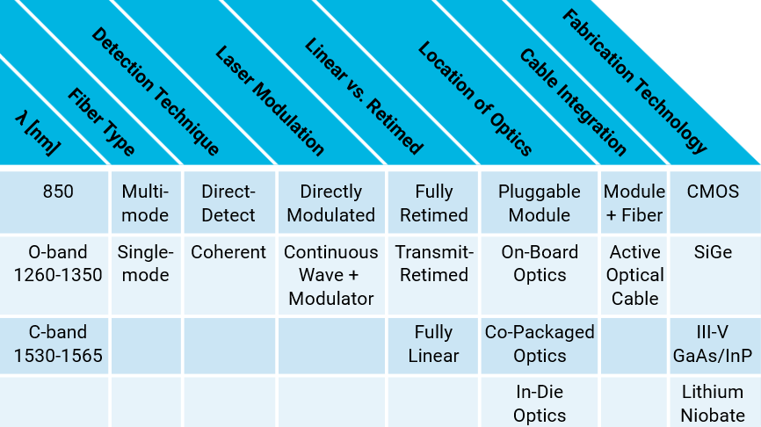
Optical Links
DSP
  CMOS
TIA
  SiGe, InP
PD
  III-V, Ge-on-Si
Modulator
  LiNbO₃, InP, Si

Slide 15
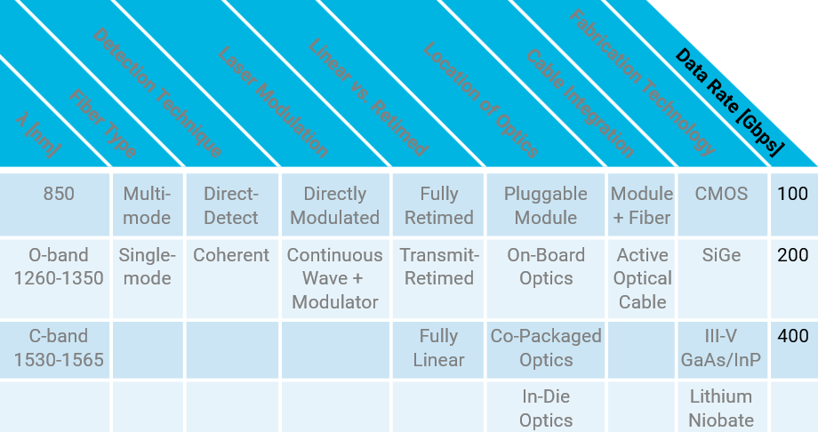
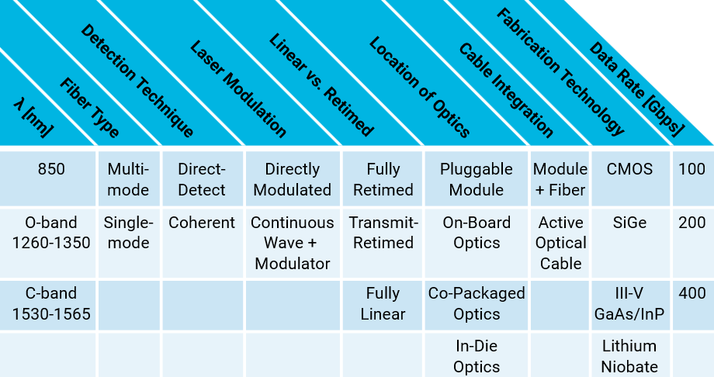
Optical Links
Baud Rate [Gbaud] | Chip-to-Module Loss [dB]
25 | 10
50 | 22
100 | 37
200 | ?
High Data Rate Challenges:
BW + ESD protection
Tight jitter spec
Hard power budget

Slide 16

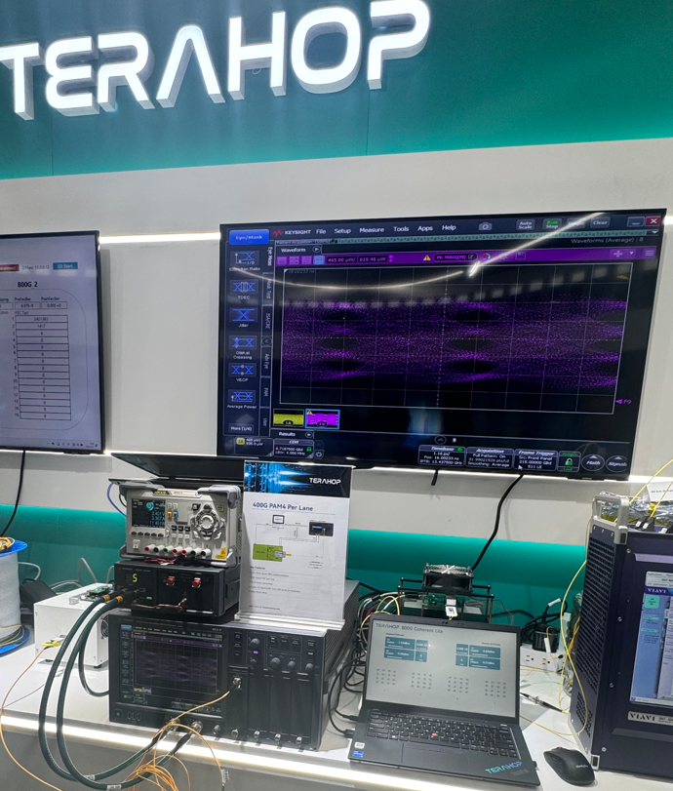
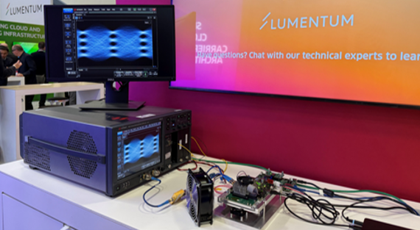
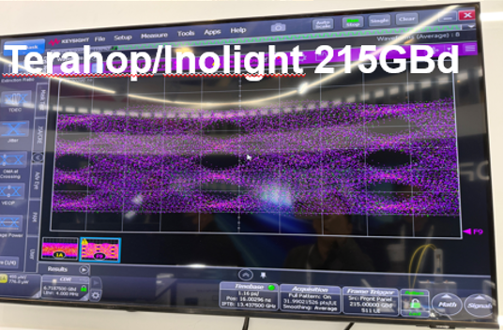
>400Gbps/lane Direct-Detect at OFC 2025
2 demos with external partners
Joint Marvell demos with Lumentum and Terahop
Optical TX
Lumentum 225GBaud
Terahop (Innolight) 215GBaud
Source: OFC 2025

