Slide 1
The Toronto Wireline Workshop
Optics and Copper Will Coexist For Long Time in
AI Networks for Short-Reach Apps
Mark Lutkowitz, Principal
March 6, 2026

Slide 2

Copper Seemed to Be Leaving Before AI
Main story on shortening DACs
Uncompelling 5-to-7-meter opportunity
Amazon an early AEC exception for over a decade
> Links between leaf & spine layer or spine & super-spine layers
Google does not see element leaving soon
> Confident about 2m reach for 400G/lane
-- Plan to do CPC for 400G/lane practically ignored

Slide 3
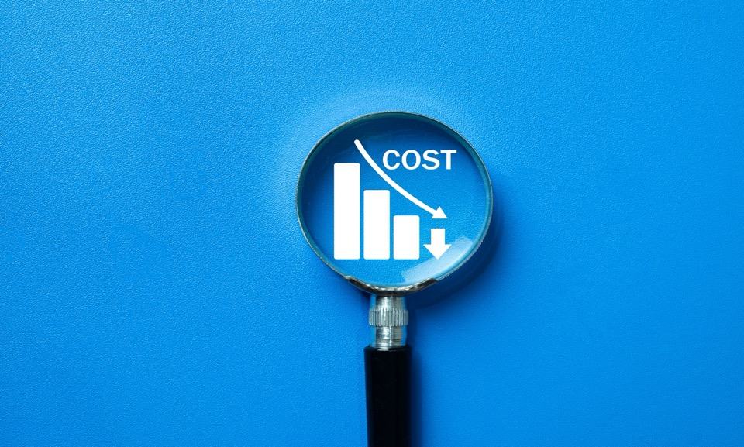
Exaggerated Impact of Present Cost Disparity with Copper
On optics needing to be 10x lower
> Copper densities being dramatically pushed
Resulting from some very complex packaging solutions
Optics needs to differentiate on performance, not cost
Will help extend copper, but will also increase cost

Slide 4
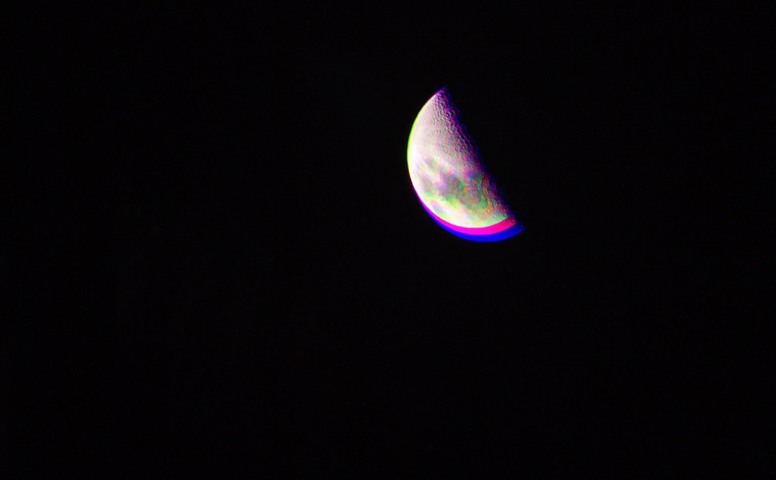
Market Aberrations for Copper/AEC Spurt
Nvidia loves copper
> Firm in sole control of datacom transmission space
-- Amphenol as key enabler
Credo
> Niche DSP strategy
Creation of neoclouds
> Need to scale up quickly
> xAI a major purchaser of AECs
--Wanted simplified link margin analyses
> Oclaro expected to be big buyer of AECs
> High risks including capital intensity

Slide 5

Focus on Active Copper Cables
Requires more upfront engineering than AECs
Nvidia’s product used low-power, linear analog ASIC from Samtec
> To make 200G ACCs
> Ciena/Nubis has similar ASIC
-- Viewed as lower risk vendor at Nvidia

Slide 6

Insufficient Clarity on 1.6T AOCs
Other than whatever is covered by 20 or so meters
Question on scale-up vs scale-out breakdown
> NVIDIA has no optics in scale-up, but two exceptions
-- Google with bidi FR4 modules in combo with OCS
-- Huawei with VCSEL LPO at 56G
> Argument that AOCs are impractical for scale-up
-- Building cable incorporating an 8x8 shuffle
Reasonable expectation on post 400G/lane
> Ubiquitous AOCs

Slide 7

Historic Context of CPO
Struggle by in-field technologists
> Ex. SNAP12, Micro-PODs, and other initial toe-dipping by vendors
Microsoft initial effort unserious
> Pacifying bean counters at firm
-- Number-one priority
Pre- AI, Broadcom invested big
> But calculated risk from start
> CEO never touted it much publicly

Slide 8

Current Hurdles with CPO
Same goal of low power/low cost
> Yet, still concerns with reliability, yield, manufacturability (serviceability)
-- Challenge goes beyond TSMC ‘s ability to produce a solution
Getting system suppliers to construct CPO is difficult
Yield issues will reside with them
Just requirement for clean room is deemed a pain

Slide 9

Nvidia’s Motivation with CPO
Use market position in AI hardware
To potentially double its switch revenues
Like previous strategy of commanding premium with pluggables from large users
Limited deployment of CPO in near term with volume installations being several years out

Slide 10

NPO as Interim Option?
Engineers also grappled to make NPO
work commercially
Still need large customer to
make major commitment to NPO

Slide 11

Bright Future of Pluggables
Optical pluggables remaining dominant through 400T switches
> Virtually forever
No problems at all in reaching 200T devices
New alterations at 400T will be necessary
Beauty of pay as you go will never go away

Slide 12

Google’s Unique Move to CPC
Google’s early commitment to being a technology/hardware leader in AI will result in the only guaranteed, significant co-packaging effort

Slide 13

LPO’s Original Insulting Narrative
Nightmare with 10G-LRM about 20 years before
> LPO had same problem with link robustness & interop
Cisco ACO: ~ five years earlier linear interface between host and optic
Unconcerned about cost and power in leapfrogging to 400GbE with PAM4
Centralized processing drawbacks ignored
Resulted in big waste of industry resources

Slide 14

LPO’s Limited Future
Real innovation with HALO
> Minus altering biz model
Nothing beyond 100G with LPO
> No way to close LPO link budget at 200G/lane
-- Regardless of pristine nature of transceiver
> No forthcoming customer
-- Hypersclalers will deploy half-retimed

Slide 15

Resurgence of NRZ
Speculation about establishment of consortium
> By two hypersalers for standardization effort
-- Slower and wider 25-50G
-- Logically Microsoft & Meta
Lower cost, power, etc.
> Likely need for a weak FEC
> Drawbacks include restrictions on
number of channels
“Micro-VCSEL” play at 50G NRZ

Slide 16

VCSELs Moving Forward
Temporary lull
> Hyperscalers shifted away from multimode fiber
> Nvidia also not planning f for 200G VCSELs (1.6T Tx)
-- EOLed 100G VCSEL for scale- out due to link flapping
> Scale-up with more stringent requirement
-- BER challenge with AOCs
Optimism with 1060nm
> New fiber with higher EMB
-- At least 30m

Slide 17
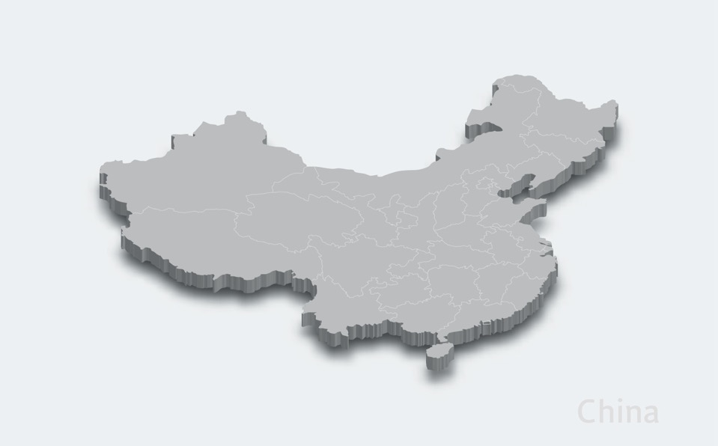
China’s Impact on AI and Optics
Deepseek will lower costs internationally, resulting in greater consumption throughout the world
Smart in moving to next-gen data rates about 2 years after west
China enabled TFLN by itself
Tx market leaders

Slide 18

Importance of Incumbent Optics Tech with AI
Incremental improvements on mature solutions will tend to be winners
Incredibly large demand for capacity results in pragmatism

Slide 19

AI Unlike Dot-Com Bubble
With any bust, no seven-year depression in this time
Major players are like night and day
Nothing like “build it and they will come” philosophy of late ‘90s
Constant market corrections now

Slide 20

Thank You!

